Slide 1

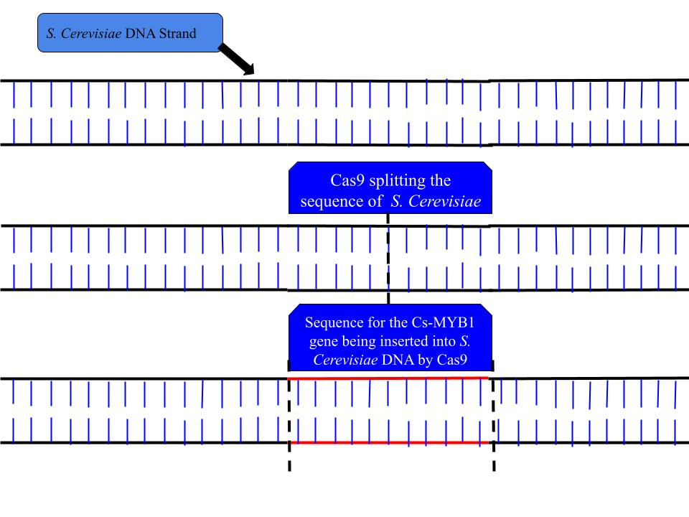






Preventing the Destruction of Caffeine During Caffeine Fermentation Process
Jack Baker, Matthew Boland, Aidan Esparza, Will Kelly, Jordan Alioto
Matt Kirkpatrick, Eric Jordenson
Oak Park and River Forest High School, Oak Park, Illinois, United States
Abstract
Traditional production of coffee and caffeine is an Earth damaging and inhumane practice. Alternative methods to extracting caffeine have been introduced such as fermented coffee, which is a more sustainable and efficient method of caffeine production. However, much of the available caffeine produced is lost during this process leading to lower than ideal yields. One possible solution to this issue is by implementing catechins in brews, to prevent the caffeine molecules from being destroyed by the SnQ2 gene. To accomplish this, inserting the Cs-MYB1 gene, using Cas9, into the yeast Saccharomyces Cerevisiae to produce these catechins. By doing this, it is likely that fermented coffee brews could see a 30%-40% increase in total caffeine yield- contributing towards a more sustainable and efficient method of caffeine production.
Science Content
The objective in this hypothetical experiment is to improve upon the process in which fermented coffee is produced using S. cerevisiae. To do this, having a more sustainable and efficient method of producing high volumes caffeine in each brew. The hypothetical experimental design developed consists of four major steps, with the first using CRISPR Cas-9 to edit the genome of S. cerevisiae having the guide RNA sequence for the Cs-MYB1 gene which ultimately produces the flavonoid- catechins. Secondly, the modified S. cerevisiae would be added to the brew, which would already have water and coffee beans. This would allow for the catechins to come in contact with the caffeine molecules, and preventing them from being broken down by SnQ2. After three days, the beans would be taken out of the vat and then steamed and washed with methylene chloride to extract the caffeine. The extract will then go through a process called ultraviolet spectroscopy to measure the total amount of caffeine extracted from this process. This value would then be compared to the calculated caffeine content produced from traditional fermented coffee, which would be labeled as the positive control, as well as the calculated caffeine content produced from S. cerevisiae in a vat of water without any coffee beans.
By following the proposed process it can be expected that there would be a significant increase in amount of caffeine extracted from the brew than the traditional 10%-15%. This is because of the catechins protecting the caffeine molecules from being broken down, and it would be expected to see a 30%-40% increase in caffeine yields. This is the expected margin because the process in which the catechins prevent the breakdown of the caffeine is heavily influenced by the environment because the two molecules must come in contact prior to caffeine and SnQ2.
Team Content:
The OPRF team is brand new this year with a total of 5 members. All 5 of us are pursuing careers in the STEM field so we felt that the BioBuilders provided us with research experience that we can use later in our life. It was an incredible opportunity to talk with professionals that perform Bio Research and tap their brains for suggestions and new ideas.
Our Next Steps/Future Research:
Genetically modify yeast to be able to survive in a higher concentration of caffeine so that further fermentation can occur.
Discover ways to remove catechins after fermentation to harvest pure caffeine compounds.
Practice real world application of catechins in fermented coffee.
What “Catalyzed” Us to do This Project:
Fermentented coffee is an area that many corporations are exploring but the problem is that during the fermentation process 85-90% of the caffeine is broken apart by the yeast’s SnQ2 gene during detoxification. We need to create a fermentation process that reduces the amount of caffeine broken down or even increases the amount overall. This is to make the practice more sustainable and practical. Coffee is not only a strategic luxury resource that uses exploited labor and causes an outflow of billions, but it also is causing deforestation which is awful in this time of climate uncertainty. In 2022/23 the United States imported 24.8 million bags of coffee. Not to say that global trade is a bad thing, but in the world of turmoil we currently find ourselves living through, it does make sense to come up with domestic ways to decrease the international dependence on this resource. Hawaii, California, and Puerto Rico can currently provide a small amount of coffee crop to feed the near insatiable domestic demand. If we can somehow supersize the amount from these three locations then we are less import focused. The solution- fermented coffee. Although fermented coffee still requires coffee beans, one batch can get multiple uses which is much different than traditional bean to cup coffee. By improving on this system, reducing the amount of beans required to be farmed and transported would be significantly reduced, contributing to a greener and more humane society.
References and acknowledgements
Huo, Q., Hao, J., & Shi, R. (2013). Determination of Catechin by High Performance Liquid Chromatography and Ultraviolet Spectrophotometer. Asian Journal of Chemistry, 25(16), 8940–8942. https://doi.org/10.14233/ajchem.2013.14923
Jin, L., Bhuiya, M. W., Li, M., Liu, X., Han, J., Deng, W., Wang, M., Yu, O., & Zhang, Z. (2014). Metabolic Engineering of Saccharomyces cerevisiae for Caffeine and Theobromine Production. PLoS ONE, 9(8), e105368. https://doi.org/10.1371/journal.pone.0105368
Musial, C., Kuban-Jankowska, A., & Gorska-Ponikowska, M. (2020). Beneficial Properties of Green Tea Catechins. International Journal of Molecular Sciences, 21(5), 1744. https://doi.org/10.3390/ijms21051744
We’d like to thank…
-Mr. Kirkpatrick and Mr. Jordenson for their continuous support
-The BioBuilders Program
-The organizations that are doing the research and publish their results to the public
Notes:
-promote production of SAM -> SAH
-Yeast destroying caffeine (Yeast dying too)
https://culturesforhealth.com/blogs/learn/does-kombucha-have-caffeine-how-much-caffeine

