Slide 1
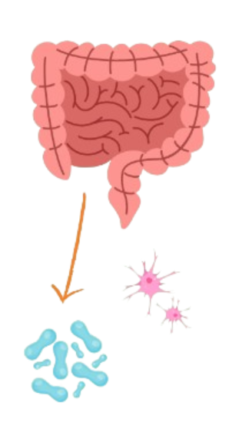
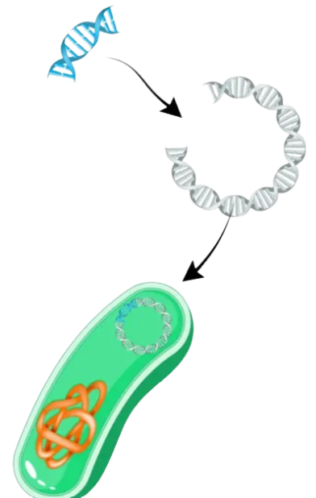
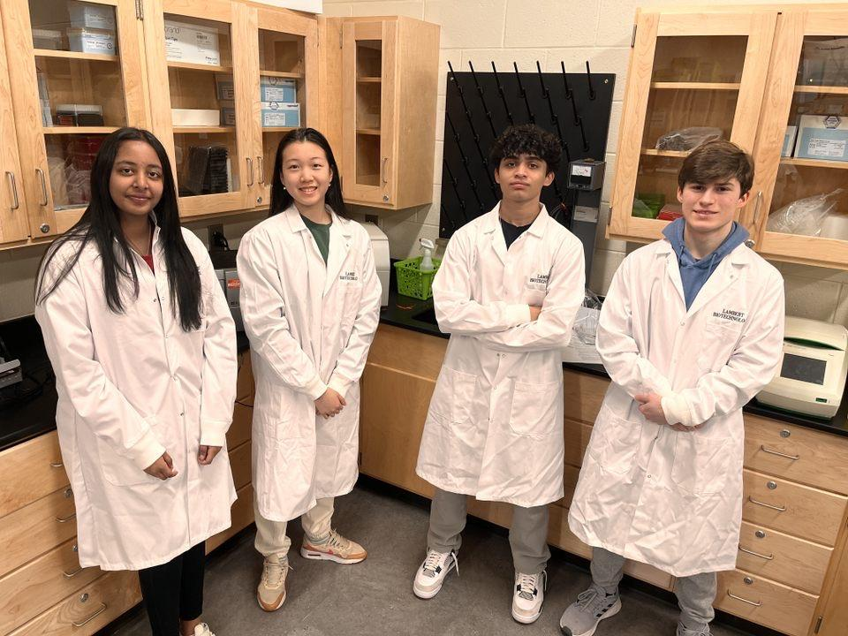
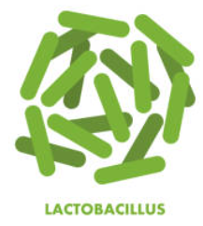
SynthMind Meals
Creating Meals Plans with Engineered Gut Microbes for Neurotransmitter Production to Improve Mental Health
Shashank Ramireddy, Yun Xin Lin, Eshawnive Kallu, Veda Vudithyala, Kanishq Palla, Harrison Turner, Vedant Kalipatnapu, Amey Saokar, Korah Kenyatta-Simmons, Sarah Verma
Project Design
Introduction
Next Steps/ Future Research
Extract DNA from Streptococcus spp., Lactobacillus plantarum, Enterococcus spp., Escherichia spp., Klebsiella pneumonia, and Morganella morganii
Find effective methods to integrate our modified samples into food for human consumption
3. Research ways to make our project safe for human consumption and take steps to understand the human body’s response after consuming our meals
PROBLEM:
Increasing acknowledgement of the prevalence of mental health within society
Mental and substance use disorders are now the leading cause of disability
4. Work with nutritionists/dietitians to integrate the engineered microbes into meal plans/food packages in a safe and effective way, introduce to retail stores
Gut microflora
1. Identify neurotransmitter-producing microbes
OVER 70%
of those suffering from a mental illness worldwide lack the necessary treatment options
17%
Of youth (6-18) experience a mental health disorder
1 in every 5 adults experience mental illness
Neurotransmitter producing bacteria: Streptococcus spp., Lactobacillus plantarum,
Enterococcus spp., Escherichia spp., Klebsiella pneumonia, and Morganella morganii
3. Introduce the modified plasmid back into Lactobacillus cells through transformation. Use an e. Coli culture to replicate probiotics
GOAL:
We can manipulate and regulate the biosynthesis, release, and reuptake of neurotransmitters by using naturally occurring microbes in the gut, which we can in turn use to help those with mental health illnesses. We can implement these microbes into meal plans that consumers can purchase from the grocery store, increasing accessibility of treatment. This way people can simultaneously find nourishment and improvement to their mental health.
2. Extract plasmid DNA of a lactobacillus bacteria and insert neurotransmitter-producing gene.
We are a team of 10 high school students from Lambert High School
(some students missing)
*Use feedback control mechanisms that enable microbes to sense and respond to neurotransmitter levels
Hunter Brown - Associate Program Manager at BioMADE
Catherine Sharer - Advisor
Pam Seeley - Advisor

Slide 2
SynthMind Meals
Creating Meals Plans with Engineered Gut Microbes for Neurotransmitter Production to Improve Mental Health
Yun Xin Lin, Eshawnive Kallu, Veda Vudithyala, Kanishq Palla, Harrison Turner, Vedant Kalipatnapu, Amey Saokar, Korah Kenyatta-Simmons, Sarah Verma, Shashank Ramireddy
References
Barandouzi, Z. A., Lee, J., Del Carmen Rosas, M., Chen, J., Henderson, W. A., Starkweather, A., & Cong, X. (2022). Associations of neurotransmitters and the gut microbiome with emotional distress in mixed type of irritable bowel syndrome. Scientific Reports, 12(1). https://doi.org/10.1038/s41598-022-05756-0
Dou, Jennifer, and Matthew R. Bennett. “Synthetic Biology and the Gut Microbiome.” Biotechnology Journal, vol. 13, no. 5, 1 May 2018, p. e1700159, www.ncbi.nlm.nih.gov/pmc/articles/PMC5882594/, https://doi.org/10.1002/biot.201700159.
Fijan, Sabina. “Microorganisms with Claimed Probiotic Properties: An Overview of Recent Literature.” International Journal of Environmental Research and Public Health, vol. 11, no. 5, 5 May 2014, pp. 4745–4767, https://doi.org/10.3390/ijerph110504745.
Diez-Gutiérrez, L., Vicente, L. S., Barrón, L. J. R., Del Carmen Villarán, M., & Chávarri, M. (2020). Gamma-aminobutyric acid and probiotics: Multiple health benefits and their future in the global functional food and nutraceuticals market. Journal of Functional Foods, 64, 103669. https://doi.org/10.1016/j.jff.2019.103669
Landry, Brian P., and Jeffrey J. Tabor. “Engineering Diagnostic and Therapeutic Gut Bacteria.” Microbiology Spectrum, vol. 5, no. 5, 22 Sept. 2017, https://doi.org/10.1128/microbiolspec.bad-0020-2017.
The state of mental health in America. (n.d.). Mental Health America. https://mhanational.org/issues/state-mental-health-america
The surprising link between your microbiome and mental health. (n.d.). https://www.optum.com/health-articles/article/healthy-mind/surprising-link-between-your-microbiome-and-mental-health/#:~:text=The%20gut%20makes%20neurotransmitters.,movement%20to%20motivation%20to%20emotions.

