Slide 1
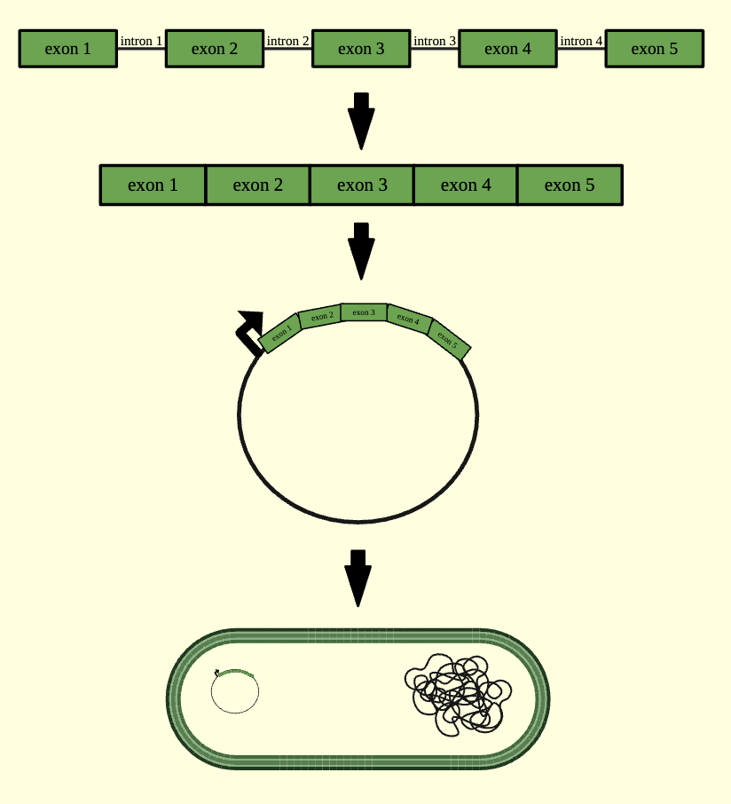
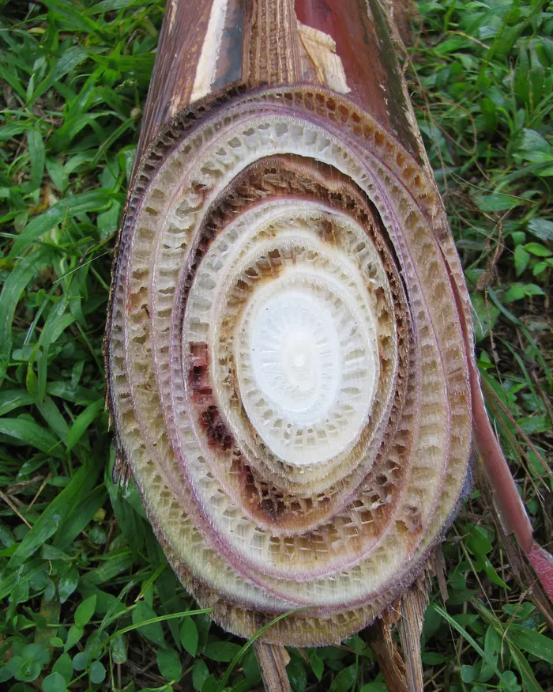
Fusarium Wilt Resistance in Cavendish Bananas
Peter McGinnes, Josh Li, Andrew Parrish, Kate McMullin, Bob Wang, Dr. Beth Pethel, Michael Sheets (Boston University)
Western Reserve Academy, Hudson, Ohio, USA
Abstract
Fusarium wilt is an infection caused by the fungus Fusarium oxysporum f. sp. cubense (FoC) that targets Cavendish banana plants. The fungus enters the plant through the roots and then blocks the plant’s ability to absorb necessary nutrients. The bananas’ inability to ward off this infection results in plant death. Further, Cavendish bananas’ vulnerability to this disease has prompted billions of dollars in economic losses to countries that rely on banana production and exportation. While previous trials have attempted to eradicate the disease, an effective solution to eliminate FoC is yet to be discovered. Our proposed solution highlights the usage of allicin, a compound found in garlic that has demonstrated effectiveness in stopping the growth and proliferation of fungal infections. Our design is an allicin expression system for Enterobacter cloacae that works by inserting the gene encoding allicin into a bacterial endophyte (E. cloacae) and implementing that endophyte into the soil. As a result, we hypothesize Cavendish banana plants can gain resistance to FoC.
Design
1.
Complete allicin gene from Allium plants
2.
Synthesized DNA
(no introns, codons optimized)
introns removed
inserted into a plasmid
3.
Plasmid
Introduction/Background
Note: We are looking into promoters that can sense a lack of nitrogen, calcium, or other nutrients that are hindered by Fusarium wilt.
Many developing countries such as Ecuador, Costa Rica, and the Philippines rely heavily on exporting Cavendish bananas to maintain and grow their economy. Fusarium wilt infections have led to devastating multibillion-dollar losses for these "banana republics."
Banana plants are especially vulnerable to fungal infections because of cloning-like reproduction methods that allow them to bypass sexual reproduction, resulting in the plants lacking genetic diversity. Fusarium wilt infects Cavendish banana plants by entering through their roots and colonizing their xylem vessels. This colonization blocks water and nutrients needed by the plant to survive, leading to the collapse of the banana plant's leaves, ultimately resulting in plant death.
4.
transformation
Enterobacter cloacae
5.
Soil
Figure 1: A cross-section of an infected banana plant
Figure 2: Our proposed design involves synthesizing allicin by removing the four introns. Then, the synthesized DNA sequence would be inserted into a plasmid, where it would later transform into E. cloacae. Finally, E. cloacae would be incorporated into the soil surrounding Cavendish banana plants.

Slide 2
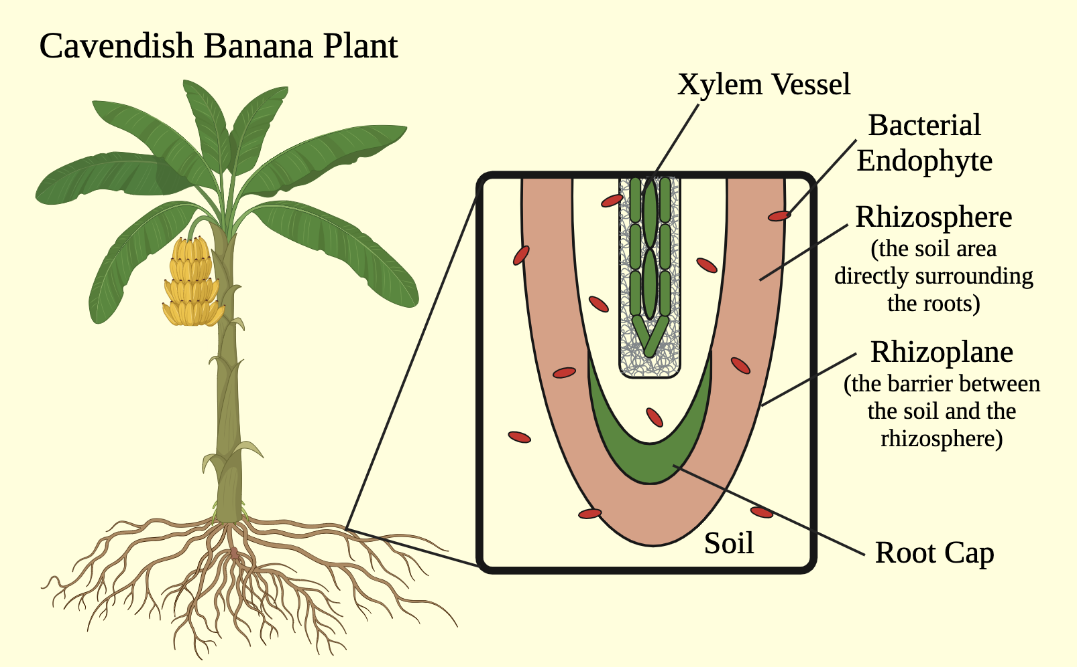
Fusarium Wilt Resistance in Cavendish Bananas
Peter McGinnes, Josh Li, Andrew Parrish, Kate McMullin, Bob Wang, Dr. Beth Pethel, Michael Sheets (Boston University)
Western Reserve Academy, Hudson, Ohio, USA
Next Steps
Once we finalize the specifics of our design, our project will be ready for experimentation
We will insert E. cloacae into the soil surrounding the plant’s roots
Since E. cloacae already exists in Cavendish banana plant roots, it should not be difficult to insert or pose any harm to the environment
From there, the endophyte will transfer horizontally from the soil to the roots (Fig. 3)
To detect the presence of allicin, we would use a bioassay test
This test will involve putting some of the compound on a plate of E. cloacae and seeing if growth is prevented
Note: for that test, we will use a simple garlic-infused liquid as the control
Also, we will test the antimicrobial properties of allicin to ensure that it does not kill E. cloacae (if it does, we will find another viable bacterial endophyte)
Assuming that test works, we will then track and compare Fusarium growth between treated and untreated Cavendish plants
Meet the Fusarium Fighters!
(left to right) Andrew Parrish, Peter McGinnes, Kate McMullin, Bob Wang, Josh Li
Acknowledgements
We would like to thank our teacher, Dr. Beth Pethel, and our mentor,
Michael Sheets, for all of their support throughout this project!
Figure 3: A Cavendish banana plant and the soil area surrounding its roots
(with bacterial endophytes present)
Scan for References

