Slide 1
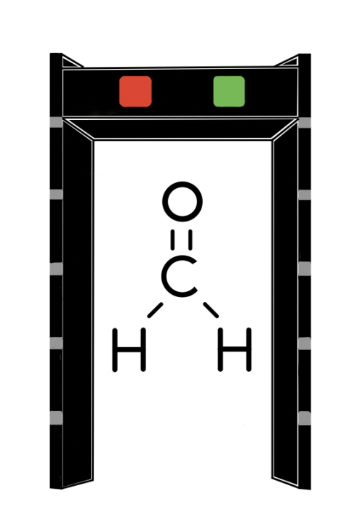
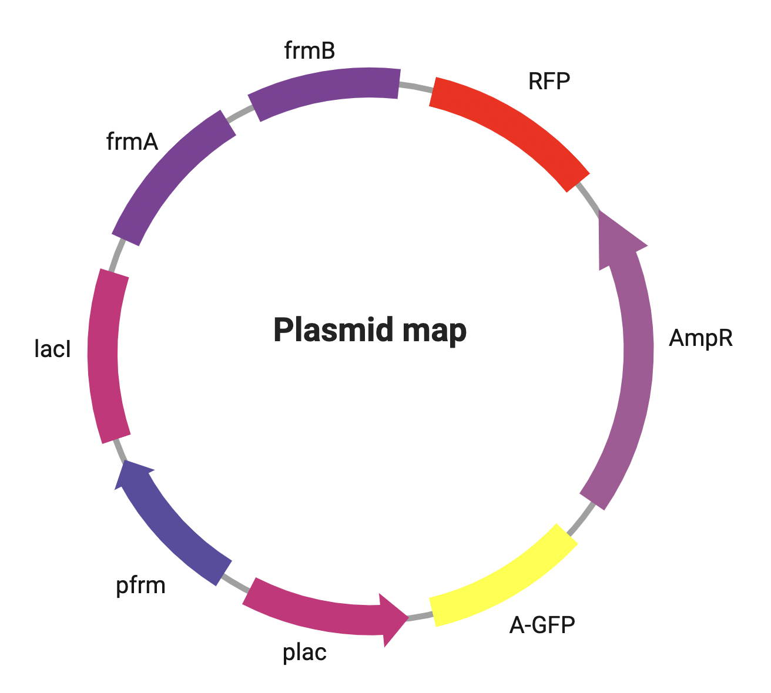
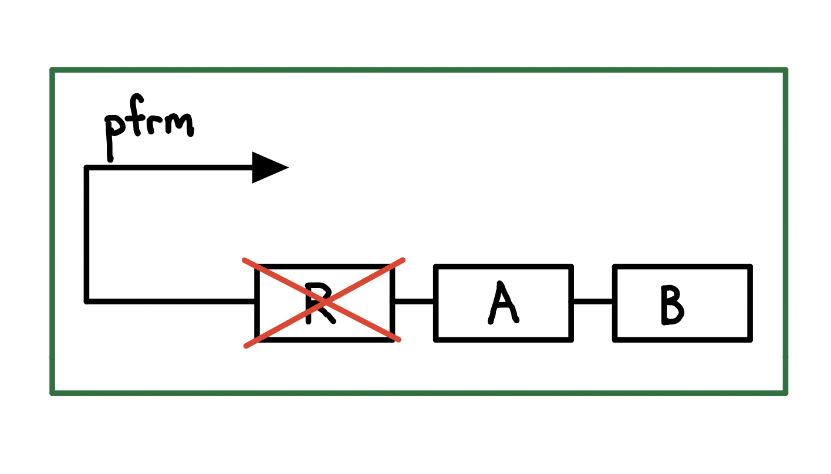
﻿
﻿
An Escherichia coli-based formaldehyde detector: An economical and effective solution for safe air monitoring.
Lujiong Danzhen, Ethan Tan, Dr. Beth Pethel, Mr. Michael Stark
Western Reserve Academy, Hudson, Ohio, United States
﻿
﻿
﻿
﻿
Abstract
Our research develops an economical and efficient formaldehyde detector which turns red in the presence of formaldehyde, offering a visual indicator using the ΔfrmR strain of Escherichia. coli. The detector incorporates frmA and frmB genes to remediate formaldehyde in the solution, assuring its reusability when provided with sufficient nutrients. This innovative approach promises a reliable and reusable solution for formaldehyde detection, addressing a critical need for safety and health protection.
Science Content
The plasmid design contains the frmA, frmB, lacI, the ampicillin resistance, the red fluorescence (RFP), the naturally yellow appearing green fluorescence (amilGFP) genes, the lacI repressible constitutive promoter plac, and the formaldehyde sensing promoter pfrm. The promoter pfrm controls the expression of the frmA, frmB, lacI, and RFP, while plac controls the expression of the amilGFP gene. The expression of amilGFP indicates the viability of E. coli prior to the exposure to formaldehyde. The RFP acts is a visual indicator of formaldehyde presence. Upon formaldehyde remediation, the E. coli will change from red to yellow.
Next Steps
Studies should aim to determine the detectable levels of formaldehyde and the sensitivity of the detection system.
Using a swab for formaldehyde collection on furniture surfaces may lead to inaccurate results due to limited surface area. Experiments are needed to ensure the accuracy of the detection system.
Identifying similar gas-induced promoters may enable the detector to detect different gases.
Team Content
There are two returning senior members in our team this year.
Introduction/Background
The project aims to develop an E. coli-based detector to identify harmful concentrations of formaldehyde, a compound widely used in various industries but known to cause severe health issues upon exposure. Current approaches are often unreliable, expensive, and dangerous. However, the proposed detector, using a formaldehyde-detecting plasmid and the plac-lacI repressor system, offers a cost-effective and accurate solution. The detector will change its color from yellow to red when formaldehyde is present in the air. In addition, frmA and frmB gene products produced by the plasmid will function as detoxification agents. After formaldehyde content in the air is cleared, the system will turn yellow again and be reusable.
Figure 2 (right): ΔfrmR strain with the frmR gene deleted
Figure 1 (left): Our plasmid design
References and acknowledgements
We would like to thank Dr. Beth Pethel and Mr. Michael Stark for their support and guidance throughout this project. We would also like to acknowledge Bowen Jiang, Jack Markert, Dylan Wu, and Michael Yang as the founding members of our project.
Our group utilizes a strain of E. coli, ΔfrmR strain with the frmR gene deleted, in order to maximize the expression of the design system. In the presence of formaldehyde, the frmR gene product would normally bind to the pfrm promoter and inhibit its activity. The presence of formaldehyde negatively allosterically modulates frmR, leading to the expression of frmA and frmB which are responsible for the detoxification of formaldehyde.
Figure 3 (right): QR code to our paper and references

