Slide 1



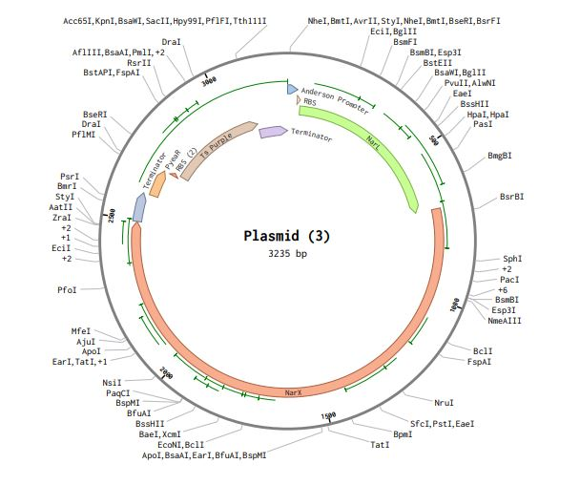

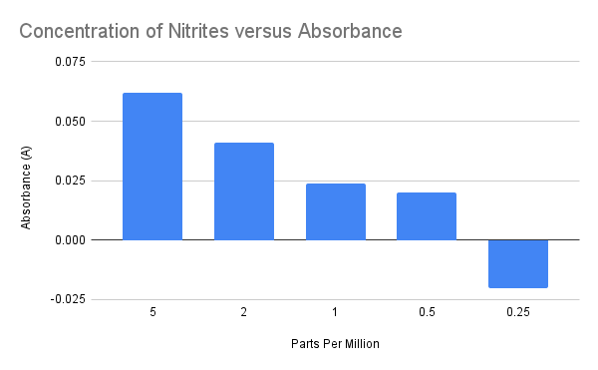






NitriAlert
Chase Howard, Tomidylan Klepper, Eric Thomas, Natalie Baker, Brylee Jones, and Tucker McLain, Amanda Dunham, Hia Ming (Boston University)
DB EXCEL, Kingsport, TN, Sullivan County
Abstract
Fish in tanks can easily die from high concentration of nitrate and nitrites in water. Water quality testing can be costly and time consuming. By designing a plasmid that combines the PyeaR promoter, a ribosome binding site and the tspurple gene. This plasmid would be used to transform E.coli that is housed in a chamber that would hang off the side of the fish tank. This would be called “NitriAlert”. There will be a visual color change in the device bringing attention to the excessive amount of nitrate/nitrites in the tank allowing for a water change before the fish are killed. By adding “NitriAlert” into the tank less fish will be harmed by a sudden spike of nitrate/nitrite.
After designing our plasmid, we initiated the sequencing of a plasmid and conducted modeling using Benchling software. The plasmid was procured from Twist Bioscience.
Transformation process:
Cultures of E. coli K-12 were cultivated overnight, followed by the collection of cells by scraping into centrifuge tubes. Subsequently, we induced cell competency through a calcium chloride (CaCl) solution. The cells were then subjected to a cold bath to facilitate the heat shock process. Heat shocking was conducted immediately after the cold bath, allowing the plasmid to efficiently cross the disrupted cell membrane. The Plasmid-E. coli mixture was incubated in the heat shock for 90 seconds, followed by immersion in cold water for recovery. The treated E. coli K-12 cells were plated onto ampicillin-spiked petri dishes and incubated overnight to facilitate plasmid uptake. Transformation was successful.
The Experiment:
To create a nitrogen-saturated sample, deceased fish were placed in water. Subsequently, the water was tested and sampled. Dilutions were performed to obtain samples with varying concentrations. This process was repeated iteratively to establish a gradient of concentration samples: 0 ppm, .25 ppm, .5 ppm, 1 ppm, 2 ppm . Our transformed bacteria was then placed in the varying concentrations of nitrites with Luria broth and ampicillin in an incubator set at 37 C. for 24 hours. A spectrophotometer was used to measure the amount of absorbance at a wavelength of 580 nm.
Methods and Results
Conclusion and Next Steps
Our tests yielded promising results regarding the production of tspurple proteins across various nitrite concentrations. However, despite our efforts, we did not observe a visible change, indicating ineffectiveness for our device. Following consultations with our mentor and further research, we discovered that the parts per million (ppm) concentration we employed might be too low for our plasmid's functionality.
Consequently, our team opted to concentrate solely on nitrates due to the higher ppm levels tolerable by fish compared to nitrites. This may elucidate the zero reading obtained at 0.25 ppm. Additionally, we resolved to enhance the efficiency of tspurple production by incorporating an Anderson promoter, along with the NarL and NarX genes, into our plasmid.
Furthermore, we have decided to utilize nitrate salts to establish a more controlled testing environment. These adjustments aim to optimize our experimental conditions and enhance the reliability of our results in future studies.
Introduction/Background
To maintain the health of aquatic life, their environment requires regulated levels of pH, nitrate, nitrite, ammonia, and other factors. Sudden drops or spikes in any of these parameters can lead to the death of aquatic organisms. Specifically, nitrite/nitrate levels are challenging to monitor as they can fluctuate suddenly and have been identified as the primary cause of mortality in our school's tank. Commonly available tests designed for detecting nitrites/nitrates are expensive, time-consuming, and pose risks to both human health and the environment.
In light of this issue, our team has developed NitriAlert, a cost-effective and time-efficient solution for monitoring nitrite/nitrate levels. NitriAlert is a device that would hang off a fish tank that would pump water from the tank into the device periodically. This device would house a bacteria that would produce a purple protein in the presence of nitrites/nitrates. NitriAlert enables users to determine nitrite/nitrate concentrations by observing a color change, making it both user-friendly and environmentally safe.
Our approach involves transforming E. coli into a nitrite/nitrate detection system. By incorporating the nitrate-sensitive promoter PyeaR and the chromoprotein tsPurple, which is only produced in the presence of nitrogen compounds our test yields visible results without the need for specialized equipment.
In contrast to existing kits, NitriAlert offers safety, cost-effectiveness, and efficiency. Our procedures outline the steps for transforming E. coli with a plasmid containing the PyeaR promoter and the tsPurple gene, along with presenting the data from our tests with nitrites.
New Plasmid and Gene Sequence
QR code to References
A spectrophotometer was used to measure the amount of absorbance (A) at a wavelength of 580 nm. We zeroed out our spectrophotometer using our control sample which had zero ppl of nitrites.

Slide 2
