Slide 1
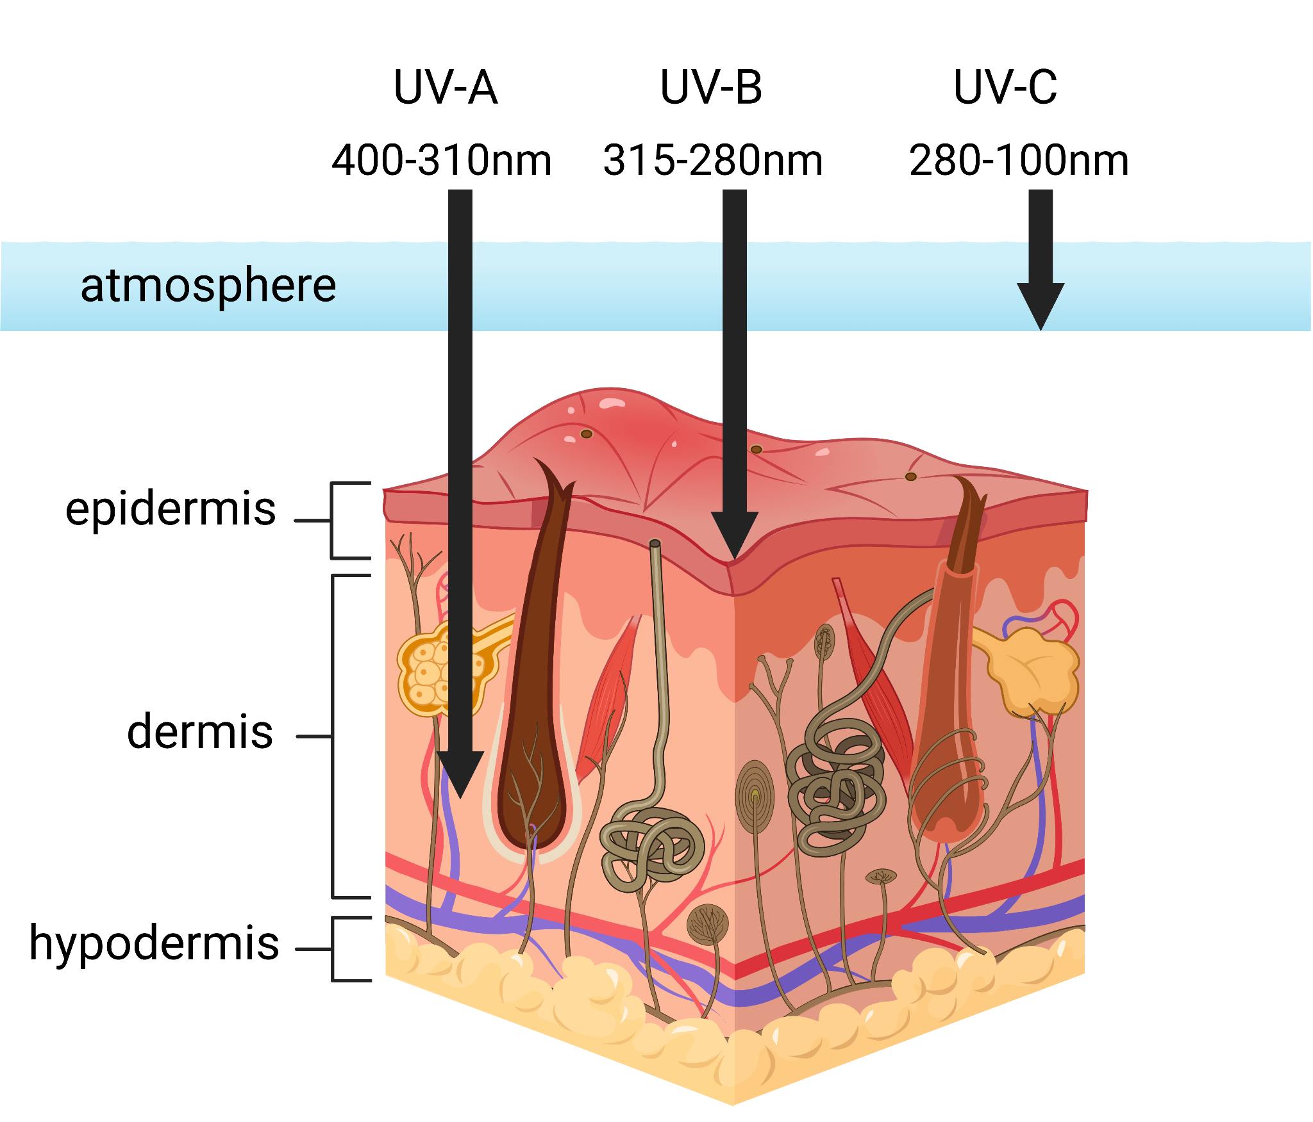
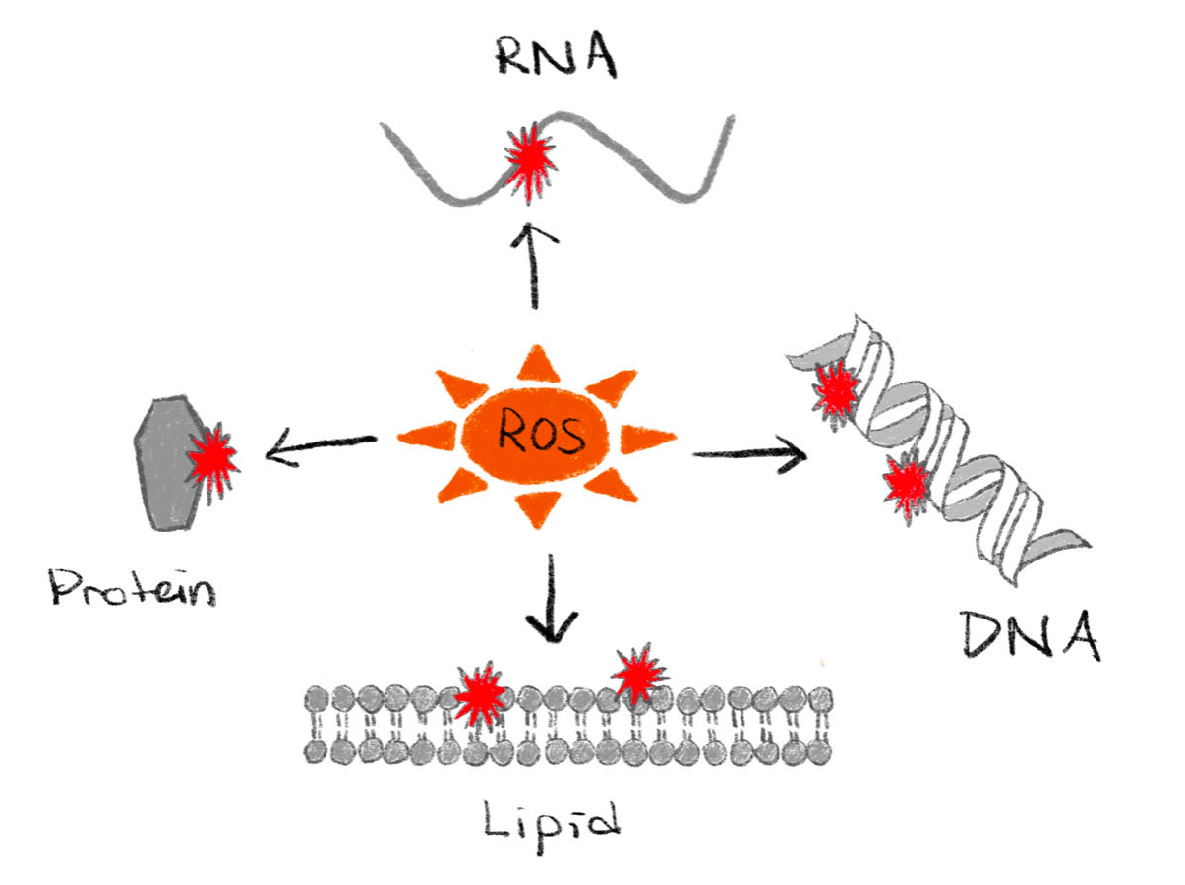
The Application of Cyanobacterial Pigments to Construct Environmentally Friendly Sunscreen
Yihan (Mariana) Ma, Dr. Beth Pethel, Ms. Jackie Thompson (Asimov)
Western Reserve Academy, Hudson, Ohio, United States
Abstract
Ultraviolet radiation plays a crucial role in the development of skin cancer. Sunscreen usage effectively blocks UV rays from the skin. However, many of the active ingredients found in sunscreen are harsh chemicals that further skin damage seriously impact the ecosystem. Our project is an innovative method to extract two sunscreen pigments from a marine bacteria, cyanobacteria, offering the opportunity to replace the traditional active ingredients in chemical sunscreens with nonhazardous pigments. This photosynthetic microbe produces two environmentally friendly pigments, scytonemin and mycosporine-like amino acids (MAAs), which shield the cell from 90% of UV-A light and absorb UV-B radiation, respectively. We will directly induce the expression of scytonemin biosynthesis gene (ScyC) in cyanobacteria and transform T7 Express Escherichia coli with a mycosporine-glycine gene (MysC) to mass-produce these pigments. Combining these pigments with inactive but beneficial ingredients commonly found in other sunscreens produces an environmentally friendly sunscreen that will benefit both the ecosystem and humans.
Introduction/Background
Ultraviolet radiation (UV) is a form of electromagnetic radiation emitted from the sun that can penetrate the layers of human skin. UV radiation is divided into three types based on the variations in wavelength (Figure 1).
UV-A can reach the Earth’s surface and hit the dermis. It contributes to skin burning and wrinkling.
UV-B reaches the epidermis, promotes skin aging, and increases the chance of developing skin cancer.
UV-C is the most harmful type of UV radiation and is completely filtered by the ozone layer.
Excessive exposure to UV radiation can lead to the production of reactive oxygen species (ROS), byproducts of oxidative metabolism. ROS are highly reactive chemicals that damage basic building blocks of the cell (Figure 2). The damage, if unrepaired, may eventually result in spontaneous mutation and cancer.
Figure 1. Different types of UV rays penetrating the skin
Figure 2. Damages caused by ROS

Slide 2
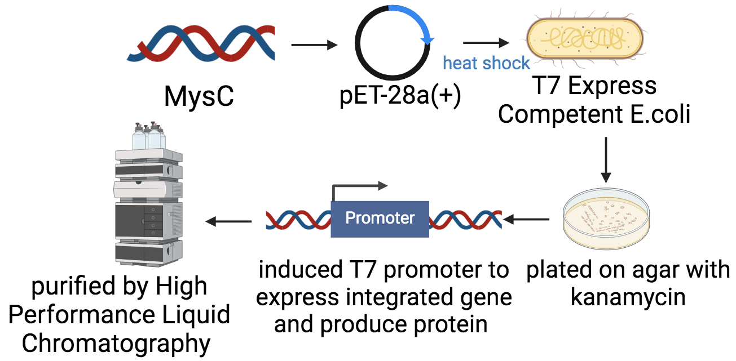
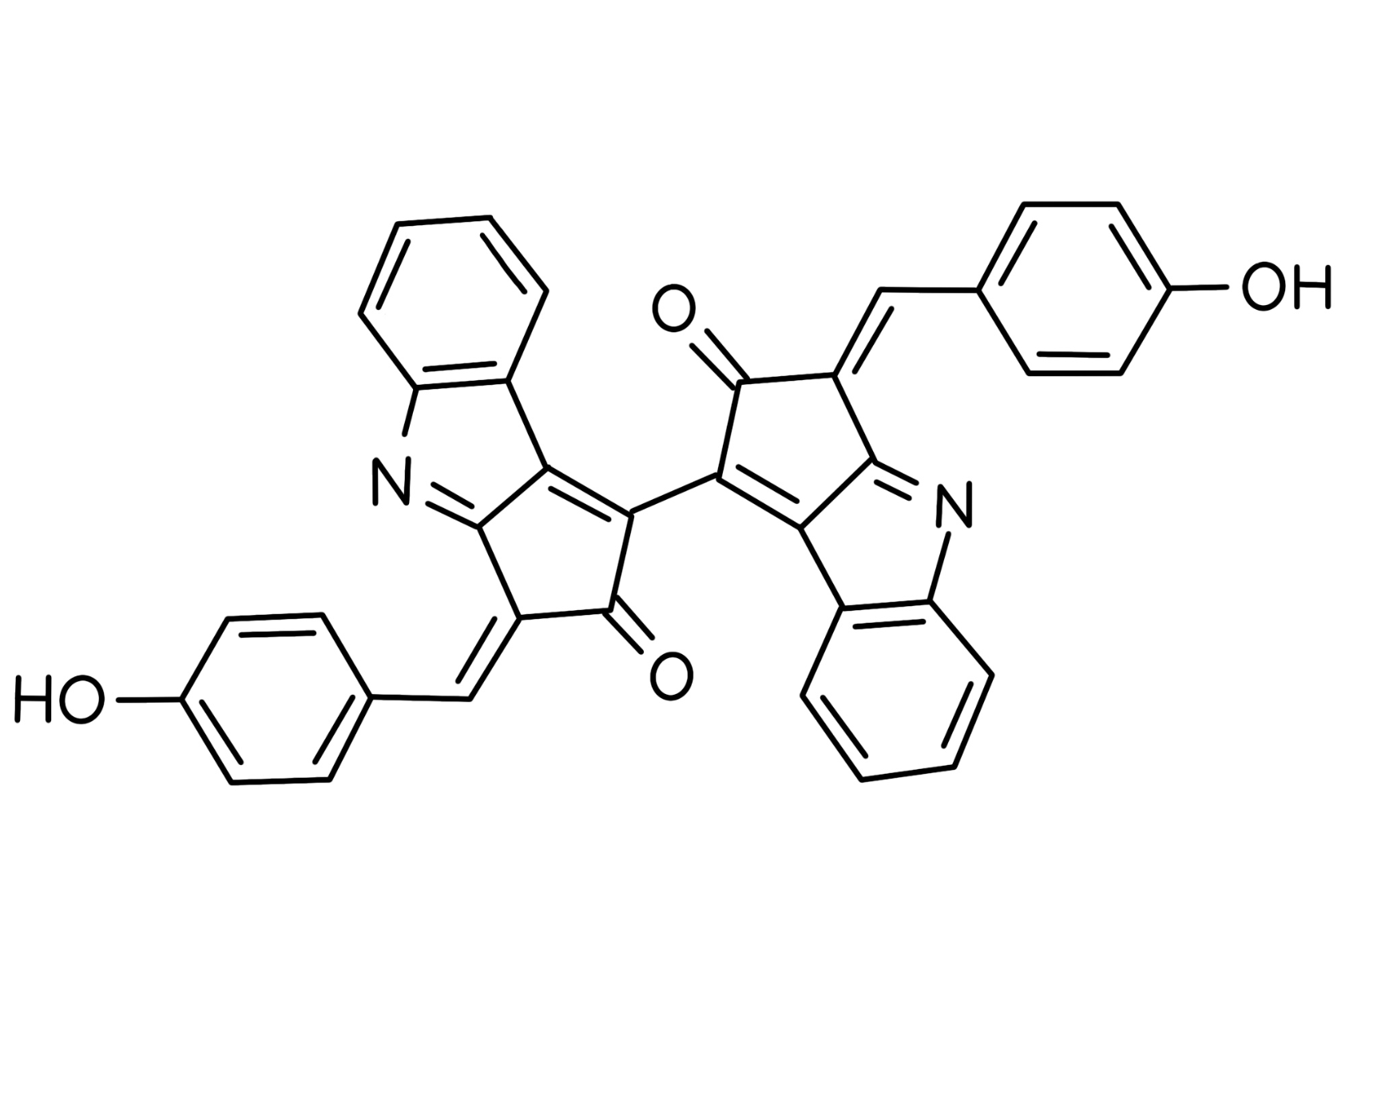
The Application of Cyanobacterial Pigments to Construct Environmentally Friendly Sunscreen
Yihan (Mariana) Ma, Dr. Beth Pethel, Ms. Jackie Thompson (Asimov)
Western Reserve Academy, Hudson, Ohio, United States
Problem
Sunscreen can help prevent sunburn, skin cancer, and premature aging. However, in 2021, the FDA reviewed previously approved sunscreen ingredients. Fourteen of the sixteen allowable chemicals were founded to have negative impacts on the environment.
Workflow
Our current lab work is focusing on the production of MAAs. We will insert a synthesized mycosporine-glycine biosynthetic gene, MysC, into a pET-28a(+) plasmid via the HindIII and EcoRI restriction enzyme sites. We will use the plasmid pET-28a(+), which contains a T7 promoter, a ribosomal binding site, a T7 terminator, and a gene encoding for kanamycin resistance. Each plasmid will be transformed into separate T7 Express E. coli competent cells and grown on LB agar plates with kanamycin. The MAAs purification process will involve High Performance Liquid Chromatography (Figure 5).
Team
2023-2024 team: Yihan (Mariana) Ma (Figure 6)
2022-2023 team: Logan Amos, Andrea Belen, Miki Fok, Yihan (Mariana) Ma, Annie Nguyen, and Yuejiao (Vivian) Zhou
Figure 6. Team Photo
Solution
The study will rely on the use of cyanobacteria to create our final sunscreen product. Many strains of cyanobacteria produce two pigments: MAAs and scytonemin, which protect the bacteria from UV rays. MAAs, such as shinorine and mycosporine-glycine, are shown to possess increased absorption of UV-B radiation while having maximum absorption of 334 nm and 331 nm, respectively (Figure 3). Once isolated and placed in a solvent, scytonemin absorbs radiation at a maximum wavelength of 384 nm (Figure 4). MAAs and scytonemin protect biological molecules from oxidative damage caused by ROS.
Next Steps
Studies should aim to identify the specific mechanism of direct induction of scytonemin in Nostoc punctiforme.
Further research into the effectiveness of the sunscreen ingredients and their concentrations, including both active and inactive ingredients.
Moving forward, our immediate focus will be on conducting the intended design and extracting necessary data to evaluate the success of our methods.
Acknowledgements
I would like to thank the foundation laid by my teammates from last year, the insights offered by my mentor Ms. Jackie Thompson, and the continuous support provided by my teacher Dr. Beth Pethel.
References
Figure 3. Chemical Structure of MAAs
Figure 4. Chemical Structure of Scytonemin
Figure 5. Flowchart

