Slide 1
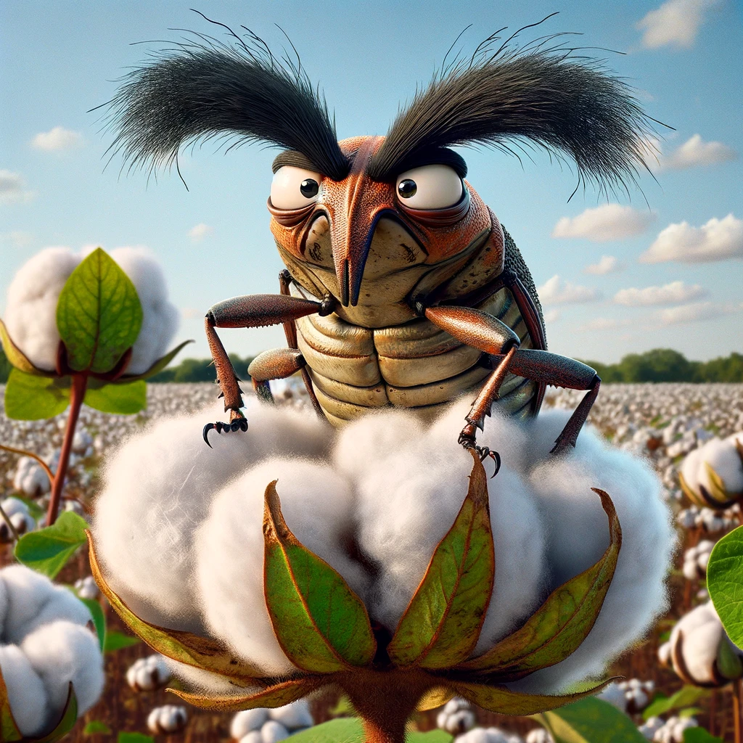
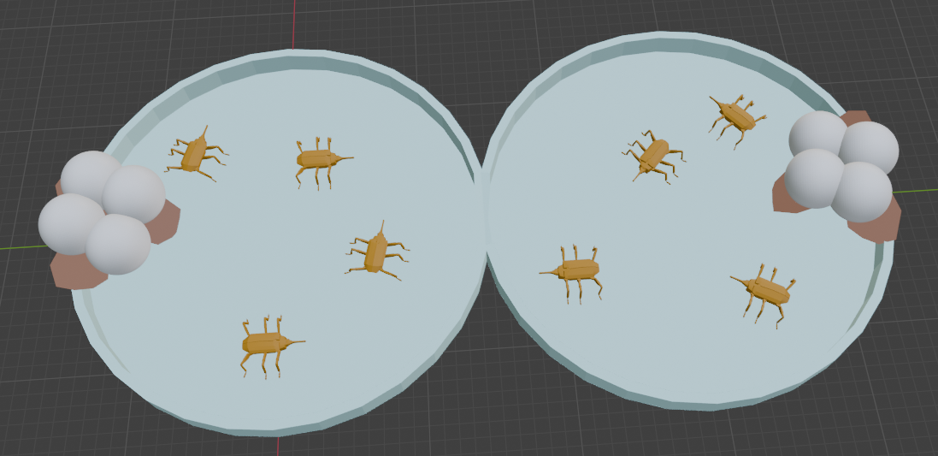
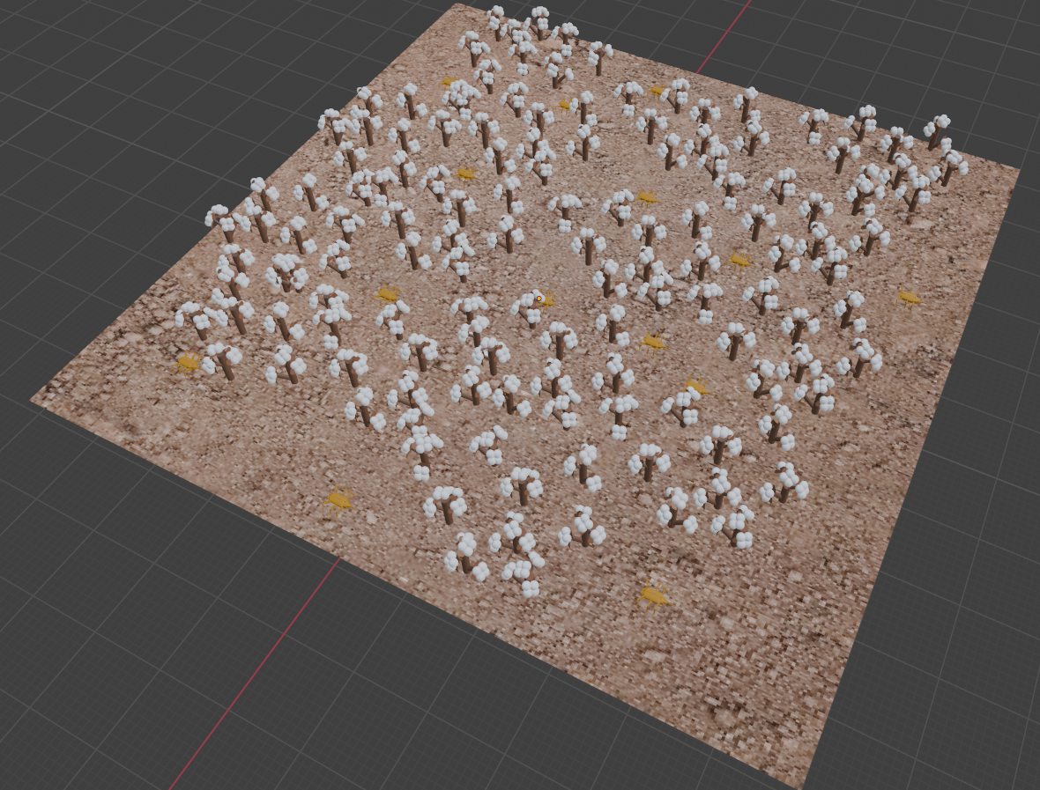
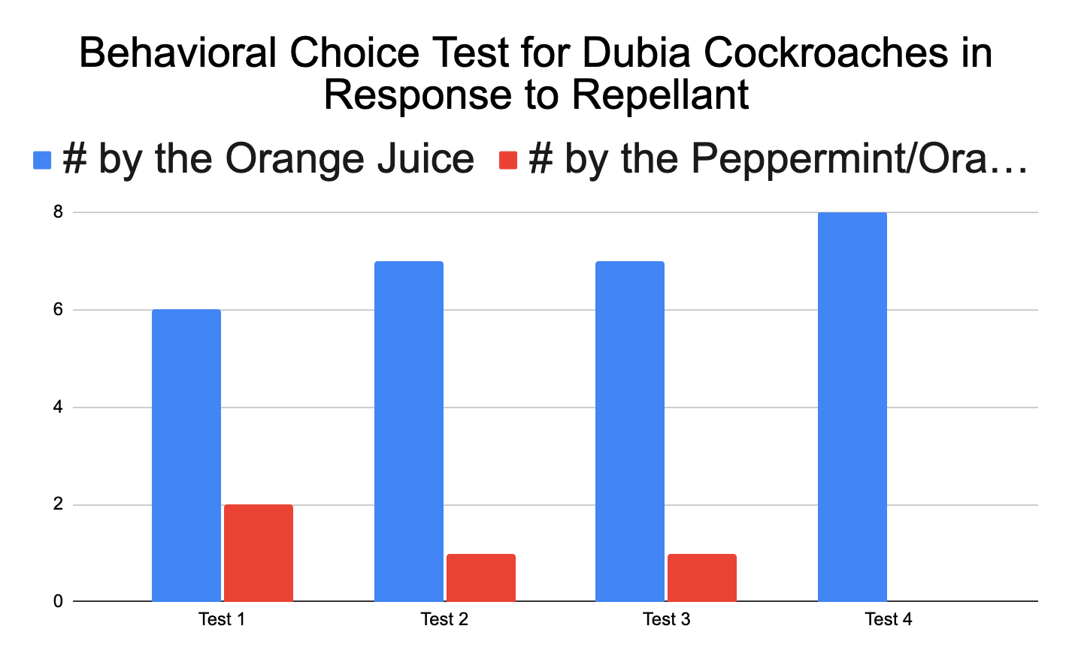
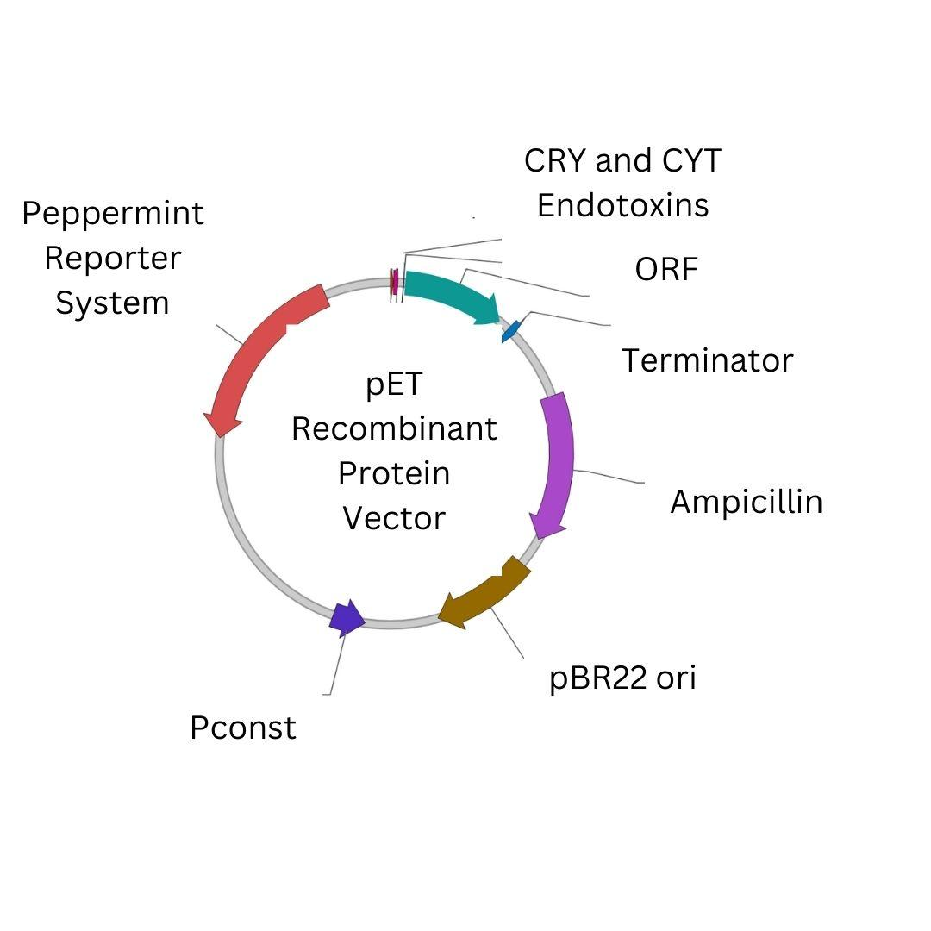
Protecting a Midsouth Staple: Using Genetically Modified Bacteria as a Pesticide to Protect Cotton
Santiago Arbelaez, Freya Donati, Alyssa Gray, Rowan Heeter, Zoe Ingram, Lily Little, Mason Owens, M Pfeiffer, Sam Sailors, Jaxon Treadwell, Tyler Vego, Mentors: Nikki Wallace, Jacob Weaver
Crosstown High, Memphis, Tennessee, USA
Objective
The objective of our project is to develop a safe pesticide that can reliably deter common pests that target cotton, particularly boll weevils.
Science Content - Optimal Test
Hypothesis: If we can engineer a bacteria that can produce the chemical menthyl acetate, then the A. grandis will be repelled by the bacteria.
Control: Put 20 A. grandis into the testing container with 20 grams of cotton.
Test: Put 20 A. grandis into the testing container with 20 grams of cotton and peppermint sprayed onto the cotton.
Our Test
We created a two-chamber behavioral choice test area for dubia cockroaches, Blaptica dubia, our model organism.
One chamber had orange juice pooled at the end while the other had orange juice with peppermint oil mixed in.
We added four B. dubia onto each side (for a total of 8) to see which side they would prefer for a total of 8 minutes per trial.
The trial was repeated 4 times.
Each time, B. dubia preferred the side without the peppermint oil as indicated by the data below.
Next Steps & Limitations
This may not work on a large scale, it requires a larger amount of testing to see if it harms the plant itself.
Experiment with the different methods of gene expression available, such as other essential oils.
Experiment with different scents to see how the A. grandis interact with them, there may be less damaging oils
If we had the capabilities to isolate out the gene for menthyl acetate from peppermint plants we would test the ease of inserting the gene into E. coli for further tests with B. dubia.
Background Information
Cotton is essential to the global textile market but faces severe threats from pests like the boll weevil (Anthonomus grandis) and various pathogens. Since its U.S. introduction in 1892, the boll weevil has been a significant adversary, historically slashing cotton yields by up to 50% in the late 19th and early 20th centuries and inflicting extensive economic damages. Although eradication efforts in the U.S. have led to yield improvements and reduced the need for pesticides, the boll weevil remains a formidable threat in areas without such eradication programs, endangering cotton production globally.
Addressing the persistent issue of A. grandis, our project introduces a novel pest management solution by employing genetically modified E. coli to act as a bio-pesticide. This innovative approach involves genetically engineering E. coli to emit a peppermint scent and produce a specific metabolic toxin targeting A. grandis. Our goal is to offer a safe, effective, and environmentally sustainable alternative to traditional chemical pesticides, potentially revolutionizing cotton pest management and protecting this crucial crop for future generations.
Our focus includes menthyl acetate, a peppermint-derived monoterpene, known for its minty aroma and favorable properties for bio-production in E. coli. This strategy aims to move away from chemical pesticides like Malathion, which, despite being deemed low-risk by the EPA, raises concerns about potential neuronal damage. By leveraging biotechnology and natural compounds, we aspire to advance agricultural practices and ensure the long-term viability of cotton cultivation.

Slide 2
Protecting a Midsouth Staple: Using Genetically Modified Bacteria as a Pesticide to Protect Cotton
Santiago Arbelaez, Freya Donati, Alyssa Gray, Rowan Heeter, Zoe Ingram, Lily Little, Mason Owens, M Pfeiffer, Sam Sailors, Jaxon Treadwell, Tyler Vego, Mentors: Nikki Wallace, Jacob Weaver
Crosstown High, Memphis, Tennessee, USA
References and Acknowledgements
Advancing Cotton Education Growth and Development of a Cotton Plant. (n.d.). https://www.cotton.org/tech/ace/growth-and-development.cfm
Arruda, L. S., Torres, J. B., Rolim, G. G., & Silva-Torres, C. S. A. (2020). Dispersal of boll weevil toward and within the cotton plant and implications for insecticide exposure. Pest Management Science, 77(3), 1339–1347. https://doi.org/10.1002/ps.6148
Oregon Department of Agriculture. (n.d.). Demonstration and Research Pest Control Oregon Pesticide Safety Education Program. Chrome-extension://Efaidnbmnnnibpcajpcglclefindmkaj/https://www.oregon.gov/oda/shared/documents/publications/pesticidesparc/pesticideapplicatordemoresearchtrainingmanual.pdf.
Palma, L., Muñoz, D., Berry, C., Murillo, J., & Caballero, P. (2014). Bacillus thuringiensis Toxins: An Overview of Their Biocidal Activity. Toxins, 6(12), 3296–3325. https://doi.org/10.3390/toxins6123296
pET Bacterial Recombinant Protein Expression Vector Design Studio | VectorBuilder. (n.d.). https://en.vectorbuilder.com/design/pET16b.html
The Truth About the Boll Weevil - 2015-03. (n.d.). https://www.mshistorynow.mdah.ms.gov/issue/the-truth-about-the-boll-weevil
We’d like to thank Crosstown High, Biobuilders, XQ, K2 Scientific , New England Biolabs, and Carolina Biological for the support of this project.

