Slide 1
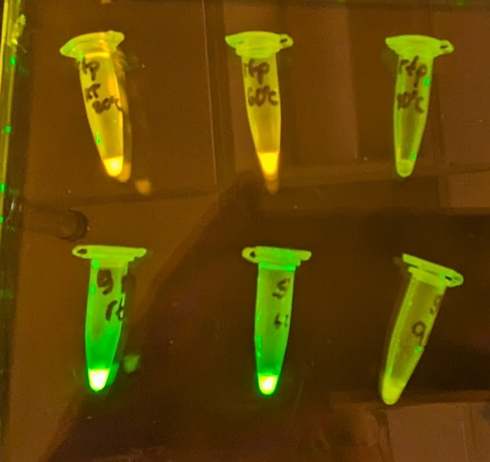
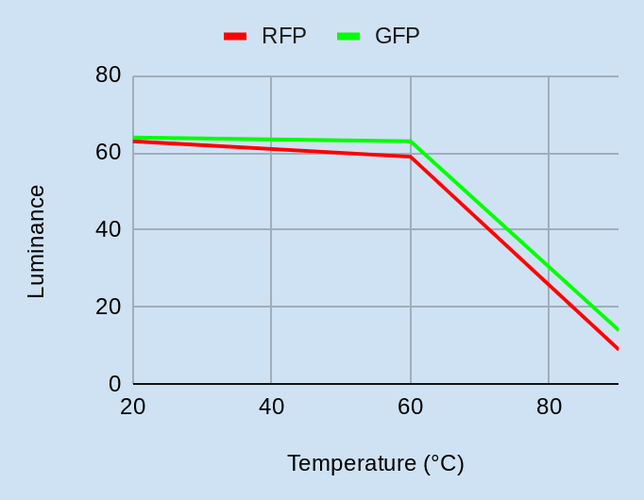
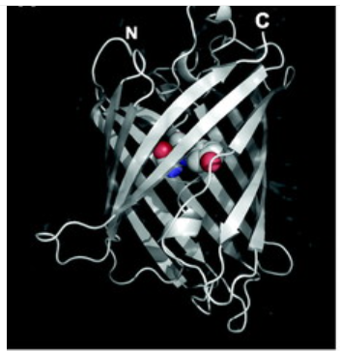
“Let it Glow” : The Heat Never Bothered Me Anyway
Heat-Stable Fluorescent Proteins
Ariadna Estebanez, Samantha O’Brien, Lillian Sequeira, Jishnu Sanyal,
Jad Yehia, Tomi Chen, Terry Deng, Luchezar Pirogov
Teacher Leader: Laura O’Brien, Mentor: Mary Lerner (UCB)
Castro Valley High School, Castro Valley, California
Abstract
Fluorescent proteins are widely used in biotechnology to determine levels of gene expression and protein localization in cells. One major drawback of GFP is that it denatures at temperatures higher than 70 degrees Celsius. Our goal is to analyze what motifs and domains could be used to help stabilize GFP and other fluorescent proteins at higher temperatures, and to genetically engineer the coding sequence of DNA to create heat stable fluorescent proteins.
Experimental Results:
Up until 60 degrees celsius, the glow of the fluorescent proteins are the same for both types
At 90 degrees celsius the glow of both rfp and gfp is largely diminished
Our Team:
We are a team of eight from Castro Valley in Northern California. The majority of our members are in our second year of BioBuilderClub.
We started a new project this year with the aim of creating heat-stable fluorescent proteins for use in biotechnology.
Future Studies:
We would like to identify areas of a fluorescent protein for modification
Investigate enzymes found in thermophiles to study related structures of heat stable proteins and explore applications to fluorescent proteins.
Use homology modeling software to predict folding patterns to create a heat stable version of a fluorescent protein.
Possible experiment: Timelapse the heating of a fluorescent protein in solution to identify points of key structural changes.
Introduction/Background:
Figure 1: GFP structure
Fluorescent proteins are beta-barrels containing chromophores (509nm emission peak) in their centers.
Photo by Laura O’Brien
Figure 3 (left): Each 0.5 mL tube contains 20 𝛍L of liquid. The top row is red fluorescent protein (RFP), produced in transformed E. coli and then purified using hydrophobic interaction chromatography (from Amgen Biotech Experience materials, San Francisco group). The second row is green fluorescent protein (GFP), produced using my TXTL Linear DNA Expression Kit from Arbor Biosciences. Tubes were incubated for 12 minutes at the following temperatures:20ºC (left column), 60ºC (middle column), 90ºC (right column), then immediately visualized under blue light through an orange filter.
Figure 3 (right): The fluorescence was quantitated by extracting luminance values from the photograph using a color picker website, adjusted by subtracting the luminance value from a part of the tube with no fluorescence. This graph demonstrates that both GFP and RFP denature rapidly and lose fluorescence after 60°C. Additionally, the graph suggests that RFP loses fluorescence at a faster rate than GFP.
References and acknowledgements
Chudakov DM, Matz MV, Lukyanov S, Lukyanov KA. Fluorescent proteins and their applications in imaging living cells and tissues. Physiol Rev. 2010 Jul;90(3):1103-63. doi: 10.1152/physrev.00038.2009. PMID: 20664080.
Choi, J.Y., Jang, T.-H. and Park, H.H. (2017), The mechanism of folding robustness revealed by the crystal structure of extra-superfolder GFP. FEBS Lett, 591: 442-447.
Bianchi, F. (n.d.). Coolors - the super fast color palettes generator!. Coolors.co. https://coolors.co/
We’d like to thank Laura O’Brien for facilitating our club, and Lata Mistry, who allowed us the use of her classroom, Biotech equipment, and reagents for experiments. We’d also like to thank our mentor, Mary Lerner, for providing us with background information on our topic, and guiding us throughout this process.
Heat-stable fluorescent protein!
Figure 2: Schematic of our design
mRNA
promoter
Ribosome Binding site
gene
terminator

