Slide 1
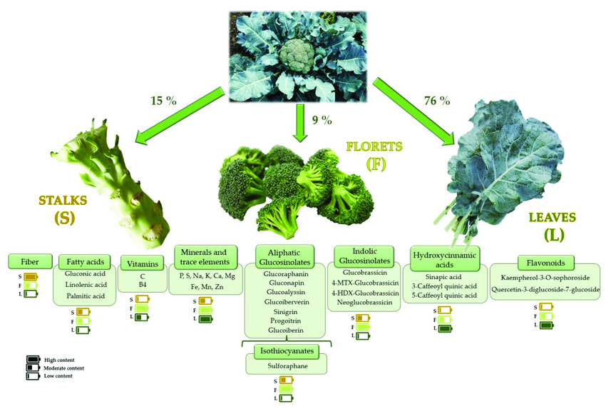
Maximizing nutrient content in Brassica oleracea: the Ultimate Broccoli
Jaeyi Kim, Chelsea Djajaria, Jing xiong, Yu Ju Chao, Andrew Tan, Avni Tyagi,
Haoken Huoermaiti, Michelle Cheah, Gitanshu Bhatia(LanzaTech, Senior Research Associate)
Sinarmas World Academy, Tangerang, Banten, Indonesia
Abstract
The aim of this project is to enhance the nutritional content and yield of Brassica oleracea(broccoli) through genetic engineering. Broccoli is known for its large quantity of essential vitamins such as C, K, and A and minerals such as potassium, calcium, and iron as well as antioxidants such as vitamins C and E, and β-carotene. Our focus is on arranging the makeup of broccoli to increase its protein and glucosinolate content.
We intend on using CRISPR genetic editing to maximise two genes, MYP34 and CYP79A2, and conduct cross-plant genetic engineering with Chinese kale to introduce the BoMYB29 gene and Serine/threonine protein kinase SRK2n (SnRK2) genes. Techniques such as gel electrophoresis and colorimetry will be utilised to check the modified nutrient levels. This project uses biotechnology to create a healthier and more resilient crop which is important for both agriculture and human nutrition.
(Figure 1) Nutrient content of broccoli per part (Artés-Hernández, 2023)
Experiment rationale - Why do we want to make the Ultimate Broccoli?
As it can be observed from the figure above, broccoli is rich in anti-inflammatory, anti-carcinogenic nutrients. However, despite having relatively significant protein content at 2.6g per 100g, the nutritional effects of protein and glucosinolates in broccoli are not as evident. Hence, by maximizing nutrient output of protein in broccoli, we aim to produce the Ultimate Broccoli, nutrient-rich in a multifaceted manner.
Planning - what possible technologies did we scrutinize?
Analysing glucosinolate content with cold acidified methanol: not recommended as protein might denature in certain pH/temp
Real-time PCR: limited resources, expensive, high risk of failure
Science Content - Selecting the genes
MYB34
MYB34 is a transcription factor that controls the production of aliphatic glucosinolates. Sulfur-containing chemicals called glucosinolates are present in plants, especially those in the Brassicaceae family, which includes broccoli.
Genes that produce aliphatic glucosinolates, which are essential for the plant's defense against infections and herbivores, are expressed more when MYB34 is activated. These substances may also be advantageous to human health.
CYP79A2
The cytochrome P450 enzyme CYP79A2 is involved in a crucial process in the synthesis of aliphatic glucosinolates.
The process by which amino acids are transformed into aldoximes involves CYP79A2. It catalyzes the conversion of particular amino acids into corresponding aldoximes, which act as precursors for the production of glucosinolates, in the context of glucosinolate biosynthesis.
BoMYB29 gene
BoMYB29 gene is abundant in kale, and is a key regulator of the biosynthesis of methylsulphinyl glucosinolate: a class of sulfur-containing compounds made up of amino acids and glucose. Introducing this gene through cross-plant genetic engineering could elevate amino acid content in broccoli, upsurging antioxidant and anti-inflammatory properties.
Serine/threonine protein kinase SRK2n (SnRK2) genes
Threonine is a necessary enzyme to regulate cholesterol levels in the human body, preventing cardiovascular diseases and toxic accumulation of cholesterol. In addition, inserting SnRK2 genes in Chinese kale plants(oleracea var. alboglabra) through cross-plant genetic modification can pivotally increase resistance to abiotic stress, such as drought, salinity, and cold.
Introduction/Background
Topic: Identifying several genes to later be engineered into the broccoli, and then do a protein quantification and analysis. The main purpose of this research is to increase protein concentration on broccoli in terms of improving the nutrients from the broccoli.
Design: Having an extraction of several genes that can help in increasing the protein nutrients for broccoli, then inserting them into the broccoli using genetic modification. The end product will be the new broccoli filled in with the new protein genes.
Chosen broccoli: Brassica oleracea var. italica cv. Green King; GK

Slide 2
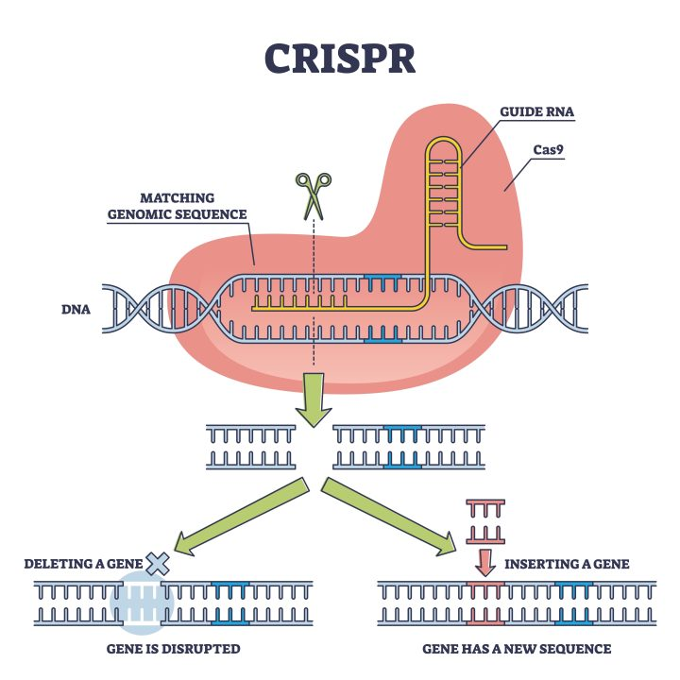
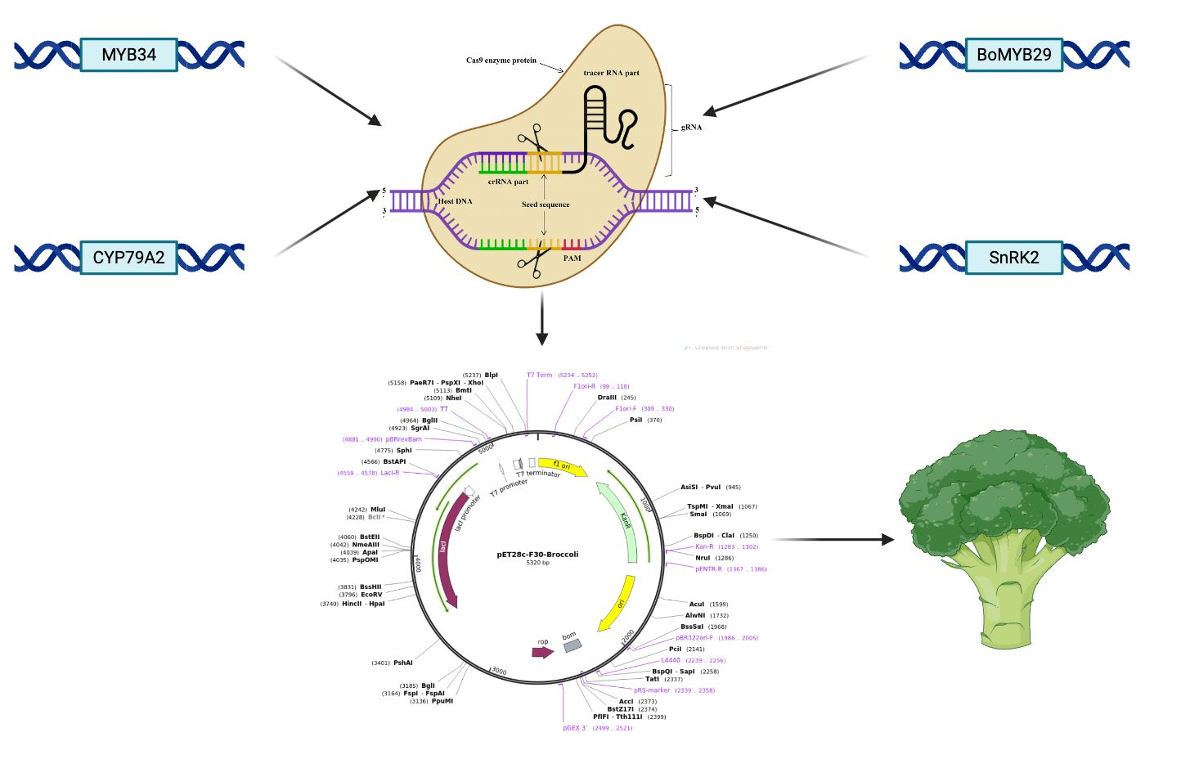
Maximizing protein content in Brassica oleracea: the Ultimate Broccoli
Jaeyi Kim, Chelsea Djajaria, Jing xiong, Yu Ju Chao, Andrew Tan, Avni Tyagi,
Haoken Huoermaiti, Michelle Cheah, Gitanshu Bhatia(LanzaTech, Senior Research Associate)
Sinarmas World Academy, Tangerang, Banten, Indonesia
Science Content
How will the genes be inserted?
Guide RNA (gRNA) Design:
Design a short RNA sequence (gRNA) complementary to the target gene.
Cas Protein Binding:
Cas protein (e.g., Cas9) is guided by gRNA to the target DNA sequence.
DNA Cleavage:
Cas protein induces a double-strand break in the target DNA.
DNA Repair Mechanisms:
Non-Homologous End Joining (NHEJ): Ligates broken DNA ends, potentially causing indels.
Homology-Directed Repair (HDR): Uses a provided template DNA for precise repair.
Inserting Desired Genes:
Provide a donor DNA template along with CRISPR to insert or modify genes.
Team Content -
Team of 6 members: Jaeyi, Chelsea, Jing, Yu Ju, Andrew, Avni
All of us had an interest in genetic engineering and modification, with some members having a decent experience behind it.
Anticipated next steps:
Identify key needs for advancing the project or lessons learned from this experience
We learned refining CRISPR and other genetic engineering techniques is important for precise modifications in broccoli. Understanding how these modifications work together with different environments is very important especially for creating resilient broccoli.
If your team doesn’t continue the project next year, but it was picked up by another school’s team, what experiment would you want them to do?
We would recommend they focus on further optimizing protein content in Brassica oleracea through targeted genetic modifications. Specifically they could could experiment with CRISPR-Cas9 to overexpress genes that regulate protein synthesis in broccoli. For example, they could focus on genes involved in amino acid metabolism or protein storage. They can test different gene targets and analyze data they obtain for protein content using techniques like gel electrophoresis and protein quantification assays.
Testing methods
Sequencing analysis in DNA: Check whether gene is being expressed or not
Colorimetry: analyse protein content
Gel electrophoresis: determining nutritional content and location
Biomass quantification:
Acid/base pre-treatment, enzyme reaction to break down sugars, centrifugation to separate sugars from rest of the material(filter), protein quantification
Off-target analysis: Evaluating potential unintended edits at sites similar to the target sequence. This is crucial for assessing the specificity of the CRISPR system. If necessary, expand the population of successfully edited cells for further experimentation or downstream applications.
References and acknowledgements
We’d like to thank our supervisor Gitanshu Bhatia from LanzaTech as a Senior Research Associate for guiding us throughout the project and sophisticating our knowledgeability in synthetic biology.
We’d like to thank Ms. Michelle and Mr. Haoken from Sinarmas World Academy also for supervising our project.

