Slide 1

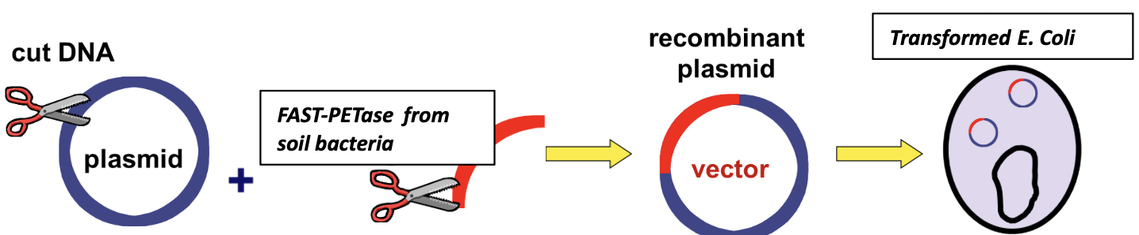
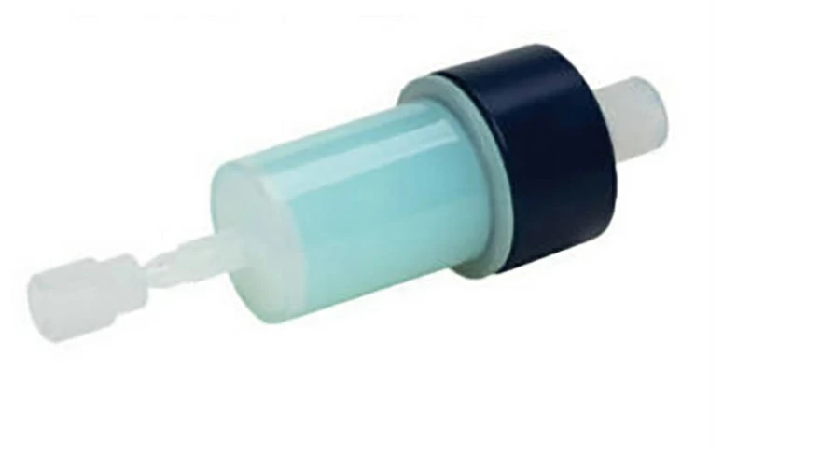






Producing a Plastic-Degrading Enzyme Using Bioengineered Escherichia coli
Katherine Duanmu, Maya Bergeron, Jomana Elghamrawy, Abigail Nunes, Sophia Velez, Dr. Enhua Wang
Academy of Notre Dame, Tyngsboro, Massachusetts, USA
‘
Abstract:
We propose using genetically engineered Escherichia coli to produce a type of enzyme: FAST-PETase which is involved in the plastic-degrading pathway.
Science Content:
Team Content
This is the first year NDA has formed a BioBuilder Team-NDA BioLancers. There are 5 members
We were excited to meet and learn from Dr. Hiroko Kaczmarek from the BioBuilder Learning lab at the Ginkgo Bioworks, Boston, MA. We did our first-ever bacterial transformation lab and the results came out beautifully!
And maybe some next steps:
The current stage of this project is to design E. Coli to produce the enzymes. We will conduct further literature research to identify more possible enzymes involving in the plastic degradation.
We will specify the details of the procedures eg: plasmid selection.
Part 1: Building a genetically engineered E. coli with FAST-PETase gene
Background:
Currently, plastic pollution is one of the biggest environmental issues people face. One of the solutions is to create a biodegradable plastic. Breaking down biodegradable plastic, compared with traditional petroleum-based plastic, is more energy-efficient and less time-consuming. Scientists have successfully created biodegradable plastic by mixing non-harmful chemicals: carbon dioxide and sugar. We are interested in the enzyme: FAST-PETase because it plays a major role in depolymerizing plastics very fast. Using genetically engineered Escherichia coli to produce this enzyme will make the degrading process more accessible and it can be implemented in small portable stations.
Part 2: Extraction and Purification Enzymes
References and acknowledgements
https://www.weforum.org/agenda/2017/10/scientists-have-made-biodegradable-plastic-from-sugar-and-carbon-dioxide/
https://phys.org/news/2017-06-scientists-plastic-sugar-carbon-dioxide.html
We’d like to thank our BioBuilder team Mentor: Dr. Ying Zhang from UCB BioSciences, INC, Cambridge, MA; BioBuilder program Ambassador: Yesenia Collins, Senior from Tyngsboro High School, MA
NDA BioBuilder team advisor: Dr. Enhua Wang
Part 3: Plastic degradation - purified enzymes in a liquid form mixing with plastics

