Slide 1



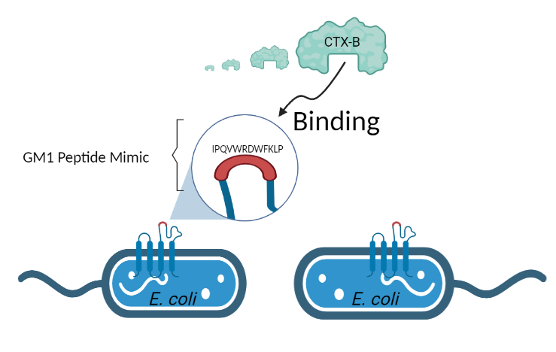
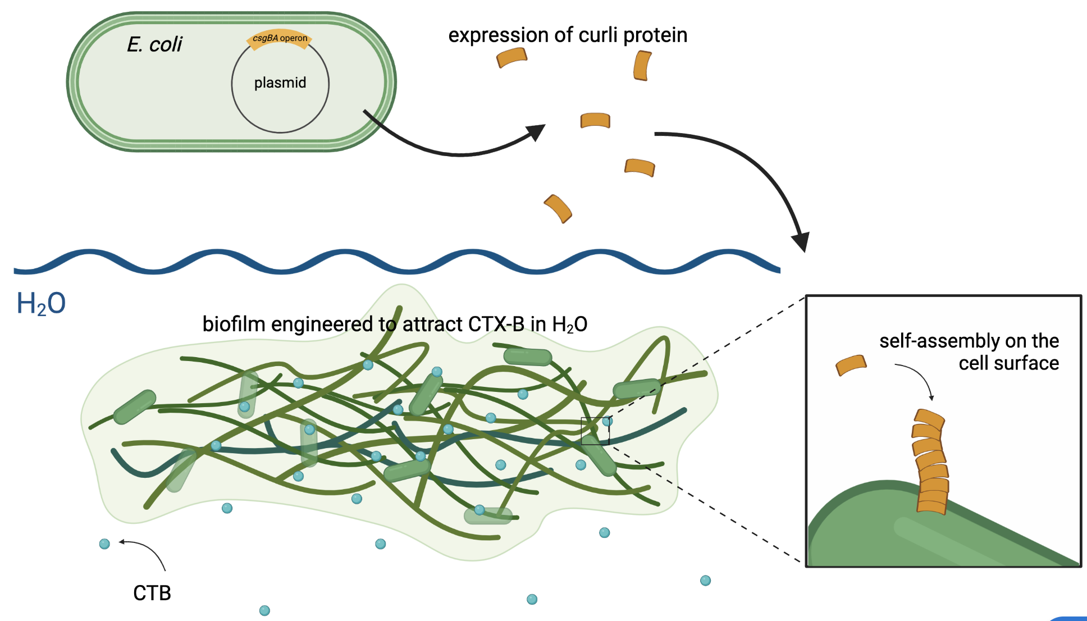





CTox-DTox
A novel method for the removal of cholera toxins
Austin Lo, Andrew Lee, James Kuo, Emma Shih, Ariel Lan, Yunho Chun, Josh Shih, Zoe Shong, Dr. Jonathan Hsu, Alex Barutis, Aya Kassem, Jarn Anowak
Taipei American School, Taipei, Taiwan
Introduction
Project Design
PROBLEM:
Cholera causes acute diarrhea in under-developed countries
Caused by infection in the gastrointestinal tract by Vibrio cholerae
~1.3 to 4 million cases each year (WHO)
BINDING CHOLERA TOXIN (CTX):
CTX, an AB5 toxin, consists of A & B subunits (CTX-B)
We will be working with CTX-B, which is non-toxic and binds to GM1 (monosialoganglioside on plasma membrane surface of animal epithelial cells)
GM1 ganglioside-like peptide sequence mimic, “IPQVWRDWFKLP” will also bind CTX-B (Yu et al., 2015)
Modify E. coli to display GM1 mimic using eCPX outer membrane display system to attract CTB (Bloois et al. 2011)
CURRENT SOLUTIONS:
Osmosis in large water treatment facilities
Sari cloth water filtration in India
Figure 1: Binding process of CTX-B to GM1 receptors using E.coli
GOAL:
Create a method of removing cholera toxin from contaminated water through engineered E. coli
BIOFILM PRODUCTION:
Curli operons (csgDEFG, csgBA) regulate biofilm formation through cell-cell and cell-surface adhesion
Curli proteins self-assemble on the membrane of E. coli and form biofilm
Utilized work from 2017 TAS iGEM
Figure 2: Formation of CTX-B-capturing-biofilm →

Slide 2
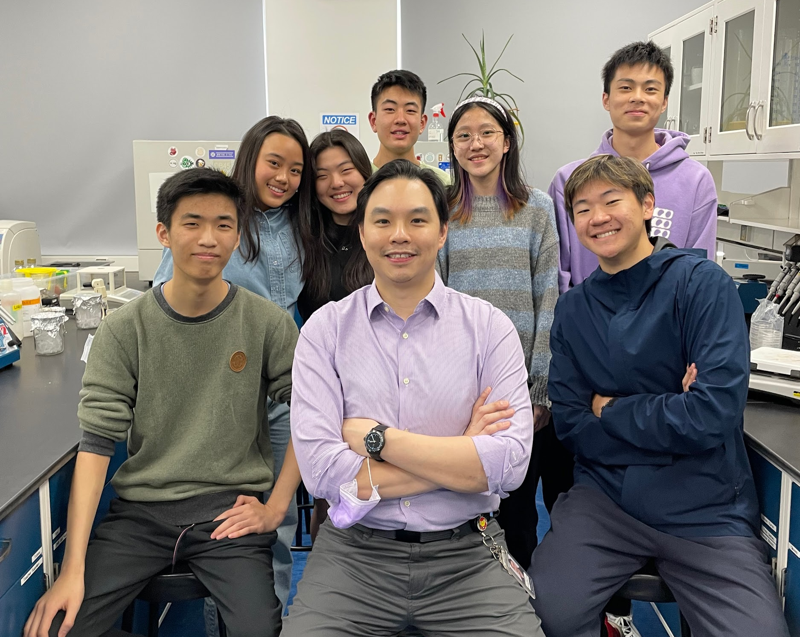
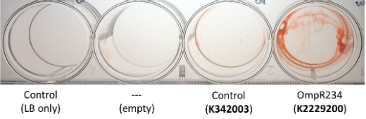
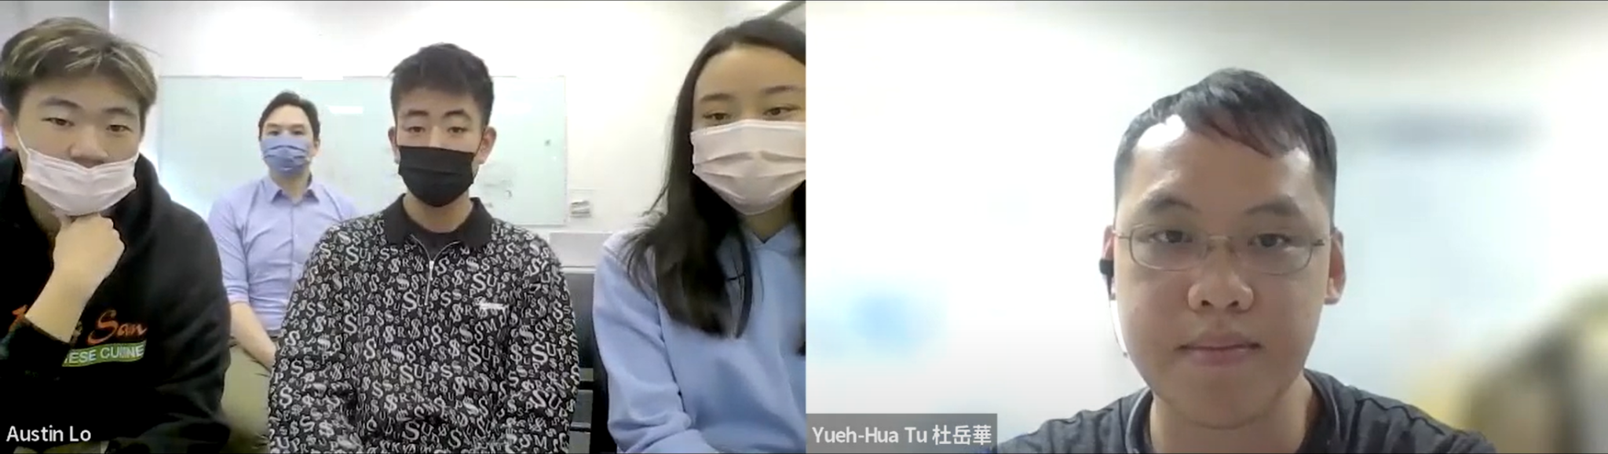
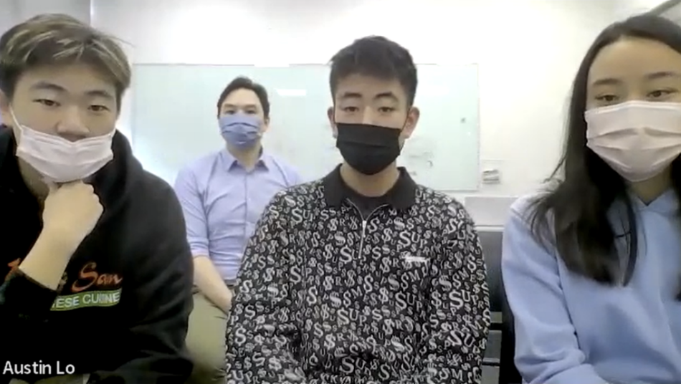
CTox-DTox
A novel method for the removal of cholera toxins
Austin Lo, Andrew Lee, James Kuo, Emma Shih, Ariel Lan, Yunho Chun, Josh Shih, Zoe Shong, Dr. Jonathan Hsu, Alex Barutis, Aya Kassem, Jarn Anowak
Taipei American School, Taipei, Taiwan
Planned Experiments
Future Work
Our Team
PROBLEM:
CTX-B Attachment:
Insert CTX-B domains into a solution with the biofilm to detect how well it attaches to it.
3D Printing Biofilm
Testing our the production of biofilm using a 3D printer
Produce biofilm through overexpression of csgD and OmpR234
Clone Gm1-mimic receptor in biofilm production strain
Test binding to CTX-B
Safety
Figure 4: Congo red assay stains biofilm (red) (TAS Taipei, 2017)
References
We are a team of 3 high school juniors, 4 seniors, and our mentor, Dr. Hsu
The Taiwan CDC recognizes CTX-B as a non-toxic subunit; however, obtaining a sample is still highly regulated.
We have spoken with CDC officials (Figure 3) and we started the application process of importing CTX-B from vendors.
The process requires a description of how and why we plan to use it as well as methods of disposal.
6. Beddoe, T., Paton, A. W., Le Nours, J., Rossjohn, J. & Paton, J. C. Structure, Biological Functions and Applications of the AB5 Toxins. Trends Biochem Sci 35, 411–418 (2010).
Cloning and expression of a cholera toxin beta subunit in Escherichia coli | Annals of Microbiology | Full
Text. https://annalsmicrobiology.biomedcentral.com/articles/10.1007/s13213-010-0062-z.
Slos, P. et al. Recombinant cholera toxin B subunit in Escherichia coli: high-level secretion, purification,
and characterization. Protein Expr Purif 5, 518–526 (1994).
van Bloois, E., Winter, R. T., Kolmar, H. & Fraaije, M. W. Decorating microbes: surface display of proteins
on Escherichia coli. Trends Biotechnol 29, 79–86 (2011).
Xu, Z. & Lee, S. Y. Display of Polyhistidine Peptides on the Escherichia coli Cell Surface by Using Outer
Membrane Protein C as an Anchoring Motif. Appl Environ Microbiol 65, 5142–5147 (1999).
Yu, R. K., Usuki, S., Itokazu, Y. & Wu, H.-C. Novel GM1 ganglioside-like peptide mimics prevent the
association of cholera toxin to human intestinal epithelial cells in vitro. Glycobiology 26, 63–73 (2016).
Cholera. https://www.who.int/news-room/fact-sheets/detail/cholera.
1.
Fattahi, S. et al. Relationship of biofilm formation and different virulence genes in uropathogenic Escherichia coli isolates from Northwest Iran. GMS Hygiene and Infection Control; 10:Doc11 (2015) doi:10.3205/DGKH000254.
Acknowledgements and References
Special thanks to Dr. Jonathan Hsu and Mr. Lowman, and Yueh-Hua Tu for their unwavering support.
Figure 3: Zoom meeting with Professor Yueh Hua Tu, former Taiwan CDC officer

