Slide 1
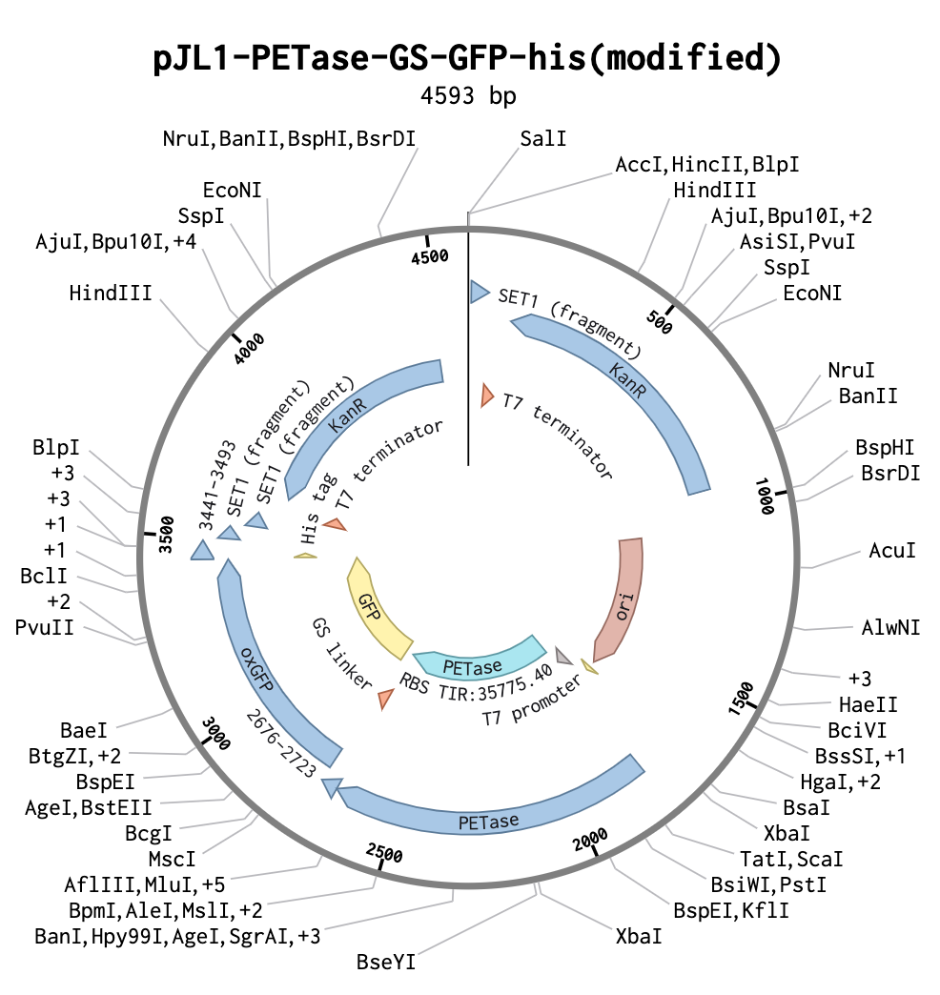
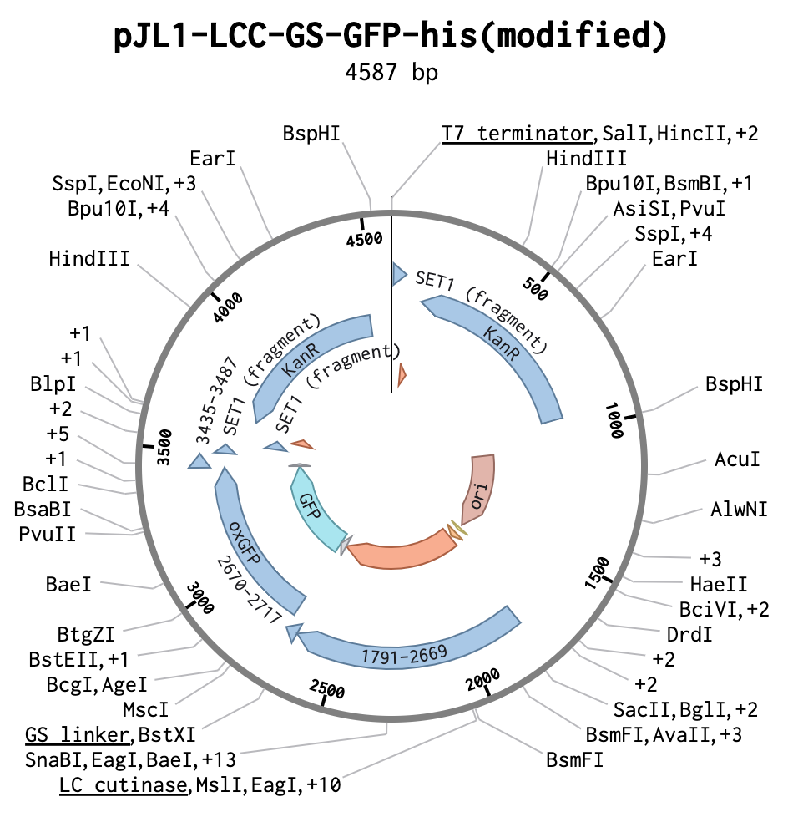
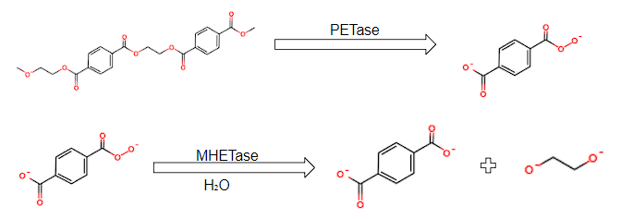
Evaluating the Efficacy of the PETase and Leaf Compost Cutinase Enzymes in Breaking Down Polyethylene Terephthalate Plastic in a Cell-Free System
Vismay Ravikumar, Evelyn Wheel, Hannah Lehmann, Megan Zhang, Aarit Chauhan, Miley Arora, Lindsey L’Ecuyer (teacher), Dr. Nathan Crook & Tianyu Li (NCSU)
Andover High School, Andover, MA, United States
Abstract
Plastic water bottles currently are made primarily from PET (polyethylene terephthalate), a plastic that does not degrade on its own and is polluting our oceans. The enzyme PETase can break down PET into its monomer, mono ethylene terephthalate, and then further into ethylene glycol(EG) and terephthalic acid(TPA) by the enzyme MHETase. Leaf Compost Cutinase(LCC) is an alternative enzyme that hydrolyzes PET into its monomeric parts, functioning at temperatures from 60 to 70 degrees Celsius. Using an engineered plasmid containing the DNA sequences for either PETase or LLC in a cell-free system, our project is a proof of concept analyzing the efficacy of these enzymes on PET substrate in powder and film form.
Methodology
The experiment uses two vectors, each containing the sequences for green fluorescent protein (GFP) and leaf compost cutinase (LCC) or PETase onboarded onto the pJL1 plasmid, with the kanamycin-resistant gene The vector will be expressed in a cell-free system, using BioBits pellets with a concentration of 25 to 50 ng/μl of water, and kanamycin.
We will be conducting the p-nitrophenyl Butyrate Assay to assess the enzymatic activity of PETase. In the assay, the ester bonds in PET plastic resemble those in p-nitrophenyl butyrate and thus are cleaved by the PETase enzyme, and then emit a wavelength of 405 nm. We will be creating a calibration curve for p-nitrophenyl using a spectrophotometer. Using this calibration curve, we will be able to determine the initial and final concentrations of p-nitrophenyl following the addition of the PETase enzyme. Lipase will be used as a control in the p-nitrophenyl Butyrate Assay to compare the PETase enzyme activity against.
Following the assay to confirm enzymatic activity, we will be using a mass-loss system to measure the enzymes in breaking down PET. We will be obtaining the substrate in two forms: as a 0.25 mm thick film and as a powder with a maximum particle size of 300 microns. We will experiment with differing amounts of the enzyme on the order of several microliters. To observe enzymatic activity on the PET film, we will be using a scanning electron microscope(SEM). While running the procedure with LCC, we will place the system into a 65 to 70-degree Celsius environment for optimal LCC activity.
Team Content
Our team is continuing a project started in 2019 by BioBuilder club members Krishnaveni Dole and Puloma Bishnu, put on hold due to the COVID-19 pandemic. Initially, our group sought to insert the vector into the Bacillus tianshenii, a gram-positive, spore-forming bacterium found in marine environments. However, after discussing this without mentor, we found that this bacteria was difficult to work and would likely reject our vector. Our group consists of 10+ people, with multiple members for whom this is their first year of BioBuilders. Working with our mentors from North Carolina State University, we worked together to design an assay and mass-loss experiment to measure the efficacy of the two selected enzymes in a cell-free system—feasible with the resources we have at our disposal.
Next Steps
Once we receive all our reagents, we will conduct the assay . We currently have the substrate, and are waiting on the plasmids to arrive. In the meantime, we will construct a calibration curve for p-nitrophenyl. Once we receive the plasmids, we will run the assay to determine if the enzymes are expressed, an expose the enzyme to plastic film and PET powder and record our observations via an SEM and record mass loss in our system. We will also vary the amount of enzyme we place on each quantity of substrate on the order of several microliters, and determine what the ideal temperature would be for maximum enzyme yield and activity.
Figure 2. Modified pJL1 plasmid with sequences for GFP, PETase, strong T7 promoter, and the kanamycin-resistant gene, assembled in Benchling. Figure 3. Modified pJL1 plasmid for LCC
Background and Introduction
Polyethylene terephthalate (PET) account for 78.8% of plastic found in water bottle. As PET is not biodegradable, they end up accumulating within the ocean: leading to roughly 500 million kilogram of plastic water bottles enter the oceans annually, and potentially causing the death of marine organisms due to ingestion or entrapment.
When PET is decomposed by PETase, the reaction yields the byproduct mono-(2-hydroxyethyl) terephthalate (MHET). This also must be broken down by the MHETase enzyme into environmentally benign, organic components: ethylene glycol and terephthalic acid.
Leaf Compost Cutinase (LCC), an alternative enzyme that degrades PET, is more reliable and is believed to be more effective in degrading PET than PETase (Csicsery, 2012).
Figure 4. Hydrolysis of p-nitrophenyl butyrate into p-nitrophenyl and butyric acid, enzymatically catalyzed
References and Acknowledgements
Figure 1. Decomposition of PET into MHET by PETase, and then of MHET to EG and TPA

Slide 3
Breaking Down Plastics
Using genetically modified enzymes to reduce plastic pollution in the ocean

Slide 4
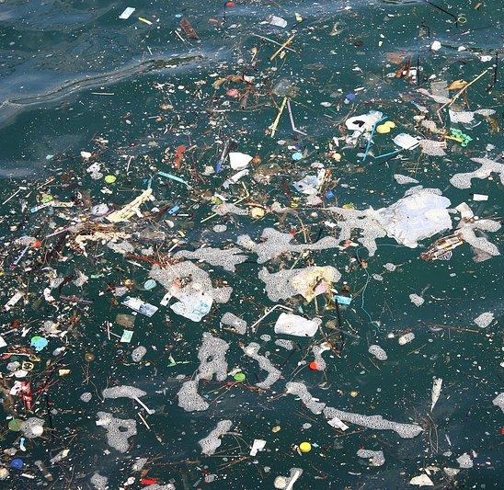
Plastics In The Ocean
There currently are 5.25 trillion pieces of plastic in the oceans (2019)
Take an average a millennia to decompose
Made primarily of PET (polyethylene terephthalate)
Used for clothes, manufacturing, and food/drink containers

Slide 5
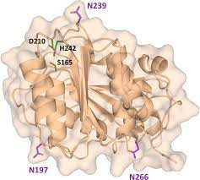
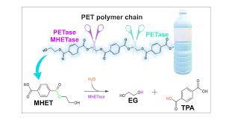
Enzymes
Leaf Compost Cutinase
PETase

Slide 6
BioBits™ can do this without cells
Freeze-dried, cell-free
Cell-free: contains the extracted cellular tools but no live cells
Freeze-dried: can ship and store at room temperature
What else do we need to add to BioBits™ pellets for transcription and translation to happen?
DNA + water
TM
Notes:
Typically TXTL happens in live cells (like our cells or how scientists do it in labs). What are the challenges of using live cells? Well, FD-CF overcomes a lot of that!

Slide 7
Plasmid Design for PETase
T7 promoter
Strong promoter because it is viral
Necessary for biobits
T7 terminator
Green Fluorescent Protein gene

Slide 8
Plasmid Design for LCC
T7 promoter
Strong promoter because it is viral
Necessary for biobits
T7 terminator
Green Fluorescent Protein gene

Slide 9
Assay
Adding GFP
Add enzymatic solution to 4-NPB
Will turn yellow when broken down
Emits light able to be picked up by a spectrophotometer

Slide 10
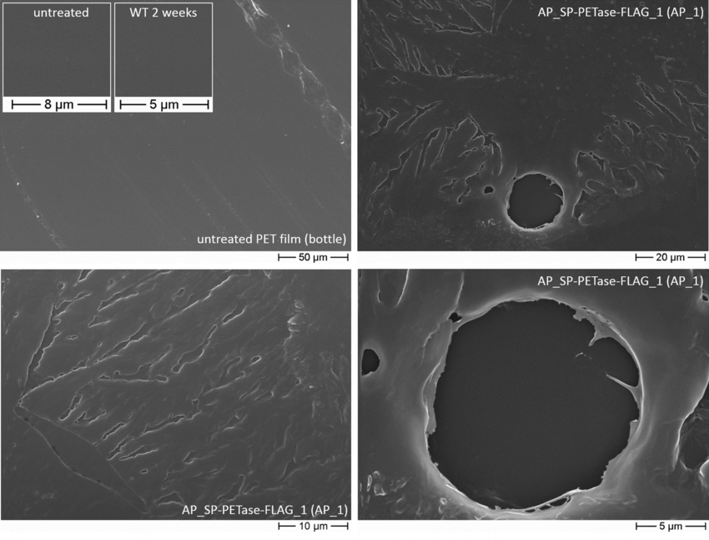
Experimental Design
Use cell-free, BioBits pellets to express enzymes from modified plasmids
Conduct pNP assay
Use micropipette to pipette several microliters of the enzymatic solution onto the PET substrate
Mass-loss system
Measure initial and final mass
SEM to observe PET at the molecular level
Was the polymer broken down?
For LCC, ensure the environment is between 65 to 70 degrees Celsius
Notes:
Past design
Problems: ocean isnt great for bacteria, pet does not work that well, water bottles are a wonky shape so enzyme may not have desired effect, sticking MHETase and PETase genes into cell is a lot of DNA
Using PETase enzyme to break down PET
PET→ MHET
Use MHETase to create organic substances
Bacillus thuringiensis

Slide 11
Citations

