Slide 1
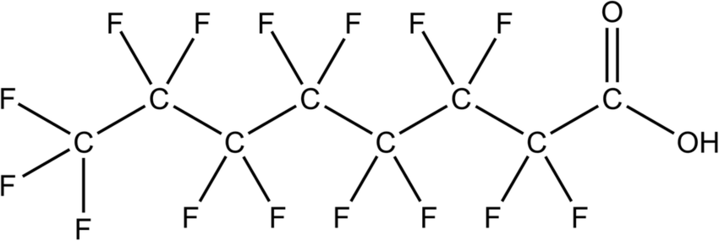
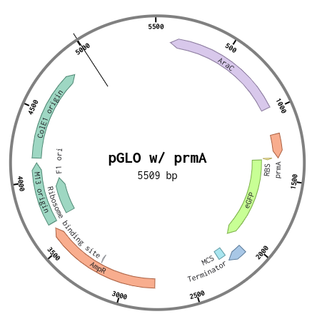
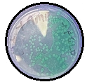
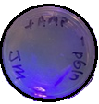
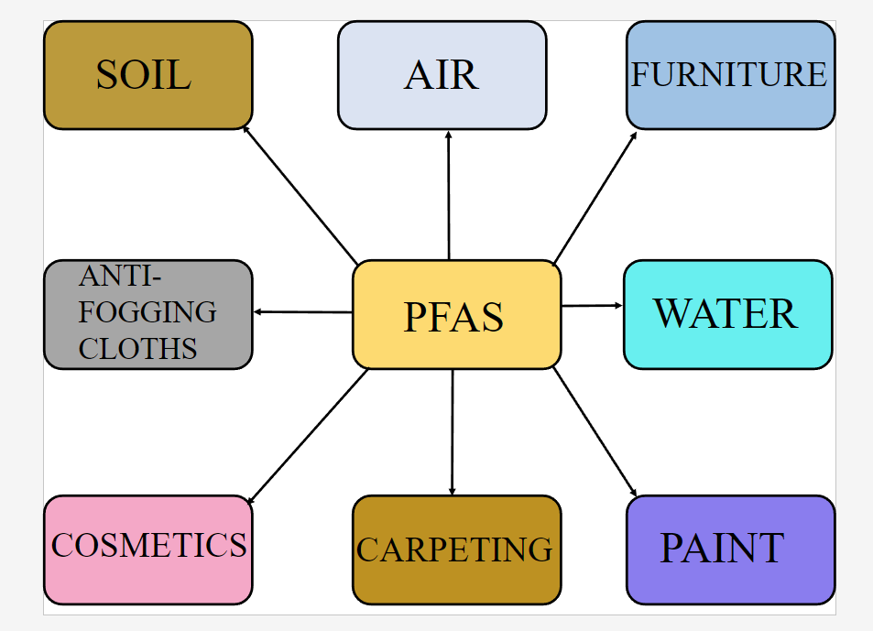
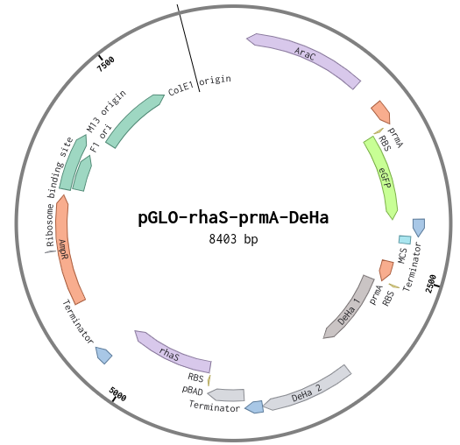
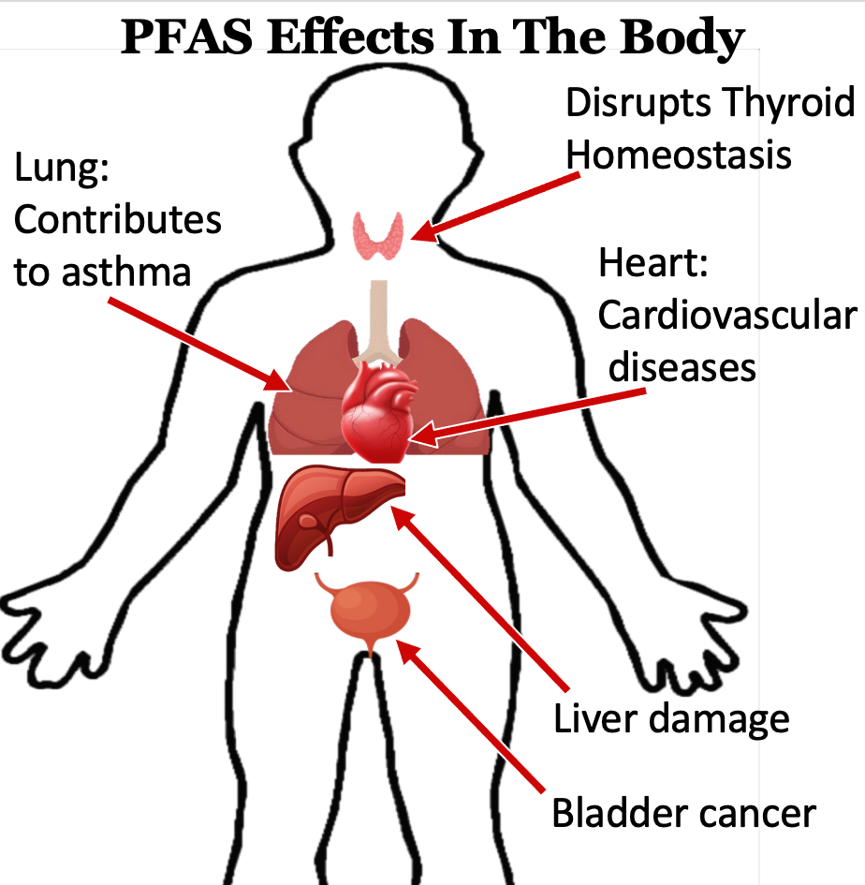
Water Treatment Degradation of Pfas
Exahel Castaneda, JoAnna Chaclan, Floricela Bravo, Juan Mendoza, Carolina Torres, Camillo Samano, Brandon Gonzalez, Kevin Cruz, Ana White, and (Sunflower Therapeutics).
Cross Keys High School, Atlanta, Georgia, United States of America
Abstract
Science Content/ Project Design
Our research focuses on addressing the significant health risk PFAS poses in drinking water [7]. Our study aims to find an effective method for PFAS degradation. To do this, we are incorporating a prmA promoter known to be activated by PFAS [9].and enzymes DeHa 1-2 known to degrade PFAS [5] into a plasmid which will be inserted into DH5 E.coli cells. After PFAS degradation we will then activate the kill switch gene in order for the bacteria to self-destruct. Our research represents a promising solution to diminish PFAS contamination and ensure the safety of drinking water..
Step 1: Proof Of Concept-Testing the Pfas Promoter
Experiment Description: Our plasmid design for proof of concept will contain the prmA promoter [9] with eGFP which will be transformed into E. coli, DH5α (Figure 2, Table 1). Our expected results would be the expression of eGFP from the bacteria containing our plasmid in the presence of ampicilllin and PFAS (Figure 1).
Testing activity of the prmA promoter | prmA | eGFP | AraBAD
Plasmid 1: Negative Control | - | + | -
Plasmid 2: Positive Control | - | + | +
Plasmid 3: Experimental | + | + | -
Introduction/Background
Figure 1: Expected Results: Would be the expression of eGFP in the presents of PFAS.These results are from our pGLO lab. On the left is the pGLO in LB ampicillim plates with arabinose added. On right is bacteria without the plasmid for pGLO.
Pre-polyfluoroalkyl (PFAS) are microplastics used in products capable of resisting heat, oil, and water. PFAS molecules contain strong bonds, making it difficult to degrade in the environment [2]. In addition, PFAS is both hydrophobic and hydrophilic, making it difficult to remove them from our drinking water with the current removal methods [3].
Table 1: Testing promoter prmA. Negative Control: The plasmid 1 contain eGFP but no promoter. Positive Control: The plasmid 2 contains a known working promoter (AraBAD) and a GFP. pGLO Plasmid- JQ064510.1; eGFP-JQ064510.1; prmA-Bba_K2911000.
Figure 2: Testing Promoter: The plasmid contains promoter (prmA) and a GFP.
Step 2: Testing Pfas Degradation Enzymes
Experiment Description: To test our enzymes DeHa 1 and DeHa 2 [5], our experimental enzymes will be inserted into our plasmids(Figure 3). The purpose of this assay will be to test the ability of our enzymes to breakdown PFAS. The expected results will help us determine which of the three is most effective.
PFAS exposure can be found in the environment and in various consumer products.
Testing activity of the enzymes | prmA | eGFP | DeHa1 | DeHa2
Plasmid 4 (Negative Control) | - | + | + | +
Plasmid 5 (Experimental) | + | + | + | -
Plasmid 6 (Experimental) | + | + | - | +
Plasmid 7 (Experimental) | + | + | + | +
PFAS
PFAS can enter our bodies through contaminated water and food consumption. In addition, exposure to PFAS through products containing PFAS also have adverse health effects. Furthermore, both long- and short-chain PFAS influence women's reproductive system and menstrual cycles by interfering with hormones among many other health issues [7]
eGFP
DeHa 1/2
Figure 3: Plasmid with enzymes DeHa1-2 inserted with the prmA promoter. In addtion, for Plasmid 10 which will contain the arabinose promoter with the kill-swtich gene RhaS.
Table 2: Testing Eznyme Activity. Plasmid 4-Negative contains no enyzme; Plasmid 5 is testing the activity of DeHa1 (WP_011137954.1), Plasmid 6 is testing activity of DeHa2 (BBaK3347002), and Plasmid 7 is testing activty of both together.
Figure 6: A schematic of the reporter gene. eGFP and the enzymes DeHa 1/2, which are enzymes that degrade Pfas into harmless materials both under the pmrA promoter with is activated by Pfas
Notes:
Labels 32 B- writing 26-28
References ~15

Slide 2
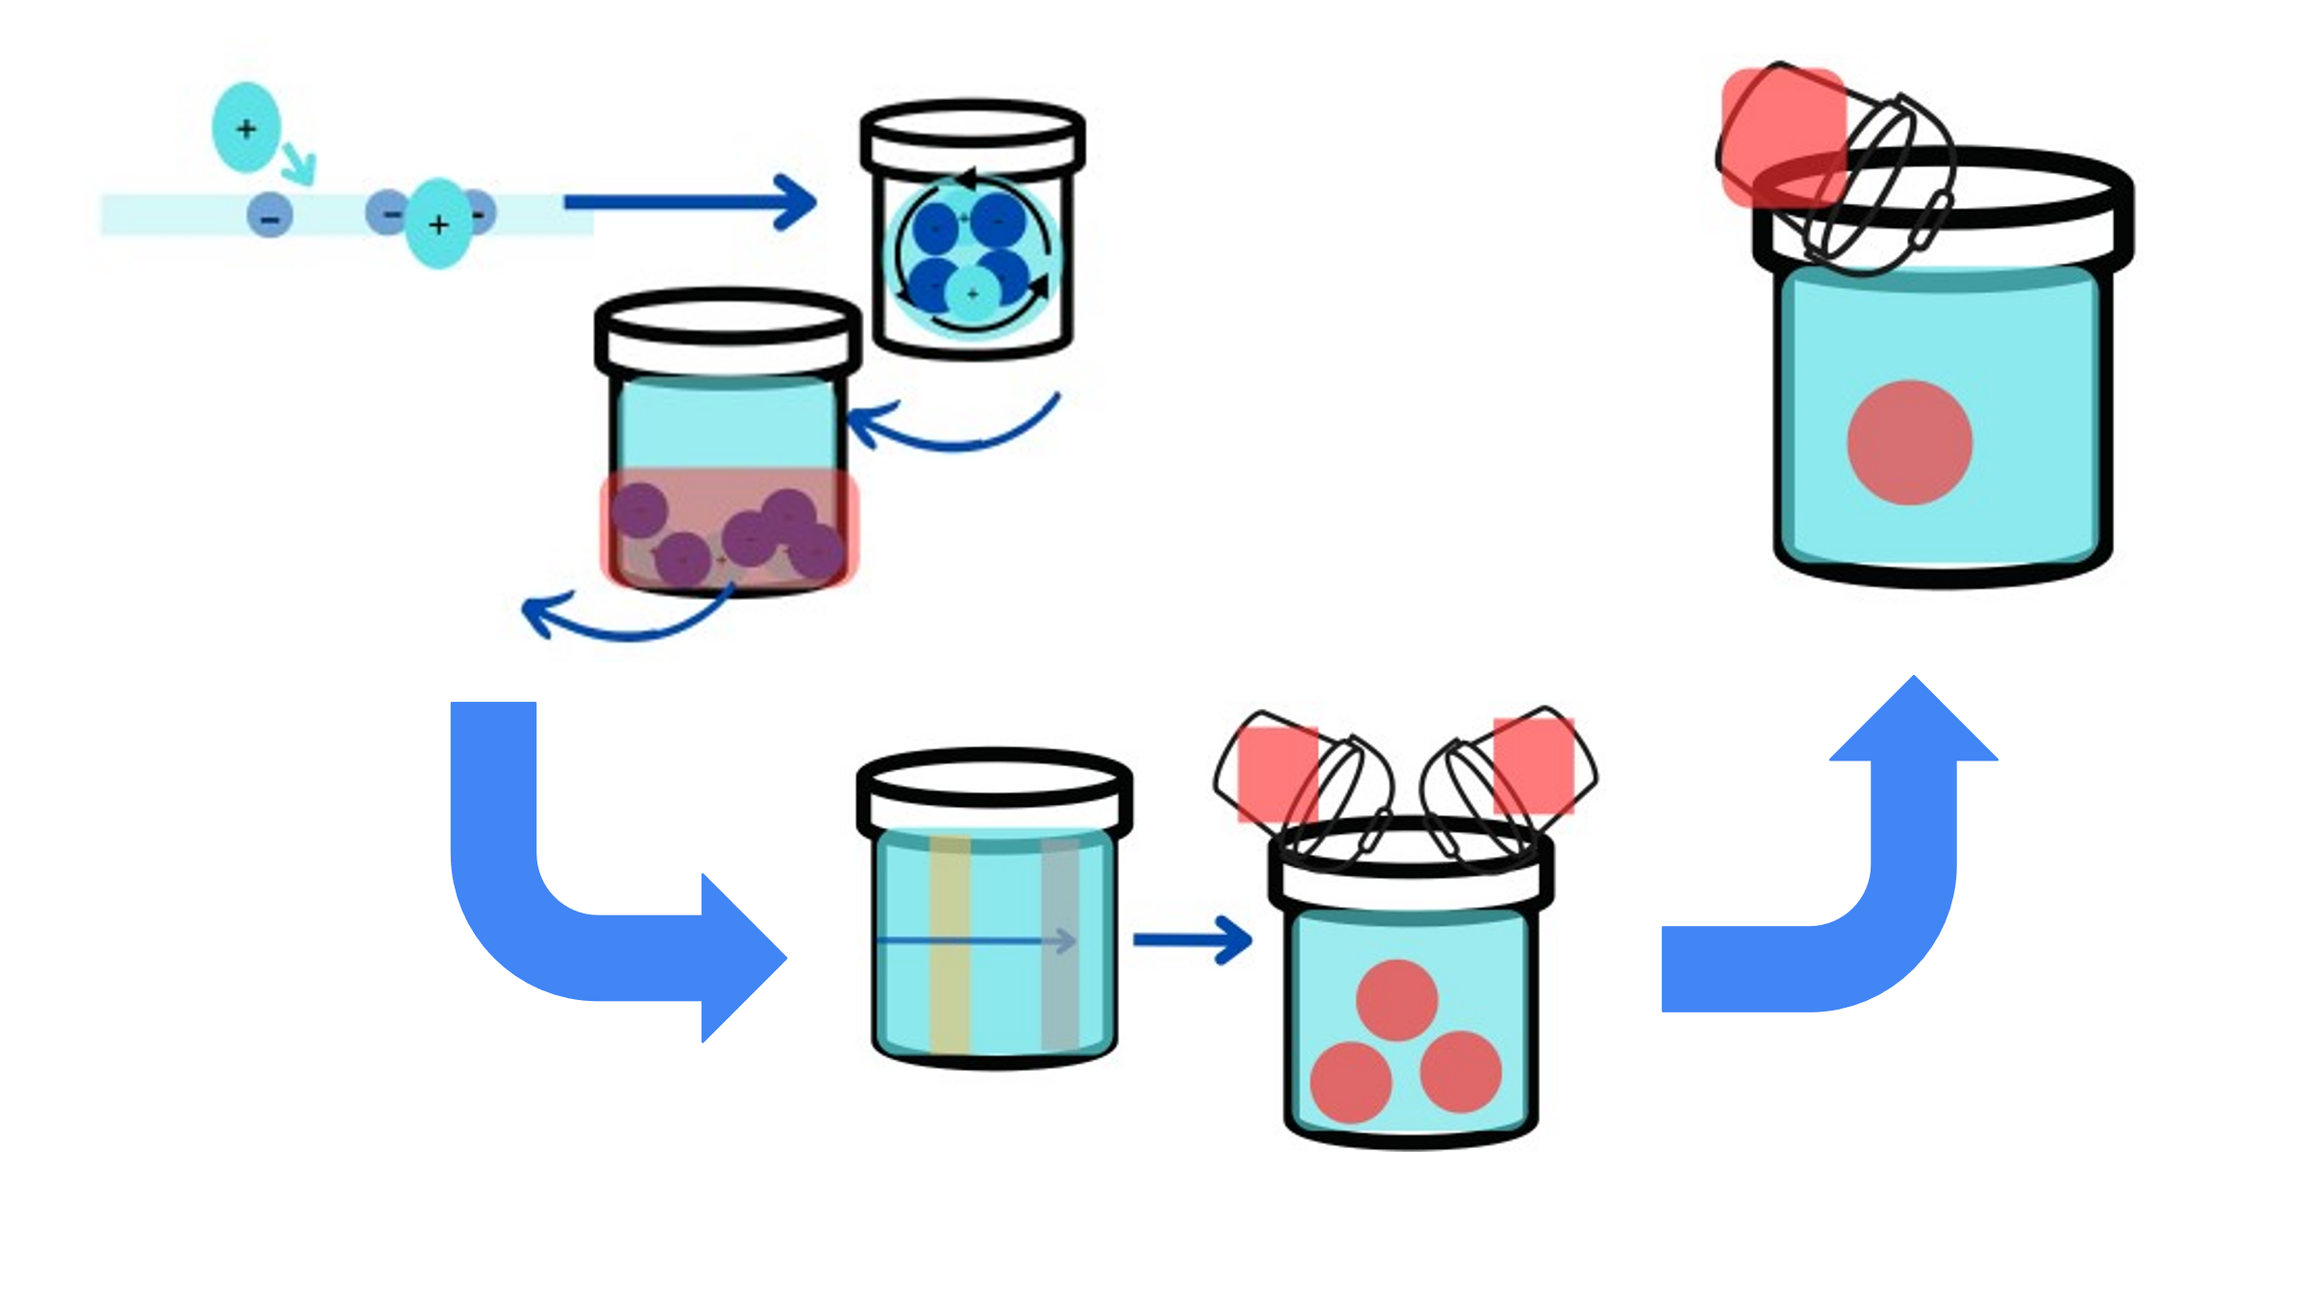
Water Treatment Degradation of Pfas
Exahel Castaneda, JoAnna Chaclan, Floricela Bravo, Juan Mendoza, Carolina Torres, Camillo Samano, Brandon Gonzalez, Kevin Cruz, Ana White, and Michael Sheets Sheets (Sunflower Therapeutics).
Cross Keys High School, Atlanta, Georgia, United States of America
Science Content/ Project Design
Next Steps
Testing activity of kill-switch Protein | AraC + pBAD | RhaS (Kill Switch Gene)
Plasmid 8: Negative Control | + | -
Plasmid 9: Negative Control | - | +
Plasmid 10: Experimental | + | +
Step 4: Integration of our system into the water processing system
We propose integration of our transgenic bacteria during flocculation, because during the last three stages of the processing system would kill the bacteria, and in the first stage, coagulation, small particles that could interfere with the destruction of PFAS.
1. Coagulation
2. Flocculation
Step 3: Testing the Self-destruct gene
Testing the self-destruct gene [6] in bacteria. The pBAD promoter with the rhaS gene will be added onto the plasmid design from step 2 with different arrangements of DeHa 1 and DeHa 2. The expected results will be an increase in PFAS broken-down content and decrease in bacteria after the addition of arabinose (Figure 3).
3. Sedimentation
6. Corrosion Control
Table 3: Testing kill switch gene. Plasmid 8 contains only the arabinose promoter . Plasmid 9 contains the kill-switch gene but no promoter. Plasmid 10 contain both promoter/ repressor for arabinose and the kill-switch gene.
Testing of System
Experiment Description: To test the efficiency of our system, our transgenic bacteria will be exposed to various concentration of PFAS (Figure 4).
Our hopes is that our system will effectively express the necessary enzymes to destroy PFAS during the water treatment process (Figure 6a). After PFAS has been effectively destroyed, arabinose (a simple sugar) will activate the bacteria to self-destruct, thus eliminating it from our water (Figure 6b).
4. Filtration
5. Disinfection
1. Coagulation: Positive charged coagulants are added to bond with negatively charged particles in the water. 2. Flocculation: Results in small particles colliding and merging into larger particles. 3. Sedimentation: Heavier particles settle to the bottom; sludge is formed and removed during sedimentation. 4. Filtration: Materials such as sand and gravel are filtered out. 5. Disinfection: During this step, chemical disinfectants are added (i.e. Chlorine or chlorine dioxide) killing the remaining bacteria, parasites, and viruses. 6. Corrosion Control: During the final step, corrosion control, the pH level is raised using caustic soda. It serves as a disinfectant and removes pollutants [8].
100 ppM
PFAS
200 ppM
PFAS
400 ppM
PFAS
800 ppM
PFAS
1600 ppM PFAS
Figure 4: Anayzing the efficacy of our system we will test under various concentrations of PFAS
PFAS
First step is to test the promoter prmA through eGFP expression when exposed to PFAS. [9]. After, we will test the DeHa 1 and 2 enzymes and decide upon which combination is most efficient. The efficient DeHa combination will then be tested with our kill switch, which the final expected results regarding a decrease in PFAS present. Gene sequences extracted from BioBricks, Plasmids designed in Benchling.
1st Cross Keys BiobuilderClub Team
Both genes are under the prmA promoter
eGFP
DeHa 1/2
Acknowledgements
Special thanks appreciation to Janet Standeven from Frugal Science at GaTech, in assisting and supported our process.
We would like to give thanks to Brookhaven Chick-Fil-A for assisting with funding raising.
Arabinose
B. Under the pBAD promoter
Kill switch gene
References
BBC_LT_Cross Keys_2024
Back row: Camillo Samano, Floricela Bravo, JoAnna Chaclan, Brandon Gonzalez, Juan Mendoza,
Front row: Carolina Torres, Exahel Castaneda, Kevin Cruz
Figure 6: A. A schematic of the reporter gene. eGFP and the enzymes DeHa 1/2, which are enzymes that degrade Pfas into harmless materials both under the pmrA promoter with is activated by Pfas. B. Kill-Switch gene (rhaS) under the arabinose promoter
Notes:
Labels 32 B- writing 26-28
References ~15

