Slide 1
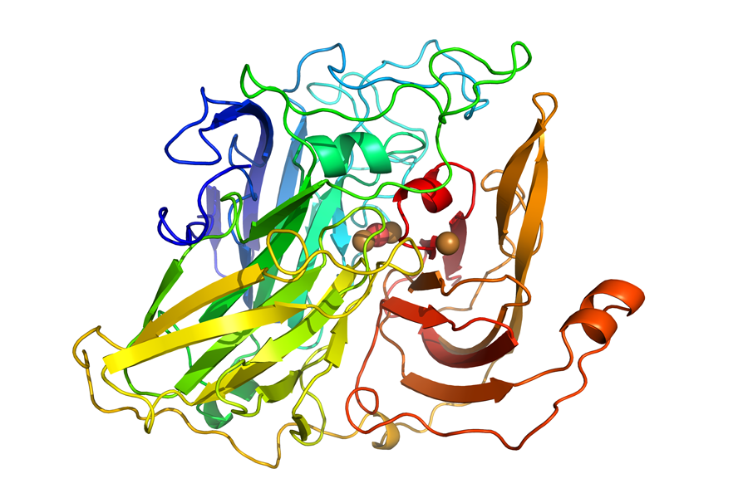
Vanillin Compound Production in Amycolatopsis sp. ATCC 39116 Bacteria
Lucy Park, Jeffrey Pan, Nina Pappas, Tyler Dong, Nicole Lu, Ethan Lee, Andrew Gong, Rayaan Padria, Ivan Cai, Ellie Wu, Dr. Miller, Mr. Mullins, Anna Li (Affiliation)
Westwood High School, Westwood, MA, US
Objective: Cut down cost and environmental impact of growing vanilla
Techniques: If the vanillin dehydrogenase is inhibited, less vanillin will be broken down which will increase the amount of vanillin produced by the vanilla plant overall. Additionally, the increased gene expression of laccase will allow vanillin to synthesize ferulic acid faster.
Technical needs/limitations: Currently impossible to produce sustainable vanillin on an industrial scale. Unable to maintain increased vanillin production for an extended period of time due to its weakening membrane as a result of the compound’s presence.
Expected Results: We expect the vanilla plant to be able to efficiently produce more vanillin and increase the prokaryote’s metabolism. This will lead to a larger amount of vanillin to be produced in a shorter time frame
Picture Sources: PubChem, BioMed Central, Gecco BioTech

