Slide 1
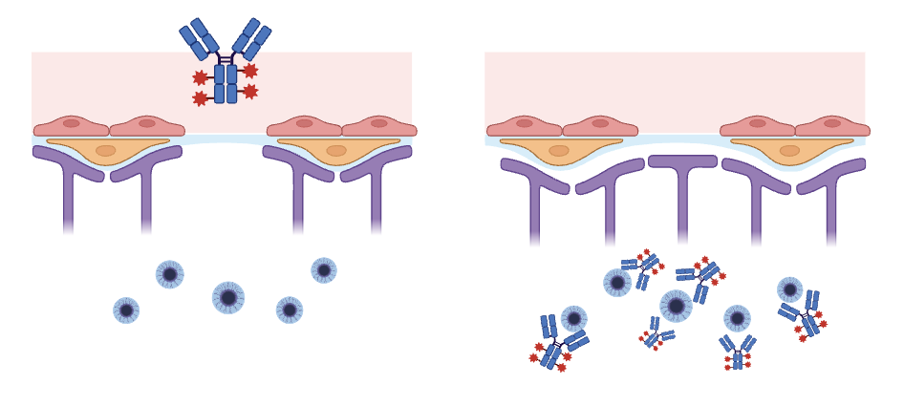
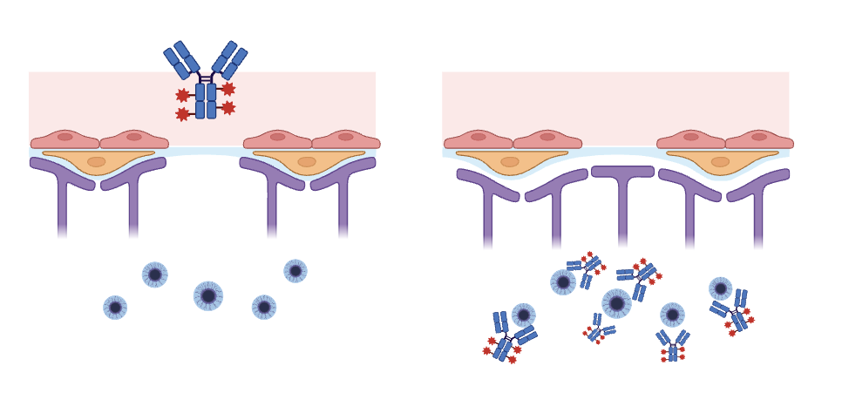
Slowing Parkinson’s Disease Progression With Biomimicry-Inspired Therapeutics
Ellie Tillman-Schwartz, Eva Odio, Mary Liu, Peter Horanyi, Ph.D.
Weston High School, Weston, MA, USA
Objective: develop a molecule with a unique approach to treating Parkinson's disease.
Techniques/plans: pass BBB using venom attached to antibody tag for immune clearance
Technical needs: engineer antibody-scorpion venom complex
Expected results: peripheral administration → shuttled through BBB → immune clearance
Limitations: unclear if antibody is too large to pass through BBB
Figure: antibody-venom complex passing through BBB and binding protein aggregates in brain.

