Slide 1


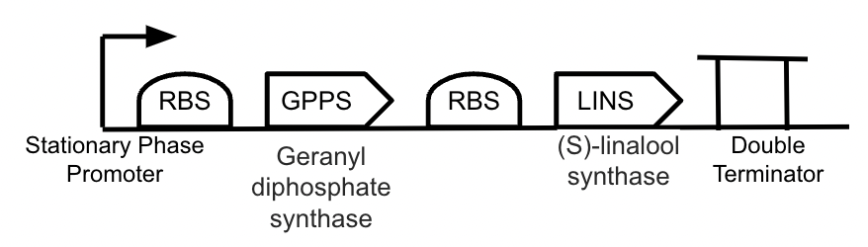
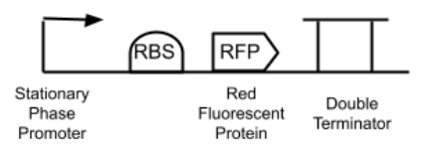
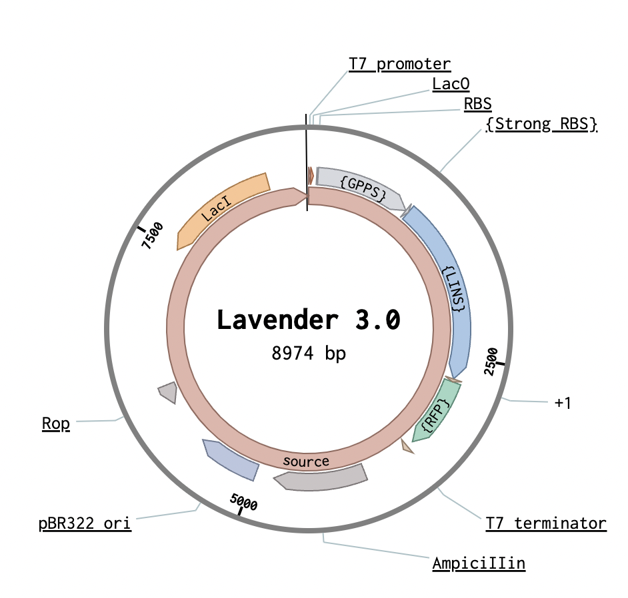
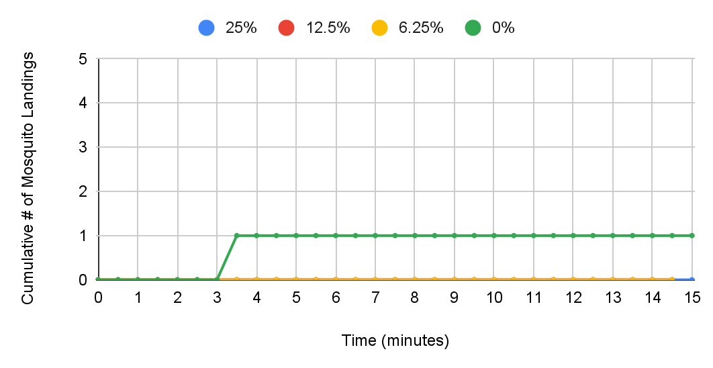
AliveSCENT: Engineering E. coli to Produce Linalool
Cavanaugh B., Collins T., Collins Y., Fugazzotto, E., Guilmette K., Meyyappan S., Patel M., Pelekoudas T.
Mentors: Rebekah Ravgiala & Michael Sheets
Tyngsborough High School, Tyngsborough, MA, USA
Objective
To engineer E. coli to produce (S)-linalool, a lavender-scented monoterpene, to act as a mosquito repellent.
Devices to be Inserted into pET Bacterial Recombinant Protein Vector backbone from VectorBuilder
AliveSCENT Plasmid
Results of Lavender Essential Oil as a Repellent Tests

