Slide 1
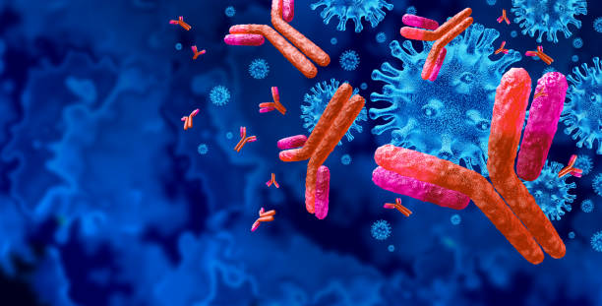
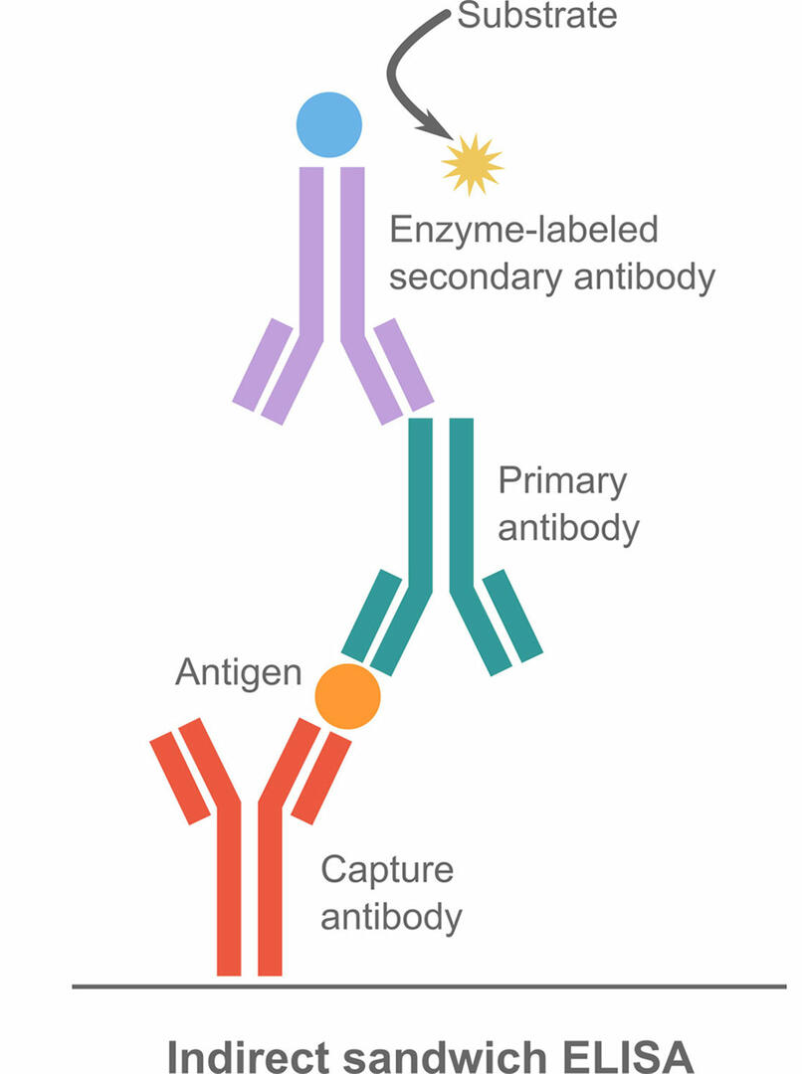
Sensor-Yeast: Creating a Widely Accessible Yeast Biosensor
Aishwarya Viswanathan, JoAnn Tu, Rishi Rao, Jons Jaison, Akshara Palaniswamy, Jessica Wu, Anaïs Ndione, Ella Rahimo, Angelina Kodudhula, Samiksha Saravanan
Teacher: Mrs. Rebecca Brewer; Mentor: Dr. Ben Steil (Arbor Biosciences)
Troy High School, Troy, MI, USA
Objective: insert a biosensor in the form of an E. coli antibody into yeast.
Techniques: yeast transformation, ELISA
Expected results: While the antibody may be integrated into yeast, it may be hard to get a sufficient response from the antibody to know its true effects on the yeast.

