Slide 1
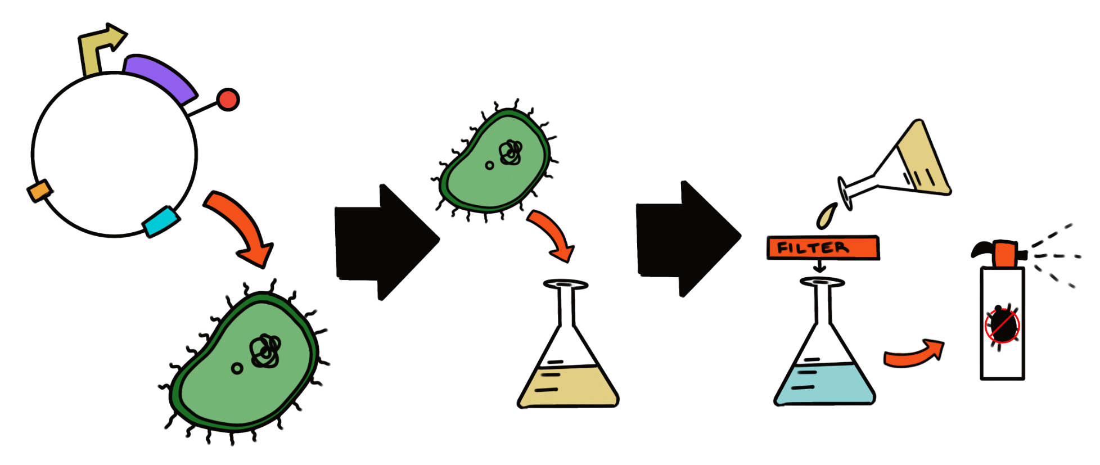
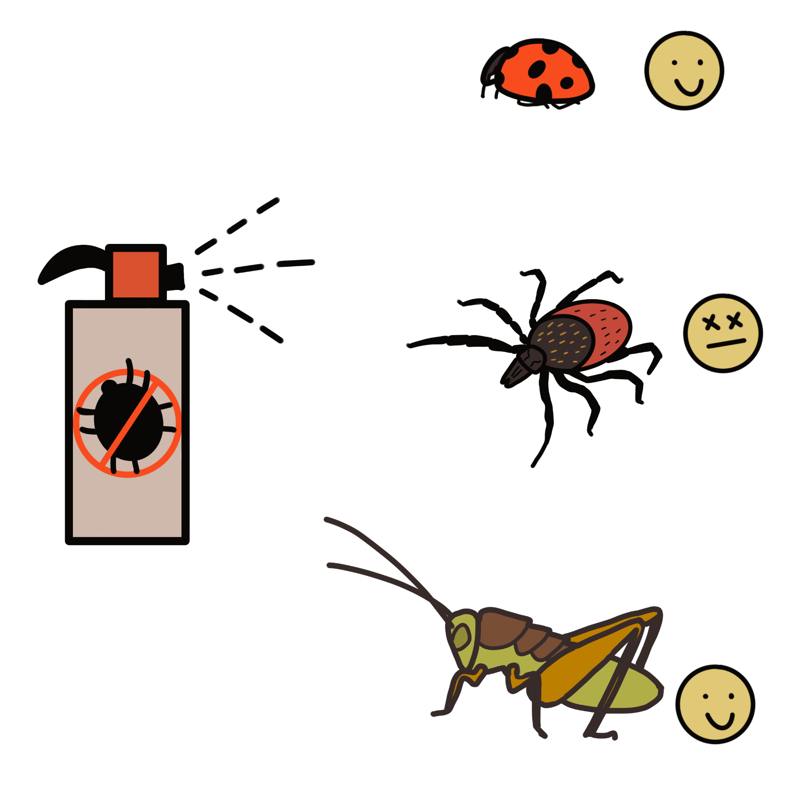
A fungal-derived enzymatic anti-tick spray: Targeting the Ixodes scapularis population
Celine Omega, Anna Childs, Evangeline Campbell and Natalia Ortiz. Dr. Beth Pethel. Maegan Plank (Union Chimique Belge)
Western Reserve Academy, Hudson, Ohio, United States of America.
2. Producing the enzymes to combine with an oil to create into a spray
Objective
Creating a spray people can use on their clothes or other areas that are susceptible to ticks to control the Ixodes scapularis population and reduce the spread of tick-borne diseases.
1. Cloning Chitinase and Lipase into Plasmids
3. Testing and creating final version of spray
4. Future Design Plans
Further testing is needed to determine the efficacy of the enzyme spray and verify that it will not cause harm to non-tick bugs, animals, or humans.

