Slide 1
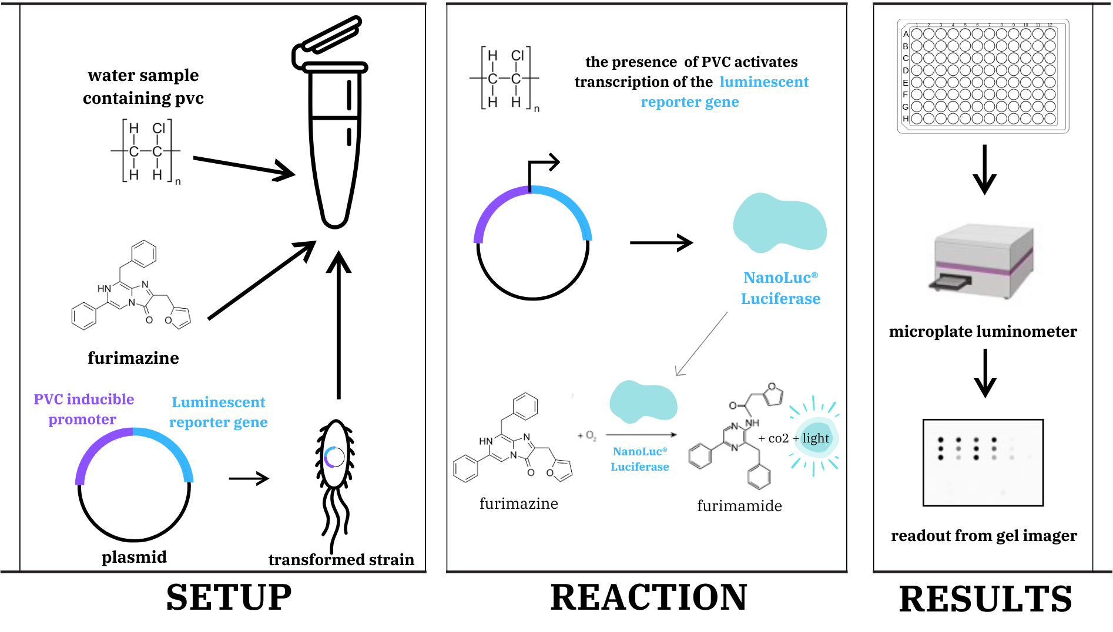
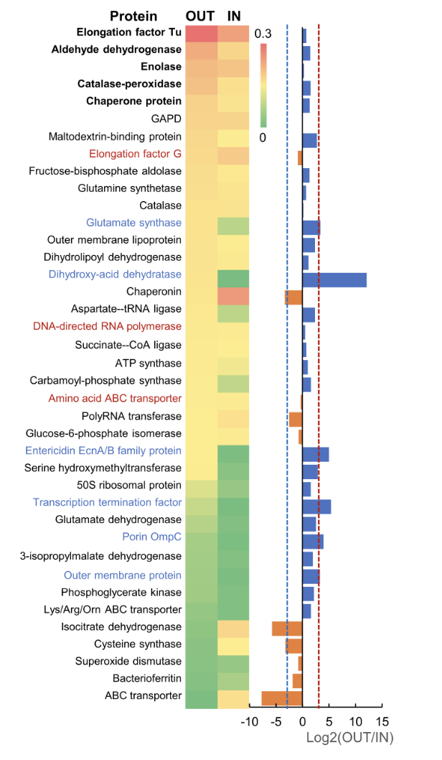
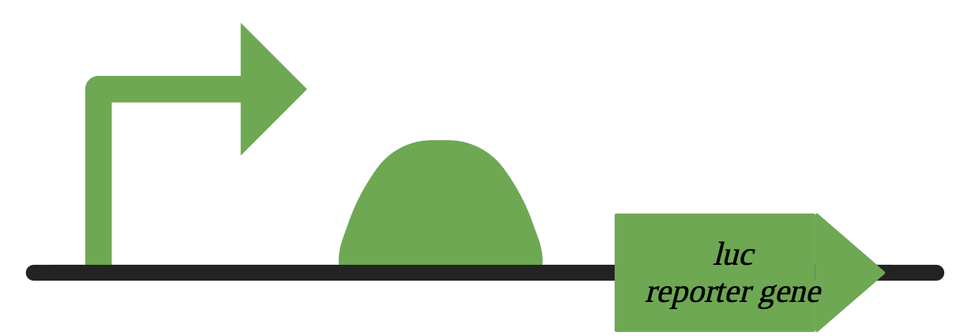
Detecting Polyvinyl Chloride
Soleil Hayes-Pollard, Chelsy Co, Sophie Wesemann
Isabella Wong, Haley Kim, Simrah Bawa, Roman Horowitz, Suvi Carlile, Tarik Hunt (Lanza Tech)
Brookline High School, Brookline, MA, US
Goal
How Our Biosensor Works
We aim to genetically engineer Escherichia coli (E. coli) to produce NanoLuc Luciferase in order to use it as a biosensor for indicating the presence of polyvinyl chloride (PVC).
Plasmid Construction
A research group in Zhejiang Province, China, conducted proteomics on a bacteria strain (Klebsiella sp. EMBL-1) in the gut of the larva of an insect pest. Their data depicts various proteins involved in the degradation of PVC; the most abundant are bolded.
Take gene sequence of the promoter in catalase-peroxidase (which can detect PVC)
—> insert into plasmid (clone promoter sequence)
—> IiInsert luciferase gene into plasmid downstream of the promoter (clone luciferase) —>
Insert newly engineered plasmid into E. Coli cell
Expected Results
SBOL visual
In the presence of PVC, luciferase is produced, visually verifying that PVC is present by measuring emitted light (detected through a microplate luminometer)
Notes:
Tools used:
-Built on previous research and knowledge of PVC- degrading enzymes and substances
-Specifically looked at research regarding biological substances and organisms that degrade PVC to investigate promoter then

