Slide 1
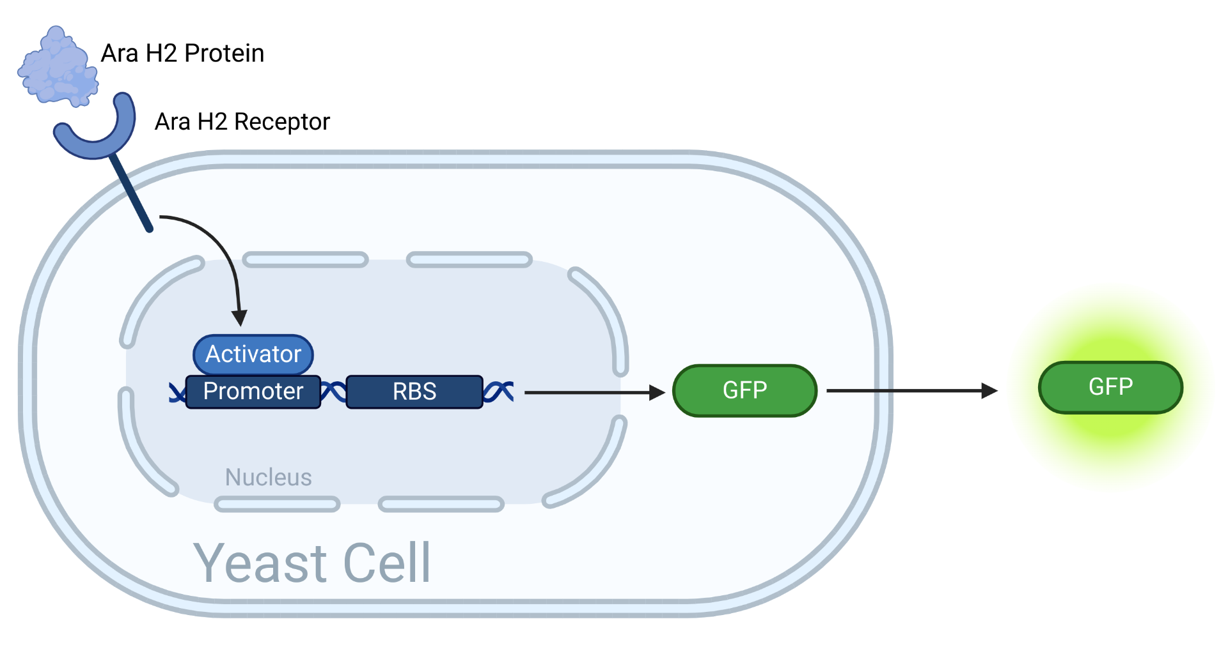
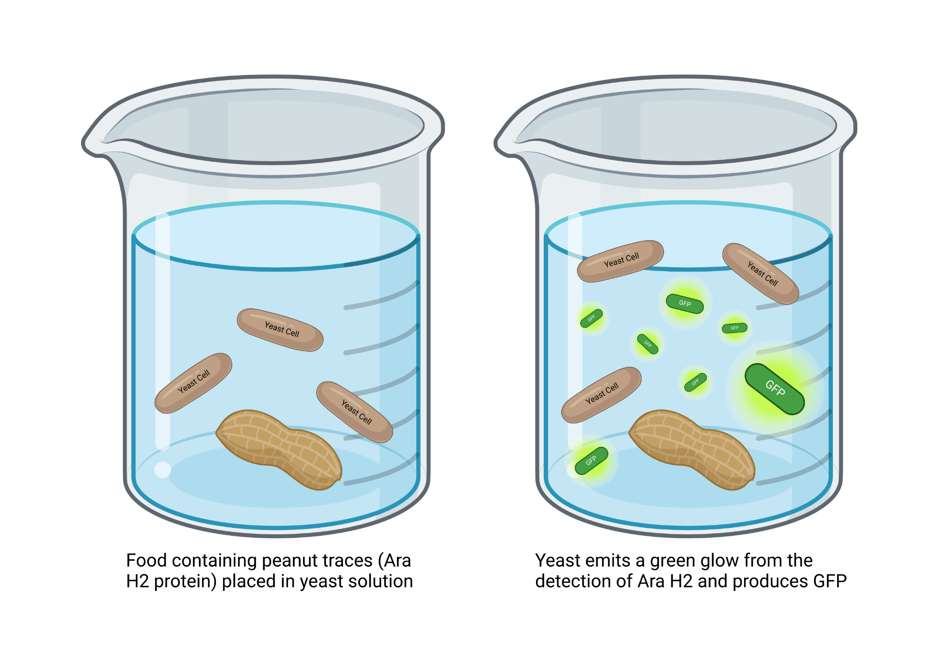
Developing a Whole-cell Biosensor and Bioreporter to Detect Peanut Allergens
Rachel Dunn, Siena Elliffe, Aneesa Maity, Tvesha Patel, Ruby Quintiliani, Liesl-Ann Vaz with Ms. Hanna, Ms. Ortiz, and Mr. Hia Ming (Boston University)
Montrose School, Medfield, MA, USA
Objective: The peanut allergy is among one of the most common allergies for adults and children. Our project assures that food is safely consumable for people with peanut allergies, using a portable biosynthetic biosensor and bioreporter for the detection of peanut traces in food samples by detecting Ara-H2.
Next Steps: To pursue this project, an experiment to test if the yeast reacts to the Ara-H2, which would then produce a green fluorescent protein (GFP) would need to be created. We then could determine the amount of Ara-H2 needed when reacting with the yeast. Additionally, we would then measure the amount of GFP released from the yeast cell.
Tools: We are using a yeast to react with the Ara-H2, which creates the GFP. We would need to determine the base amount of Ara-H2 in a peanut product to be able to set off the GFP, so a limitation of our product would be that some peanut products may not contain enough Ara-H2 to produce the GFP.
Results: The results of this project are predicted to be that the green fluorescent protein GFP should shine its green color when it comes into contact with the Ara-H2.

