Slide 1
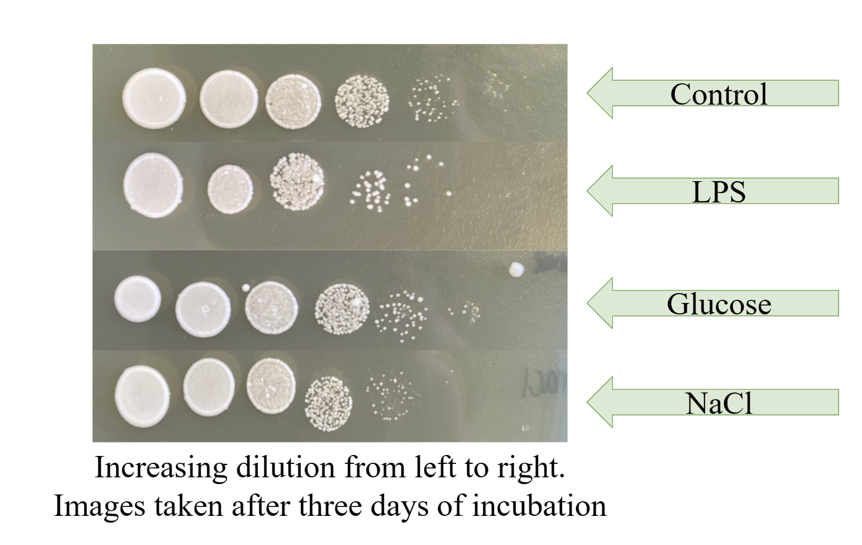
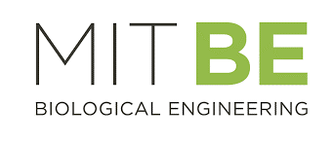
Detecting S. typhi with Engineered Yeast
Hana Shinzawa, Cate Lynch, Leslie Baker & Rosalia Reale
Montrose School, Medfield, MA, USA
Objective: To detect Salmonella typhimurium contamination in food and water with a yeast-based system.
Advantages of a yeast-based system: Can self-regenerate, safe to use in homes, and easy to store (similar conditions to a sourdough starter)
Experimental results: Bacterial LPS appear to slightly decrease the viability of the yeast, but the yeast (S. cerevisiae) was able to survive contact with the LPS, suggesting that it is a suitable choice for our system.

