Slide 1

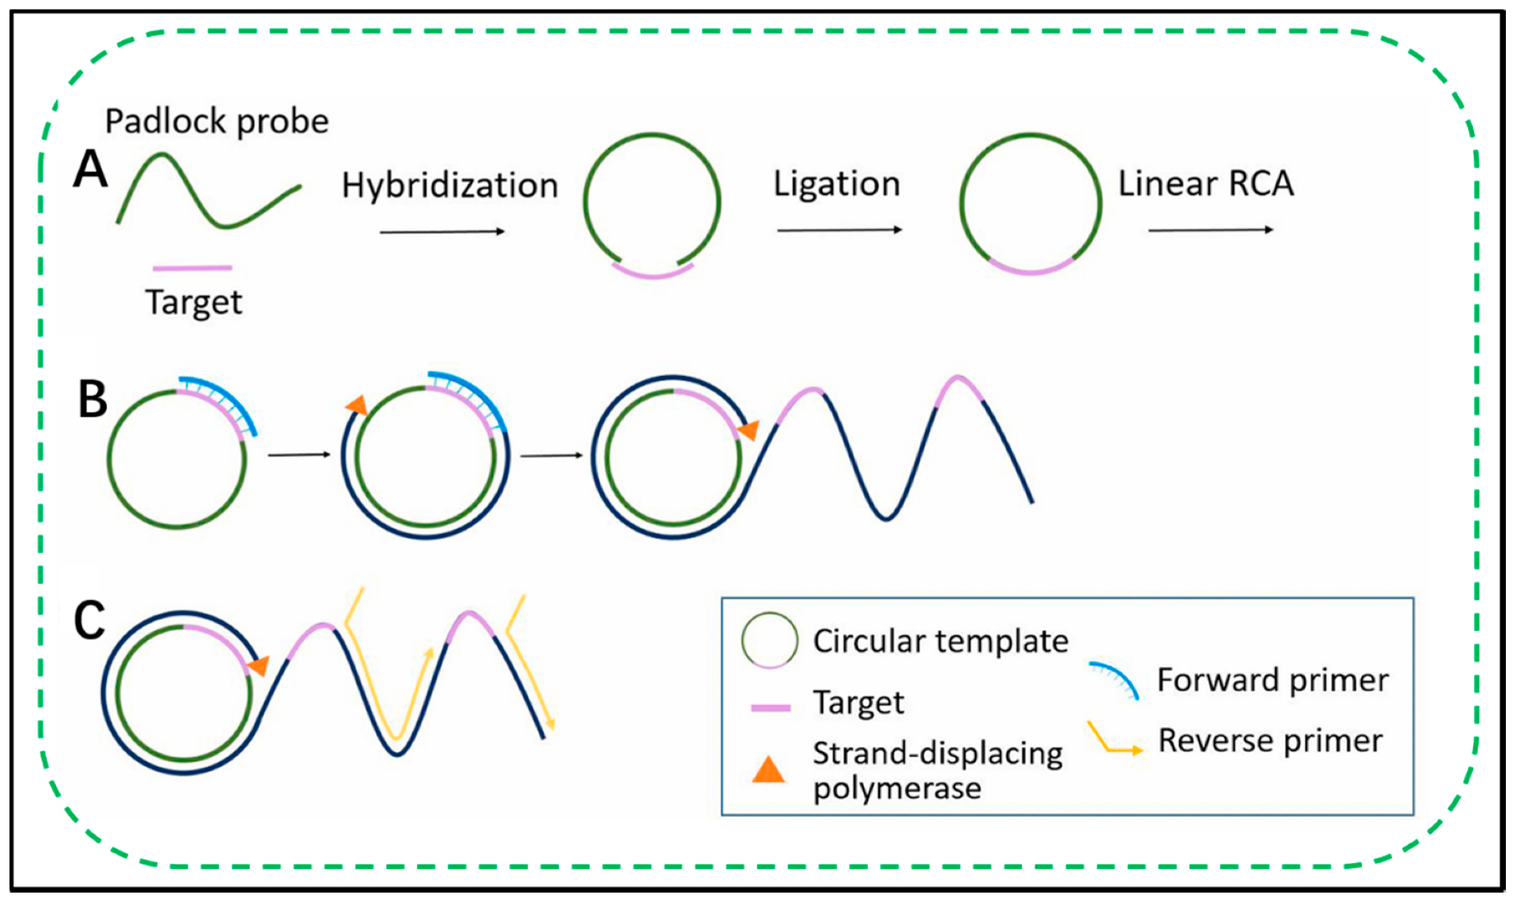
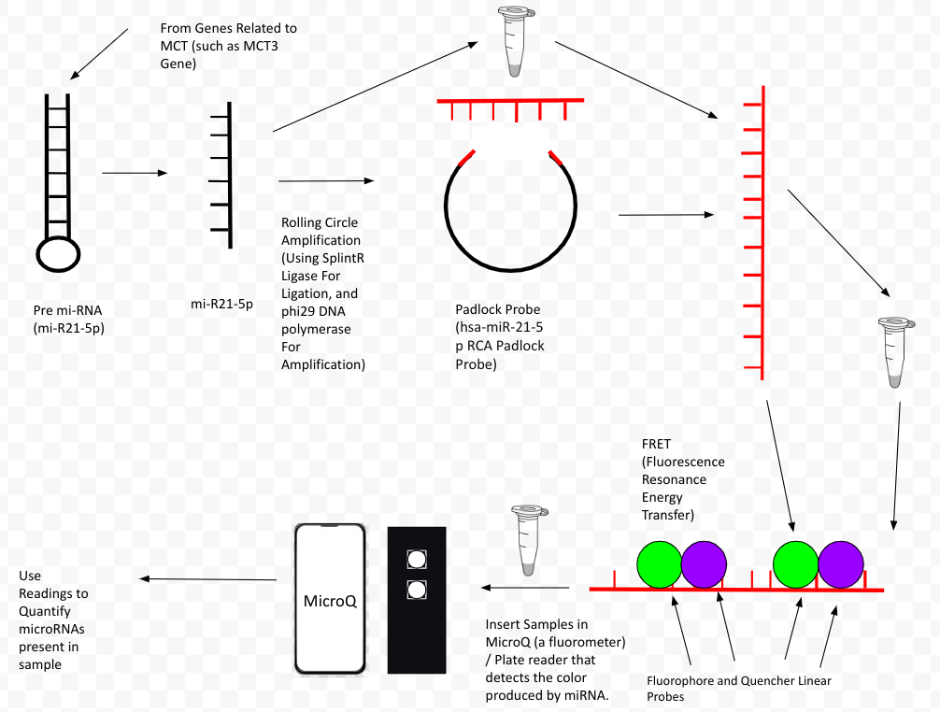
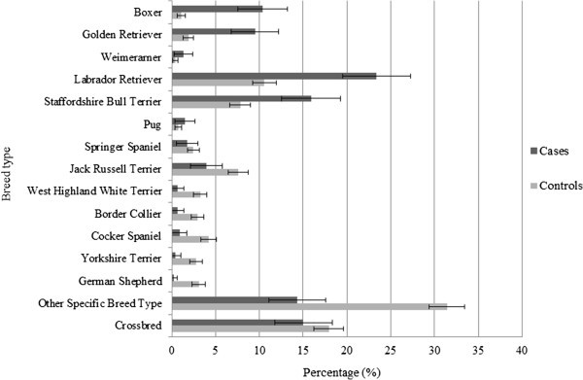
How miRNA biomarkers can be used to detect / quantify Mast Cell Tumors in Canids
Members: Reva Badkundri, Skanda Bharadwaj, Varsha Chennam, Eshawnvie Kallu, Sarvesh Krishnamoorthy, Matthew Murad, Naga Sahithi Rajuladevi, Arav Raghunathan, Yeryn Song, Swadha Surange
Advisers / Mentors: Mrs. Catherine Sharer, Ms. Caroline Matarrese, Mr. Sussmit Chowdhury (GT), and Mr. Maxwell Kazman
Lambert High School, Suwanee, GA, USA
Objective: Utilize miRNA biomarker miRNA-21 to understand the presence of Mast Cell Tumors in Canids
Plan: Use Lambert iGEM’s Rolling Amplification and FRET processes on collected saliva from canids to quantify the upregulation of miRNA-21.
Expected Results: Our team expects to see decrease fluorescence produced from the RCA process, signifying the upregulation of miRNA-21

