Slide 1

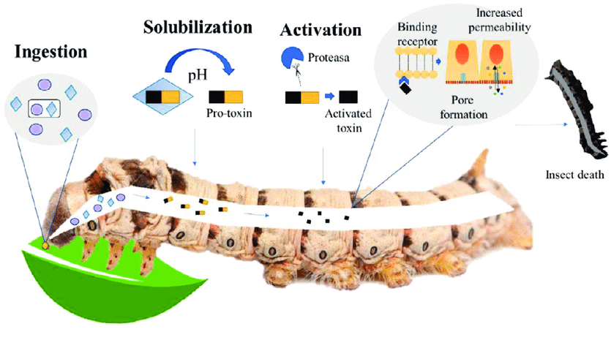
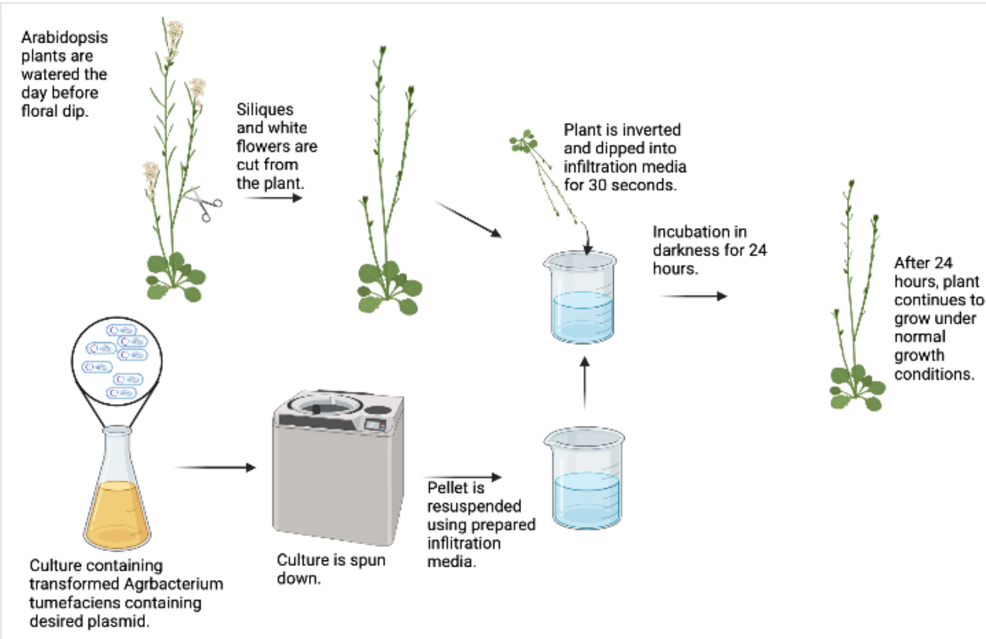
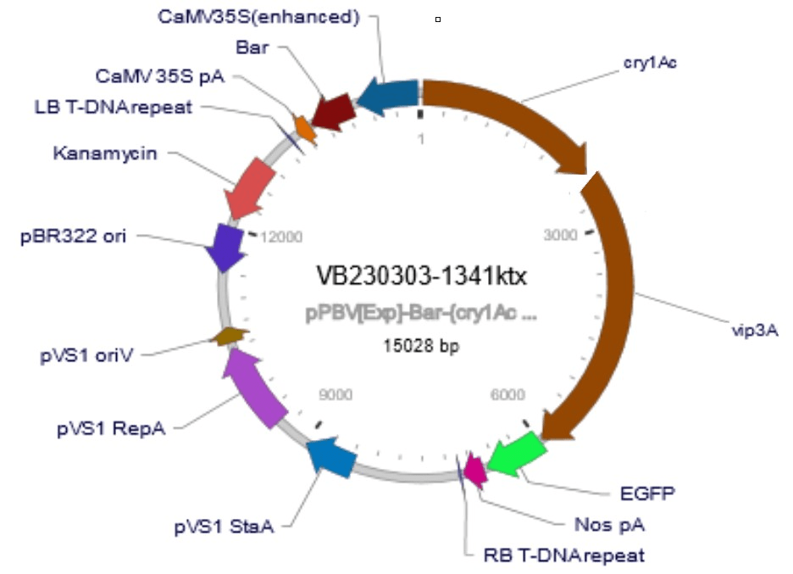
Poison Broccoli
Saisiri Akarapu, Kensley Burke, Sasha Chelnokov, Jenny Christopher, Sean Lee, Vedant Mehta, Rachna Murugula, Shashank Ramireddy, Aarushi Verma, and Sankalp Yeleti, Kate Sharer (Teacher) and Caroline Matarrese (Teacher), Carine Robichon-Iyer (Mentor)​
Lambert High School, Suwanee, Forsyth County, Georgia
The objective of our project is to genetically engineer plants from the Brassica family in order to prevent Diamondback moths from eating them.
We plan to insert the proteins cry1Ac and vip3Aa, which are toxic to moths, into the plants by floral dipping the seeds.
We will need restriction enzymes that will be able to cut our Ti plasmid and insert the genes as well as a solution with the modified plasmids to insert into plants via floral dipping.
The limitations of our tools are that we are not aware of the proper enzymes yet and will need to purchase the created plasmid.
We expect money lost in the agriculture industry to decrease over time as our transgenic plant becomes more widespread.

