Slide 1
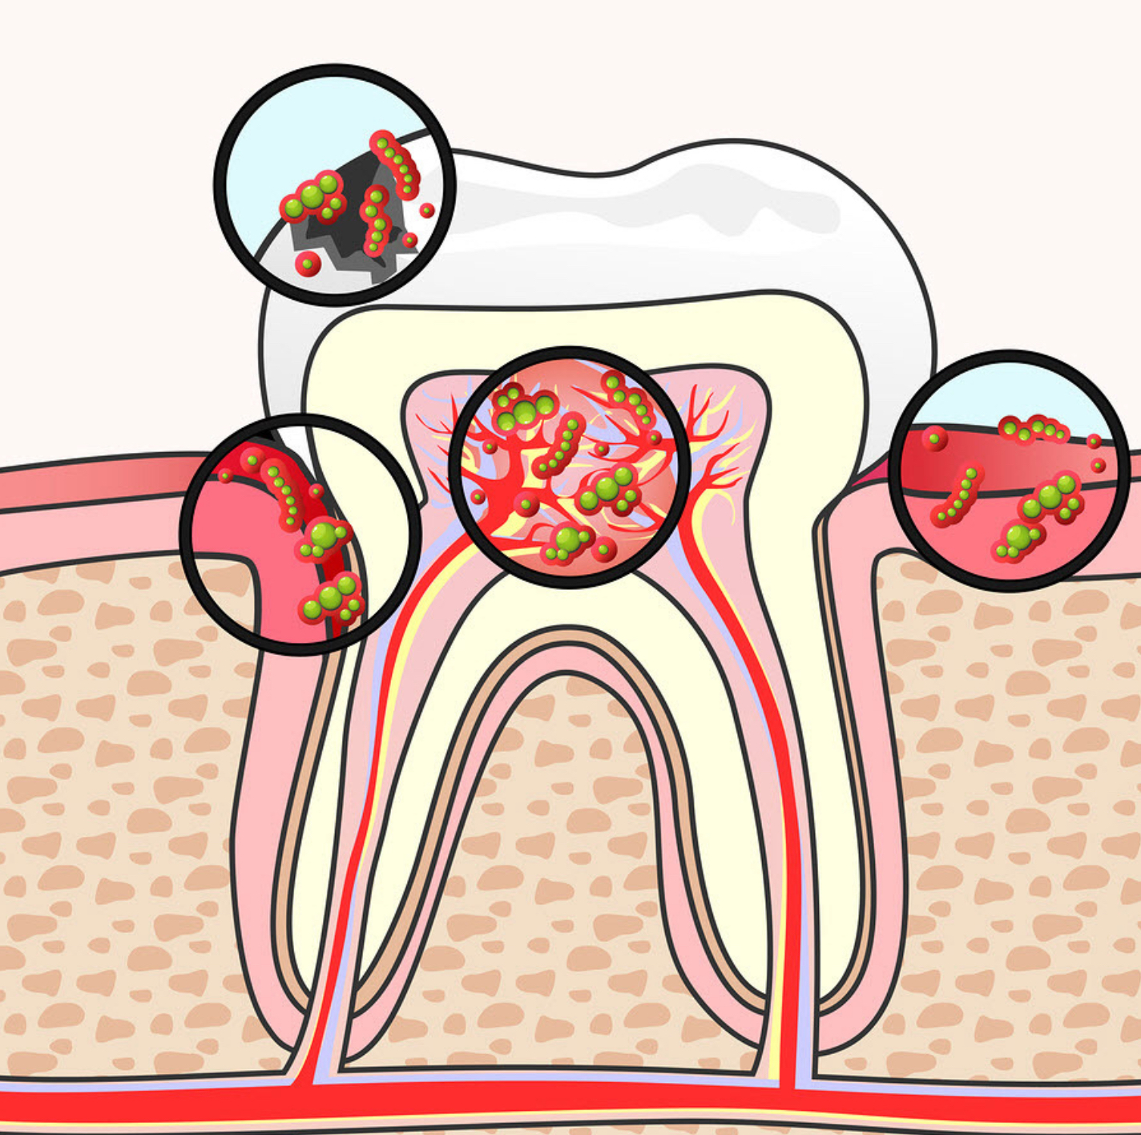
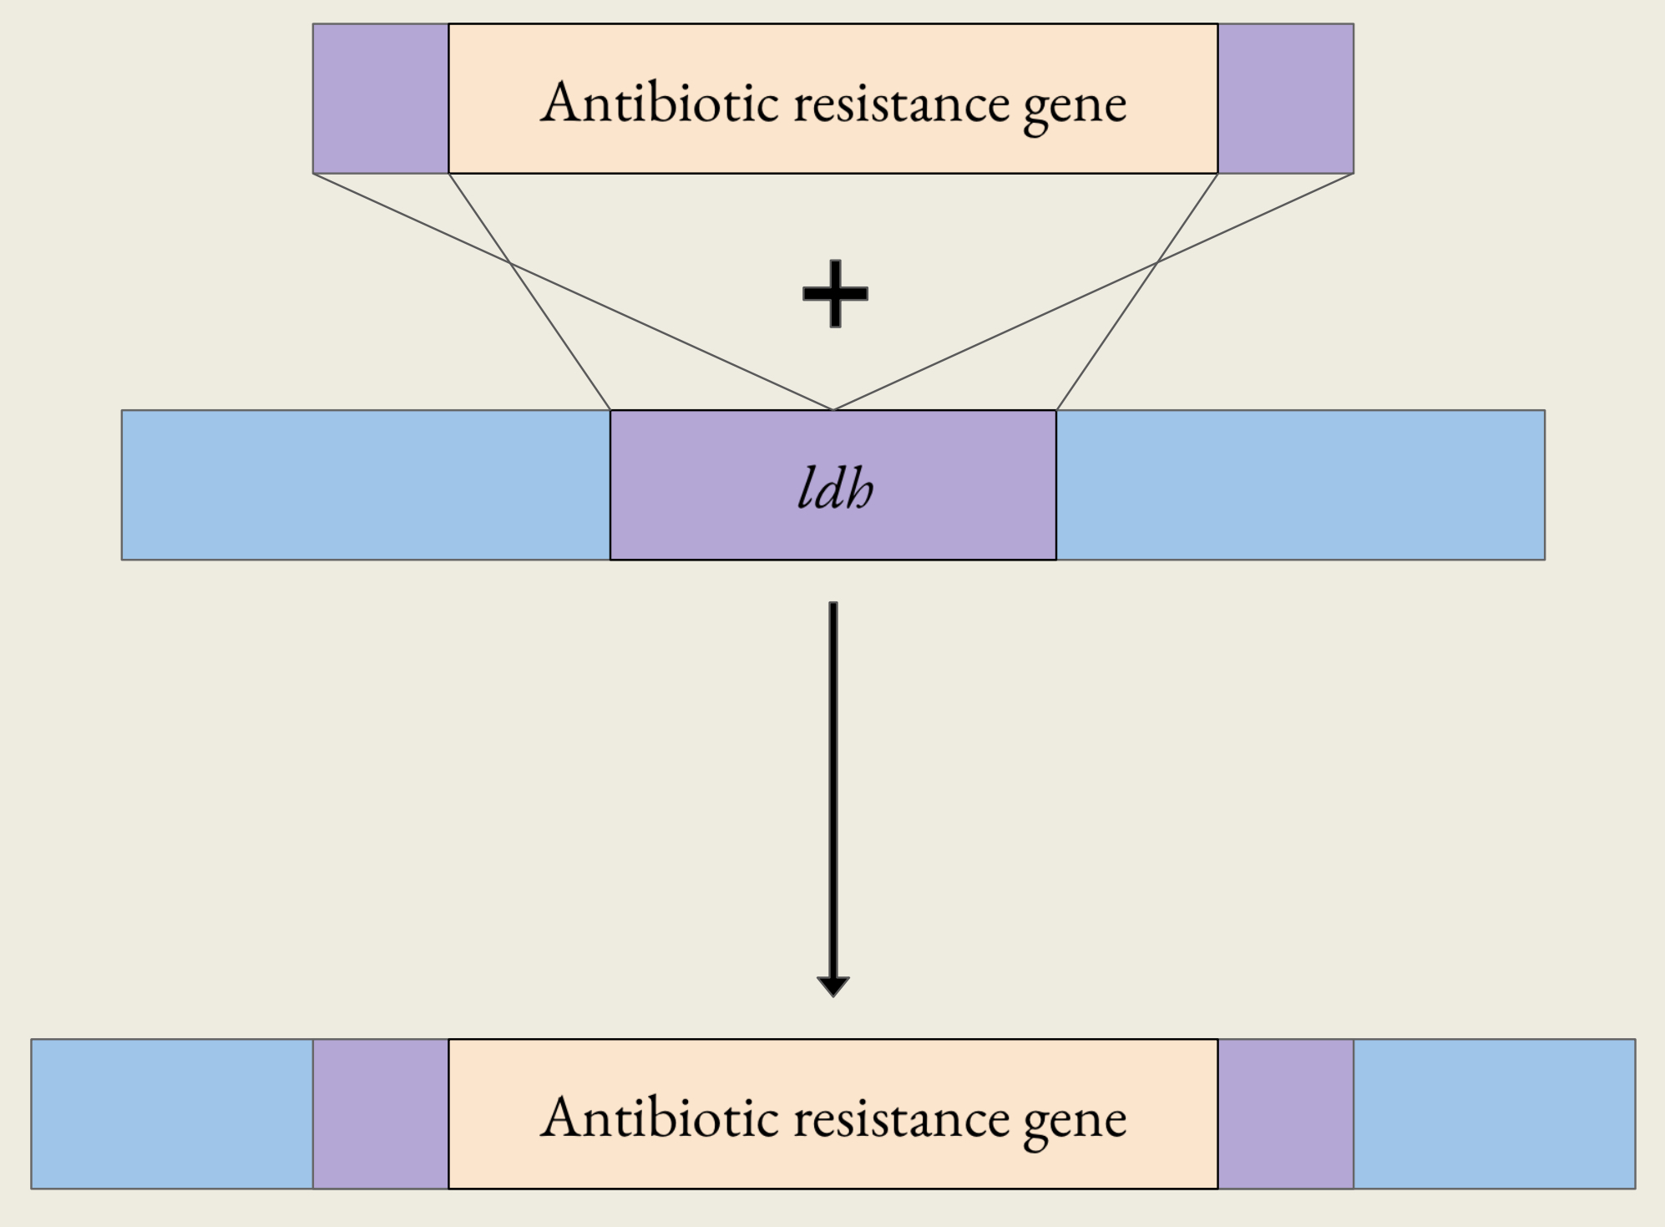
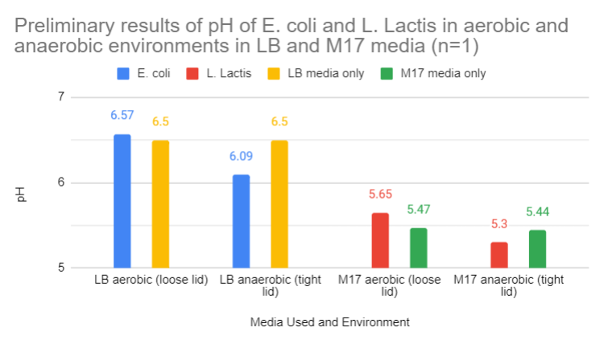
Lack-Tis Acid: Engineering a Lactic Acid-Free Oral Bacteria
Nikki Huang, Annie Chang, Audrey Leu, Steven Kuo, Elliot Brennan, Kenneth Miao, Ethan Lin, Tinsley Wu, Aaron Liu,
Junui Song, Emma Shih, Dr. Jonathan Hsu
Taipei American School, Taipei City, Taiwan
Project Objective:
Replace a strain of lactic-acid-producing bacteria with a dominant strain that doesn’t produce lactic acid.
Technique (Method):
Gene replacement via cross recombination
Fig. 3: Model of Cross Recombination Technique
Fig. 1: Tooth decays occur when bacteria produces acids that attack the tooth's enamel which can lead to cavities.
Click on me for audio
Fig. 2: Schematic flow of our project
Fig. 4: Graph of Preliminary pH tests

