Slide 1
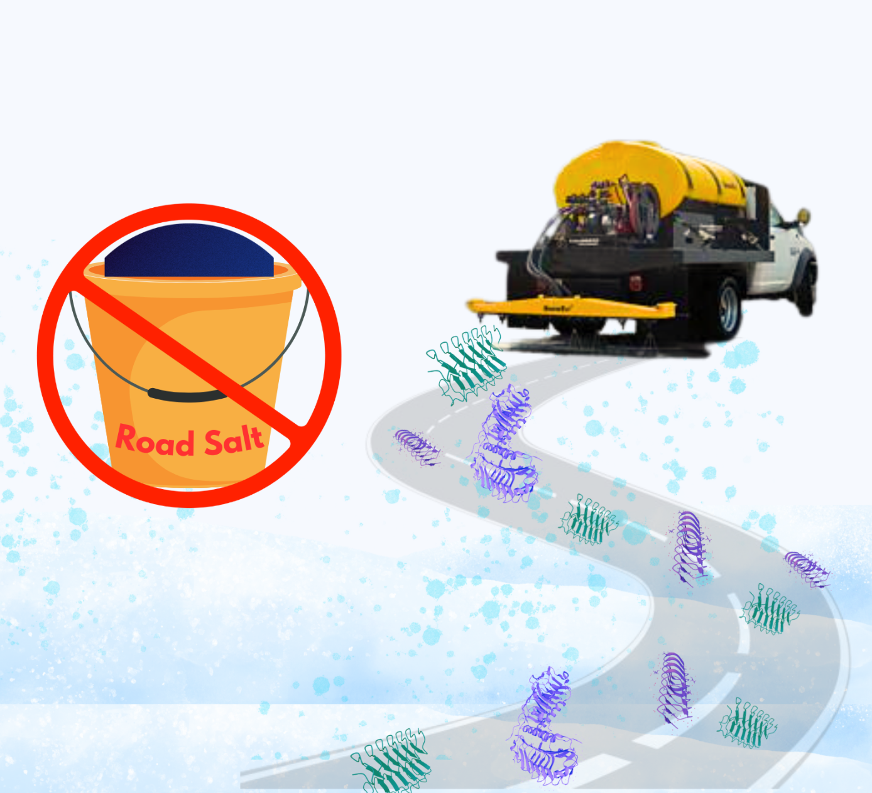
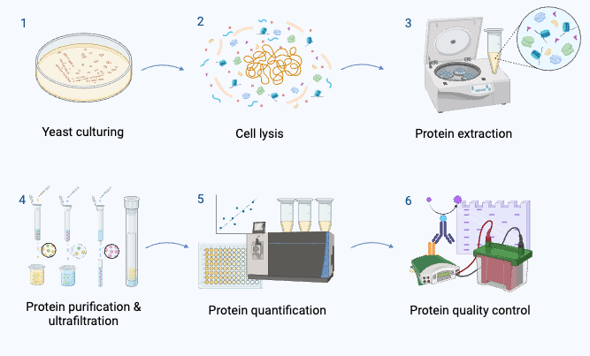
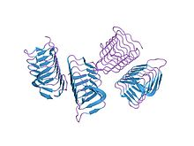
Road Salt Alternative Using AFPs
Loretta Wang, Paige Dix, Nicole Pae, Taylor Strilesky, Min Roh, Dr. Beth Pethel, Vicki Liu (Lanza Tech)
Western Reserve Academy, Hudson, Ohio, USA
Objective & Design
Our project seeks to address the environmental and infrastructural challenges posed by road salts through the harvesting of antifreeze proteins (AFPs).
Our design involves the transformation of Pichia pastoris with three separate plasmids, each carrying a gene sequence for AFPs derived from mealworms, plants, and arctic yeast. These AFPs operate by attaching to the surface of forming ice crystals, effectively preventing ice formation at sub-zero temperatures.
Figure 1. AFP’s mechanism
AFPs bind to the ice nucleus, inhibiting ice crystal growth, and increasing the curvature of the ice surface which creates an unfavorable shape for the accumulation of additional water molecules.
Figure 2. AFP as a road salt alternative
By harvesting the AFPs from P. pastoris, we can apply the product as a road salt alternative.
Figure 3. Cotransformation of 3 plasmids
ice nucleus
AFPs
AFPs
Figure 4. Protein harvesting procedure

