Slide 1
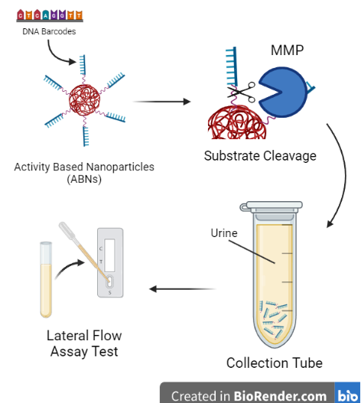
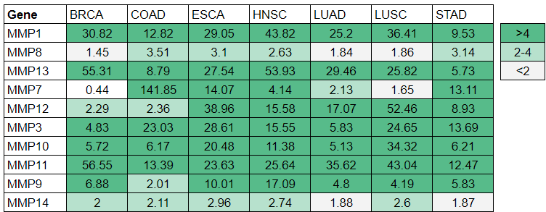
Pan-Cancer Diagnostic Using Activity-Based Nanoparticles
Harriet Lai, Jayla Chan, Sarah Huang, Nancy Sun
Derek Shapiro, Peter Horanyi
Sage Hill School, Newport Coast, California, United States
Many cancers have been associated with the dysregulation of extracellular proteases
Matrix metalloproteinases (MMPs), which have shown similar patterns of upregulation across various cancers
The goal of the project is to detect upregulated matrix metalloproteinases using inhalable nanosensors that reporter DNA barcodes are bound to
MMPs will cleave the barcodes, which are released and collected through the urine
The purpose of the project is to create a cheaper and more accessible alternative to scans and other costly cancer screening methods
Figure 1
Table 1

