Slide 1
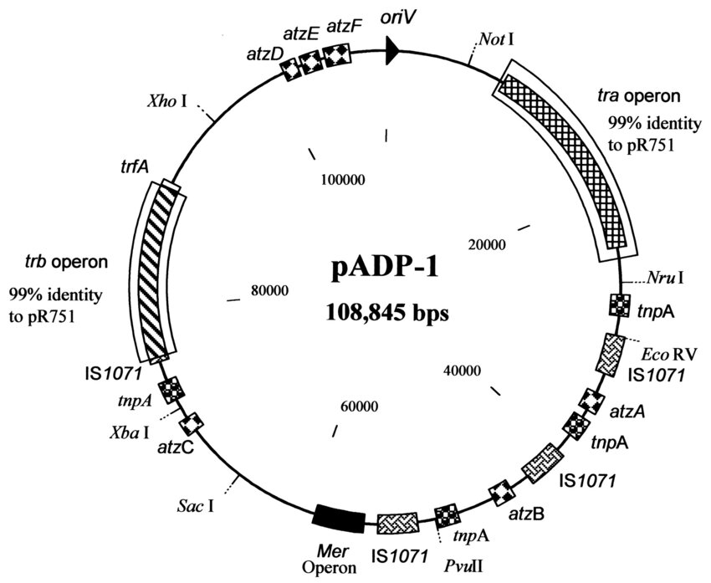
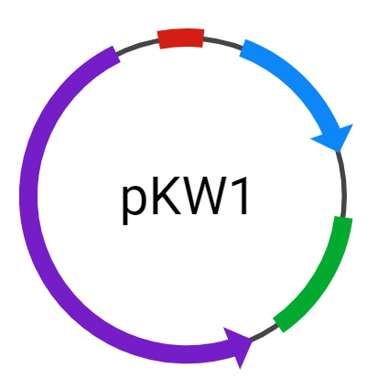
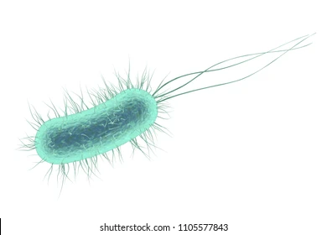
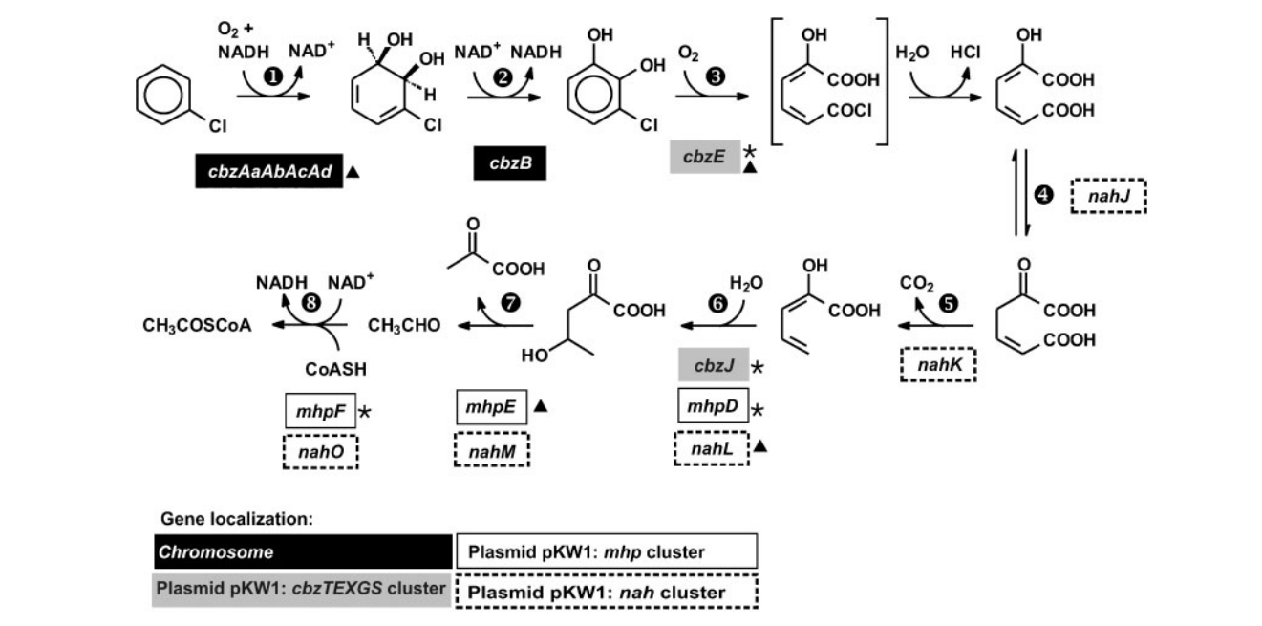
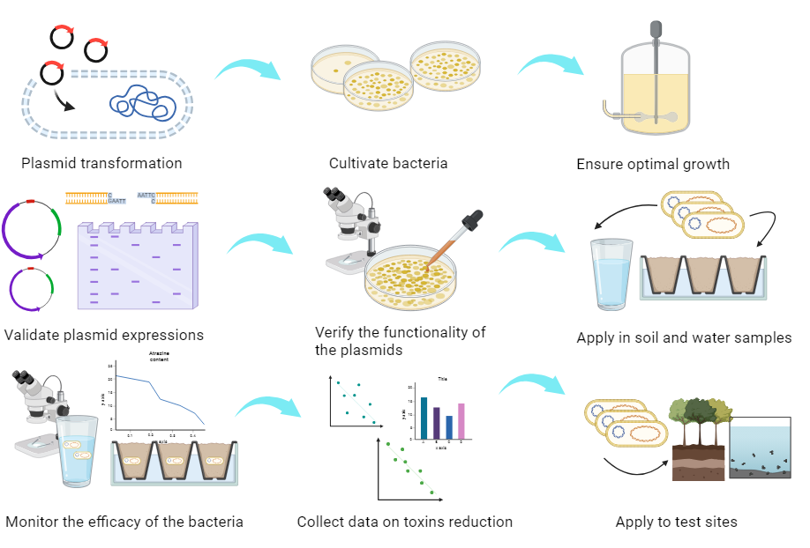
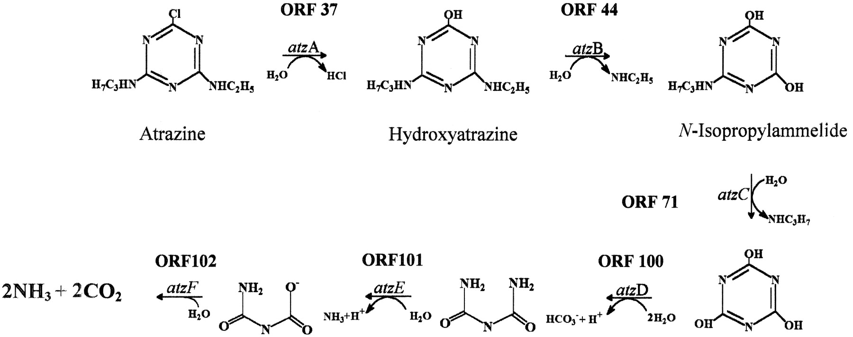
Runoff Remediation of Atrazine and Chlorobenzene via a Novel Pseudomonas putida Construct
Zhongchen Cai, Nana Kyei, Chongming Liu, Anya Mathur, Lingzhen Wang, Dr. Beth Pethel, Scott Gaines (Boston University)
Western Reserve Academy, Hudson, OH, USA
Our project aims to solve the problem of herbicide and pesticide chemical contaminants in the environment by harvesting a bioremediator targeting the toxins atrazine and chlorobenzene.
Our plan involves transforming the two plasmids pADP-1 and pKW1 into the Pseudomonas putida strain GJ31, constructing a super remediator bacteria strain that breaks down the two toxins.

