Slide 1
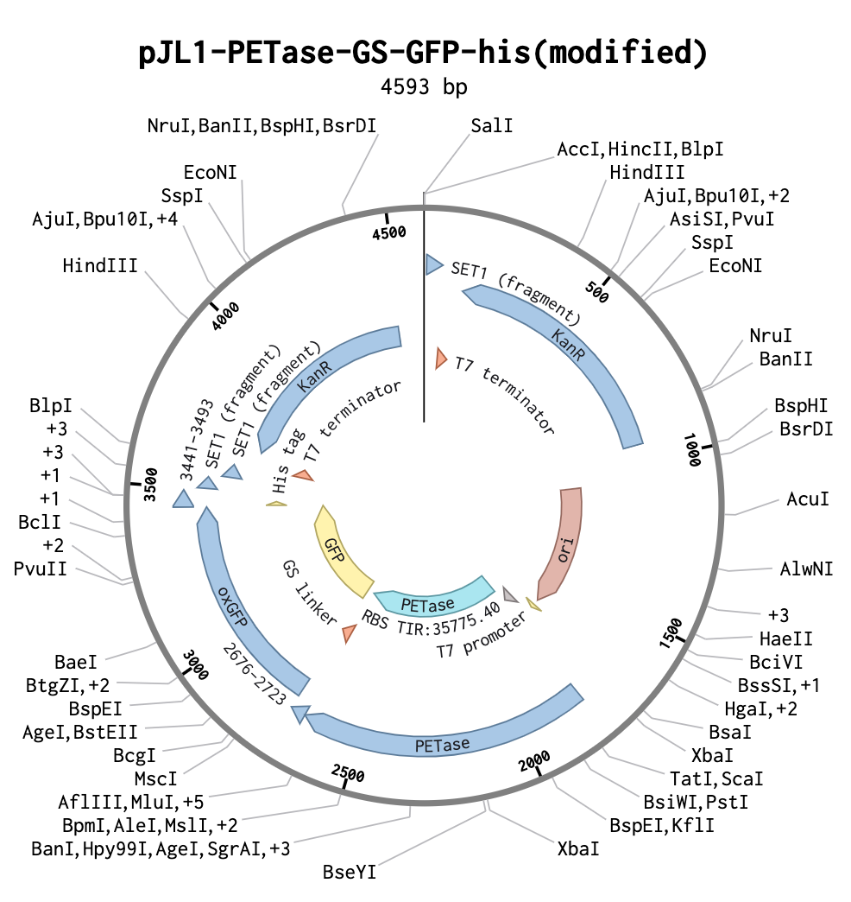
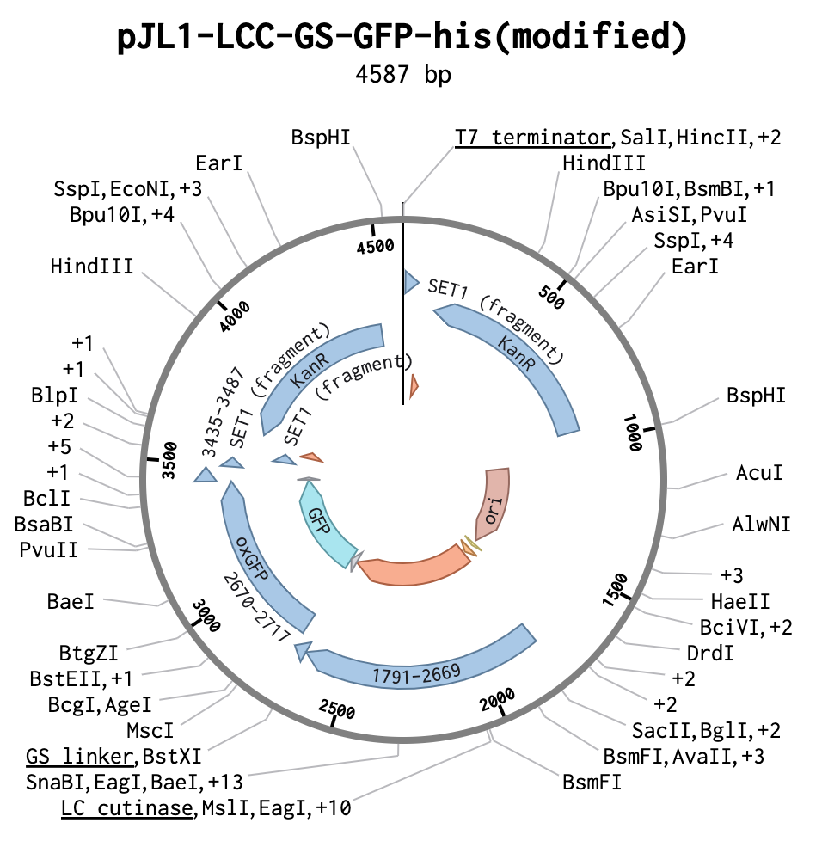
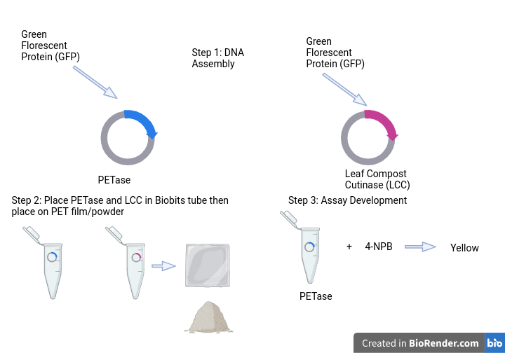
Evaluating the Efficacy of the PETase and Leaf Compost Cutinase Enzymes in Breaking Down Polyethylene Terephthalate Plastic in a Cell-Free System
Vismay Ravikumar, Evelyn Wheel, Hannah Lehmann, Megan Zhang, Aarit Chauhan, Miley Arora,
Sanjith Kalpat, Tommy Kruecker-Green, Shambhavi Jayakumar,
Lindsey L’Ecuyer (teacher), Nathan Crook & Tianyu Li (NCSU)
Andover High School, Andover, MA, United States
Create LCC/PETase enzymes to break down PET plastic film/powder using a circular plasmid
Cell free system using BioBits pellets
pNP assay to determine if enzymes are expressed
Scanning Electron Microscope(SEM) to observe decomposition of PET film, mass-loss system for powder
LCC: Leaf Compost Cutinase enzyme → works best at 65℃
PET: polyethylene terephthalate
Test modified pJL1 plasmids to produce LCC and PETase → place on PET film/powder using various amounts
Notes:
(optional) What techniques did you use or plan to use?
(optional) What technical needs do you have? What are the limitations of your tools?--- SEM, lack of sophisticated equipment
(Optional) What results do you have or expect?

