Slide 1
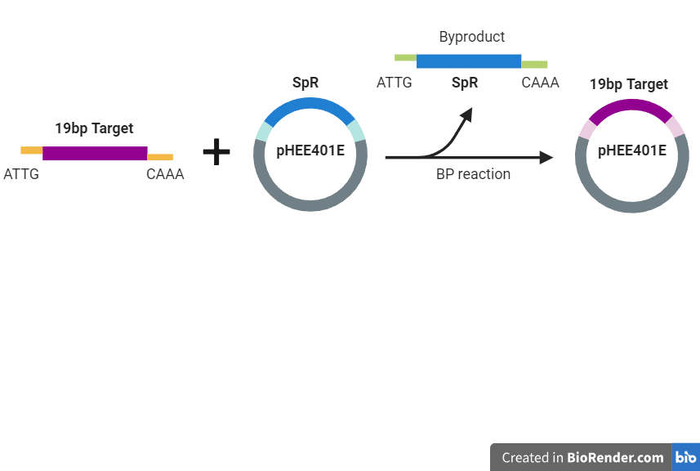
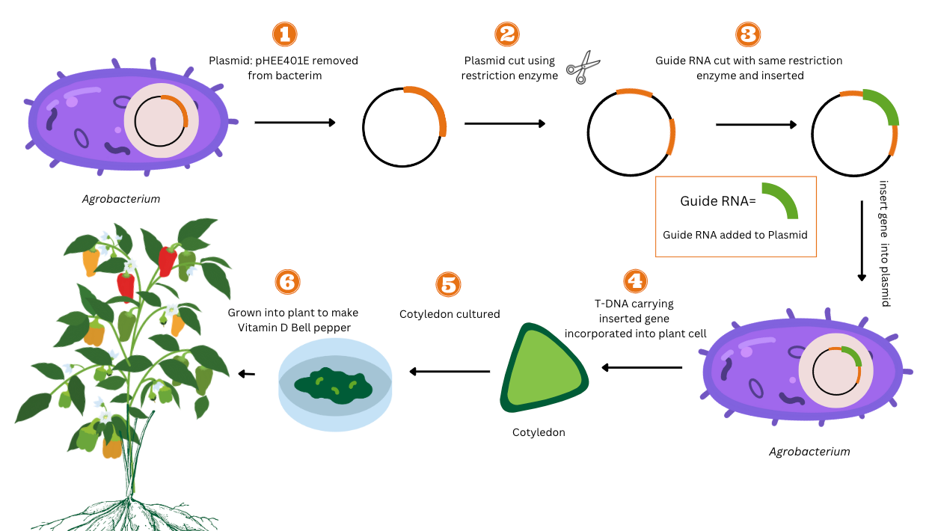
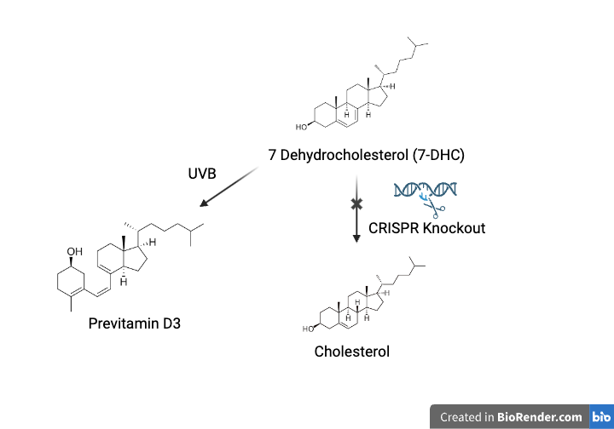
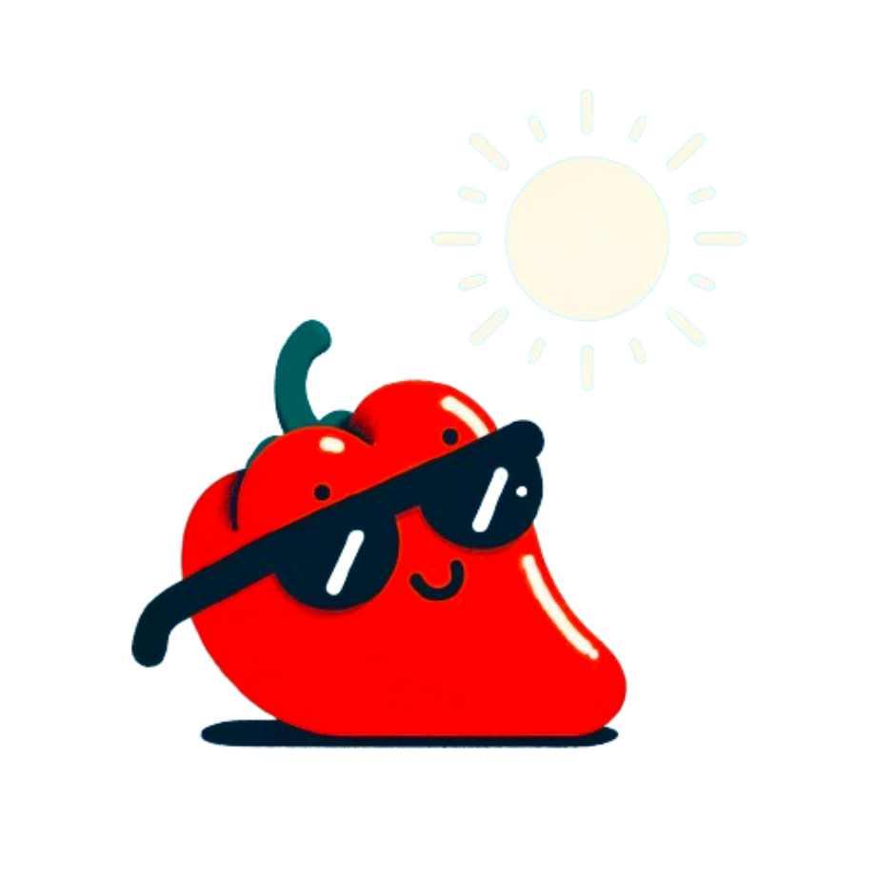
Nature's Dose of Sunshine: Engineering Vitamin D in Peppers
Junning Hu, Fernando Bermudez, Beth Pethel, Michael Stark
Western Reserve Academy, Hudson, OH, USA
Our Project
Objective: We aim to produce vitamin D in the bell pepper.
Techniques: We use CRISPR-Knockout, Agrobacterium-mediated transformation, and ELISA
Limitations: The CRISPR-Cas9 system can cause off-target effect that introduces harmful phenotype to the plant.
Expected Results: Vitamin D produced in the bell pepper
Figure 2: sgRNA cloning into plasmid pHEE401E
Figure 1: An Overview of Agrobacterium-Mediated Transformation
Figure 3: CRISPR-Knockout on 7-DHC pathway

