Slide 1
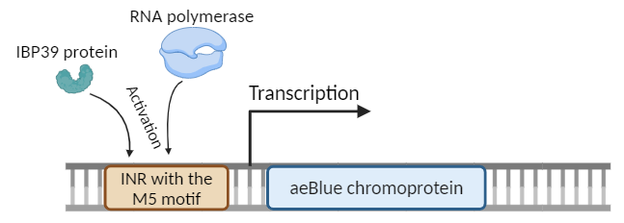
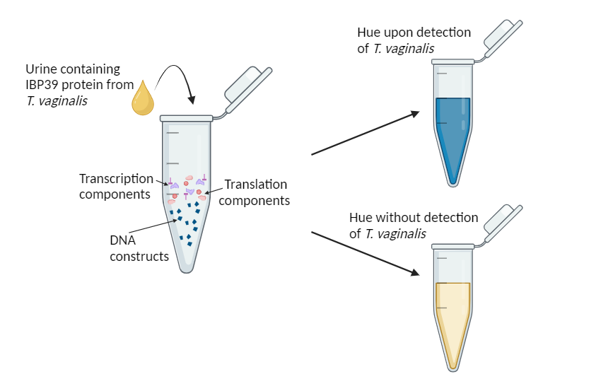
A novel parasitic STI detection system utilizing Trichomonas vaginalis-specific gene expression
Suhaan Yadama, Mira Zamarro, Dr. Beth Pethel, Dr. Becky Meyer (MIT)
Western Reserve Academy, Hudson, OH, USA
Problem
Trichomoniasis, a sexually transmitted infection (STI) caused by the parasite Trichomonas vaginalis, is especially difficult to diagnose and can lead to intense side effects. There are an estimated 156 million new cases of Trichomoniasis annually.
Objective
Our project aims to offer an accessible method for Trichomoniasis testing, providing a user-friendly color-changing mechanism to signal STI infection.
Design
We plan to utilize gene transcription, including T. vaginalis specific transcription factors.
Our final product will be a color-changing fluid test to provide a rapid, at-home solution for sexual health screenings.

