Slide 1
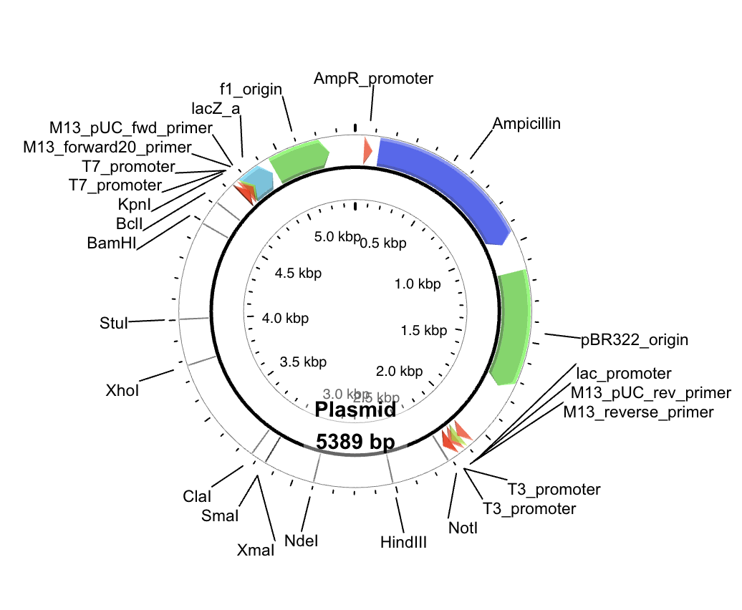
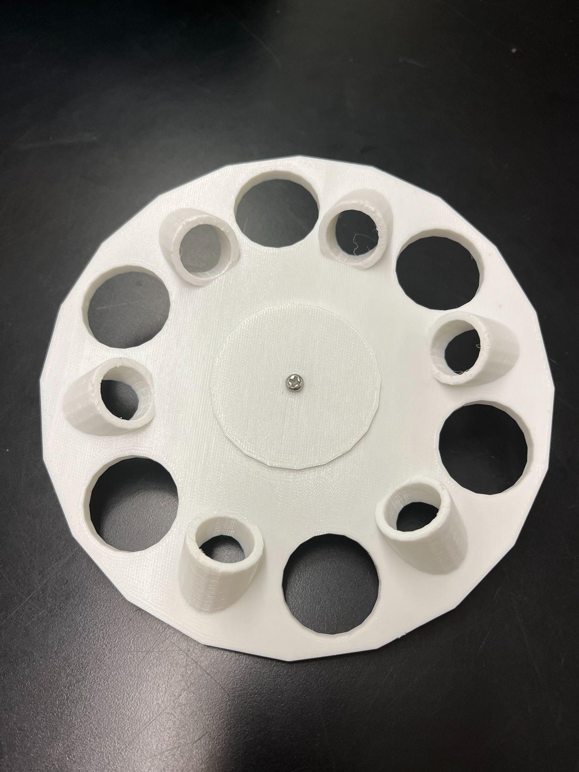
Plastic-Eating Algae
International School of Boston, Cambridge, MA, USA
Objective: Placing the PETase gene in the mCherry plasmid with restriction enzymes and inserting it in the Chlamydomonas Reinhardtii algae so it can digest plastic and break it down!
Techniques:
Restriction enzyme digest
Centrifuge
Transformation
Results expected:
slow-paced plastic-eating algae
with a cell wall
End Goal: Non-toxic, photosynthetic, cold and salt-resistant algae that can be released in the sea.
Experiment: Grow two separate plasmids, connect them, and test for expression.
Notes:
-present project: plastic eating algae
→ plasmid which digests PET (which is plastic you find on water bottles)
→ other is mCherry (inspired by study which chose this gene for its markers)
Chose the transformation technique

