Slide 1

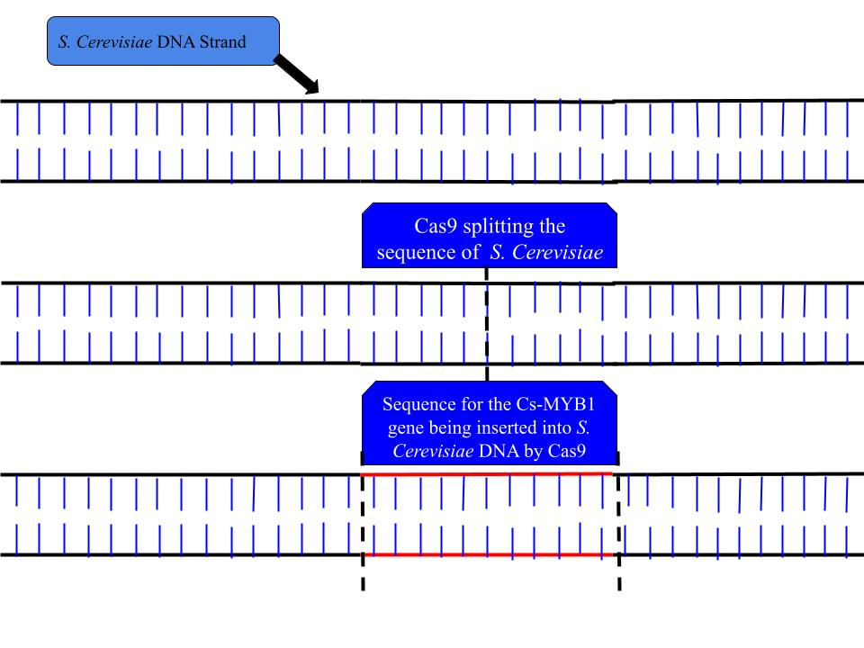
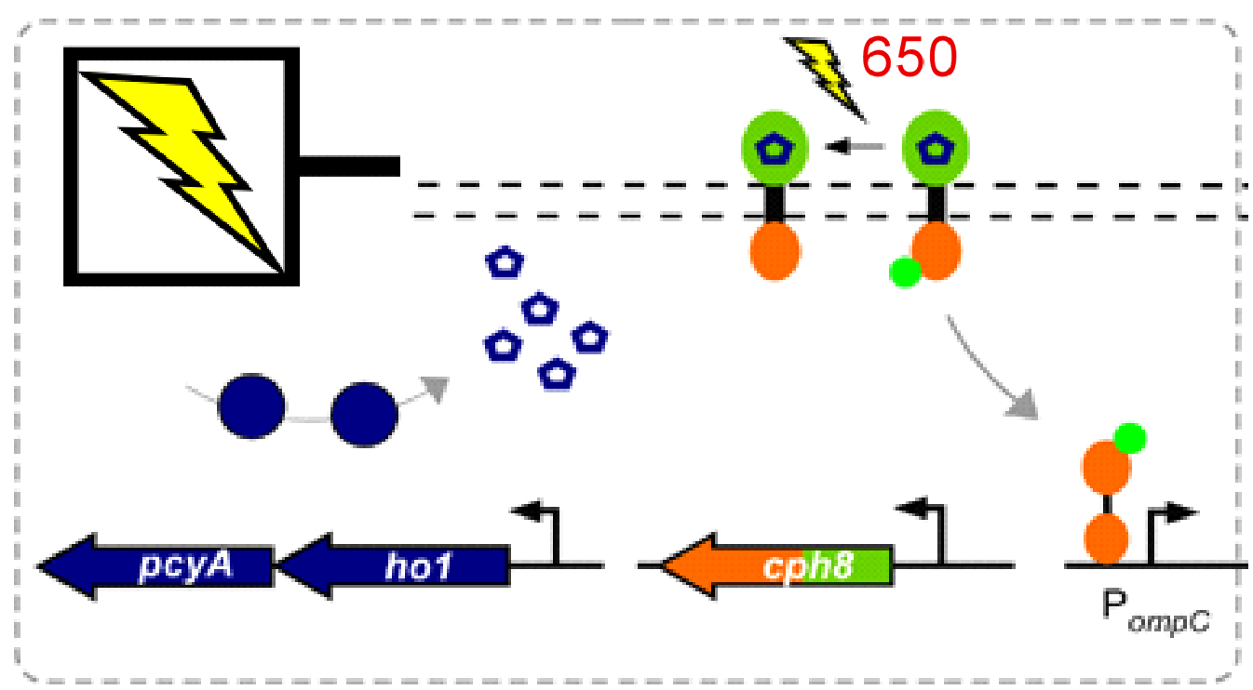
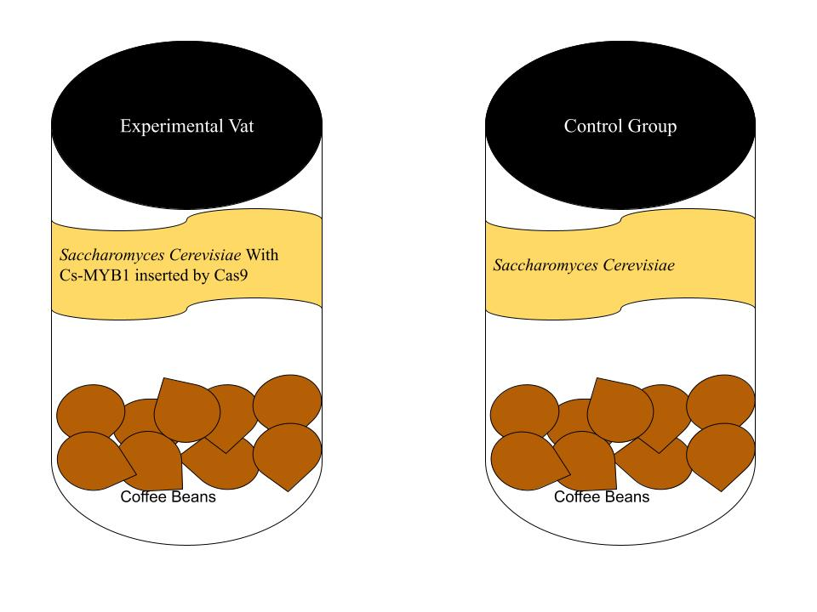
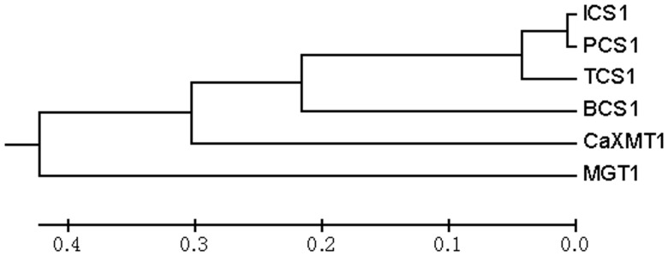
Preventing the Destruction of Caffeine During Caffeine Fermentation Process
Jackson Baker, Matthew Boland, Aidan Esparza, Jordan Alioto, Will Kelly Mr. Kirkpatrick, Eric Jorgenson (Mentor)
Oak Park and River Forest High School, River Forest, Illinois, U.S.A.
To improve the fermentation process of fermented coffee.
We plan to use Crispr to insert a gene that produces a chemical that masks caffeine from being destroyed during fermentation.
To achieve a real world application of this experiment, an autoclave, raw coffee beans, Saccharomyces Cerevisiae, Crispr gene editing kit.
We expect that the caffeine will be in higher concentrations in our edited sample over the control samples.
Simple overview of the genetic system or whatever is technically relevant

