Slide 1
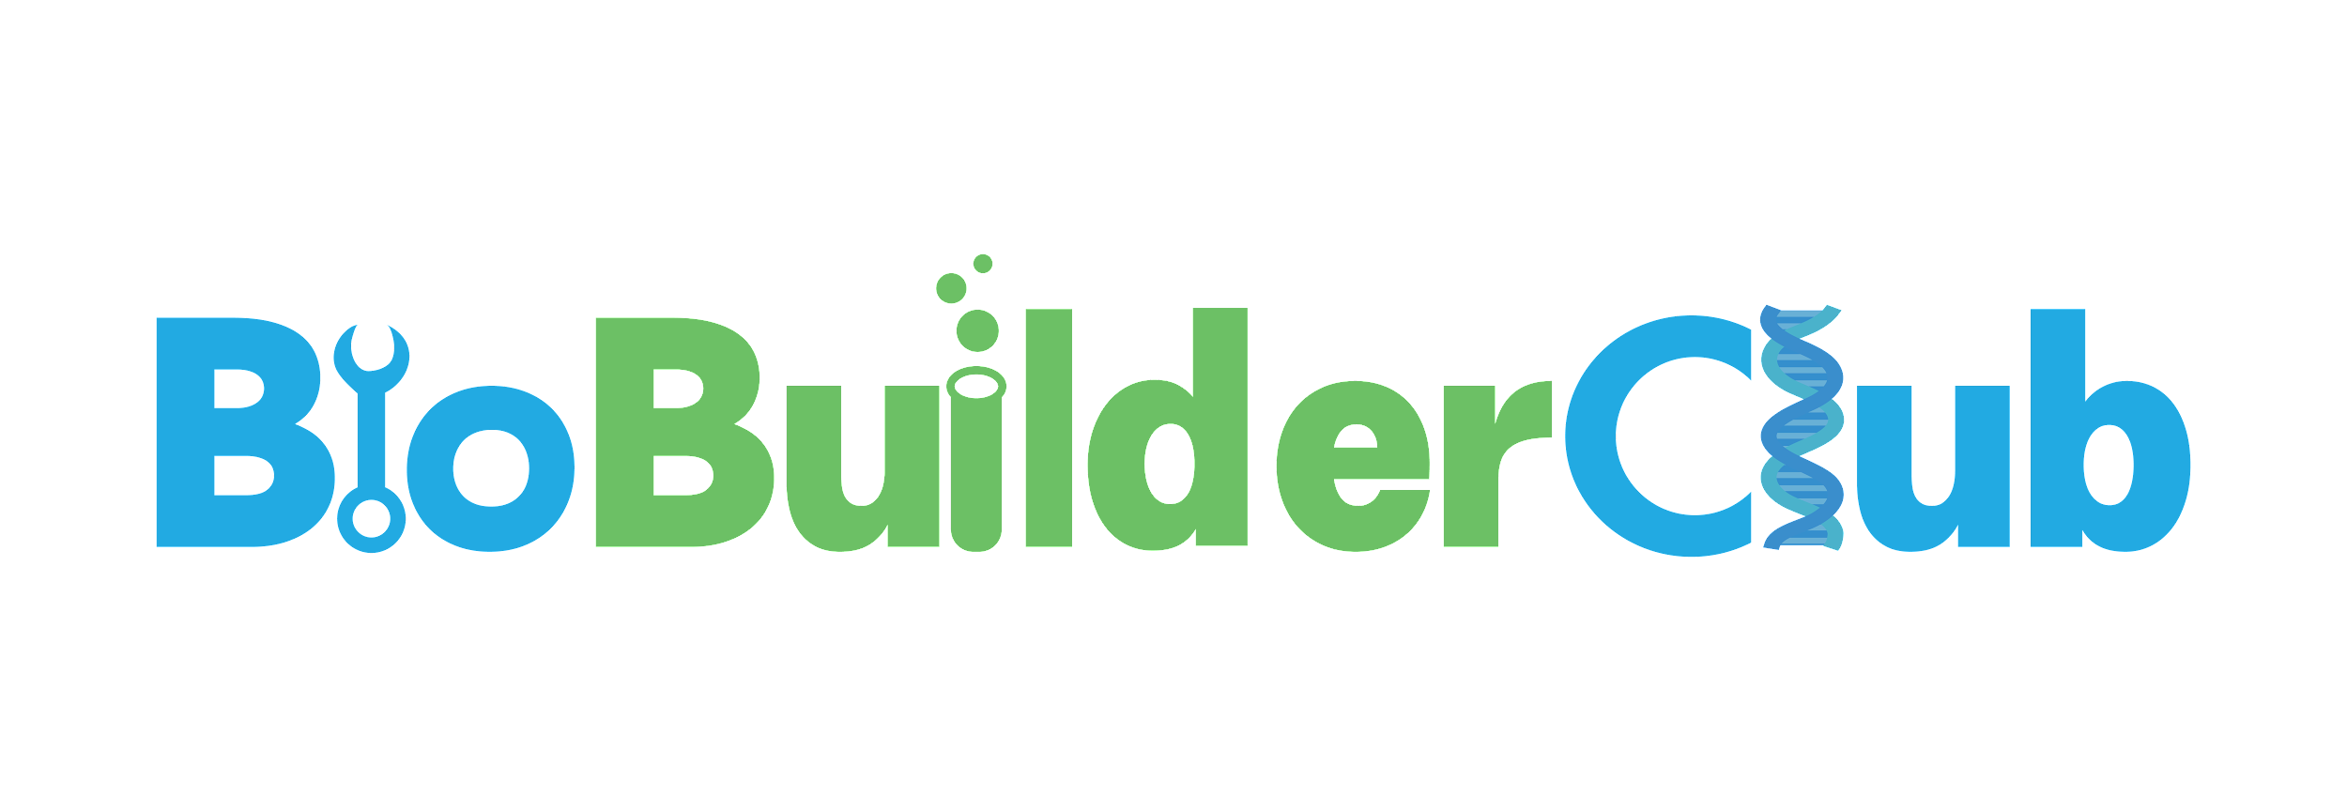
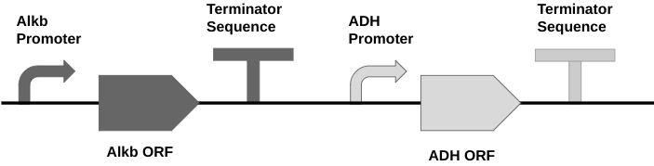
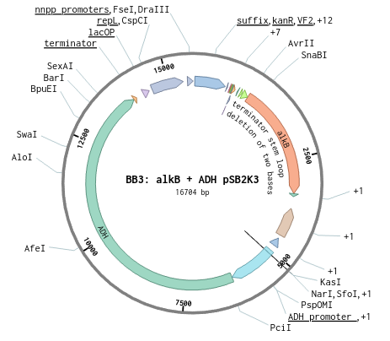
The Organic Approach to Crude Oil Degradation
Gabe Wolter, Trevor Wilson, Eli Landsman, Charles Yang, Alex Hymson, Ian Kelley
Mr. Kirkpatrick, Mr. Ben French (Mentor)
Oak Park and River Forest High School, Oak Park, IL, USA
Goal: Naturally degrade oil to lessen the impact of poor water quality in aquatic ecosystems
Methods
  Bacterial Transformation
    E.coli DB3.1
    Modified BioBrick plasmid backbones
  AlkB and/or ADH protein production
  Antibiotic resistance gene & additional components
  IPTG inducer application
Limitations
  Plasmid Size
  Reliant on Lacl operon
Figure 1a: alkB & ADH combined plasmid schematic
Control
Sample 1
Sample 2
Sample 3
Sample 4
Oil & water
alkB solo
ADH solo
alkB + ADH
alkB & ADH separate
Figure 2: hypothetical experiment test tube setup
Figure 1b: our combined PSGK3 plasmid
Notes:
Script:
Goal: Our goal for this project is to genetically modify bacteria to produce proteins that can degrade oils in aquatic ecosystems in an effective and eco-friendly manner.
Methods/Technique: Genetically modifying E.coli bacteria to produce enzymes that break down hydrocarbons in crude oil spills into fatty alcohols
Inserting plasmids with genetic code for proteins such as alkB and ADH. The BioBrick plasmid backbone also contains an antibiotic resistance gene as well as extra components that allow the plasmid to be induced for higher copy rates
Limits: Our product is limited by the size of the plasmid we insert into the E.coli. If the plasmid is too large, the bacteria may die expending the energy our plasmid requires. In order to combat this, we took a two-pronged approach where we separated the ADH plasmid and AlkB plasmid into 2 separate bacteria cultures. In the event of a spill, we would apply both modified E.coli on the site at once. Thus, each plasmid is small enough to safely be inserted into the E.coli, yet we still receive the full benefit of both enzymes.

