Slide 1

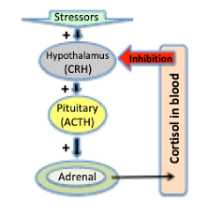

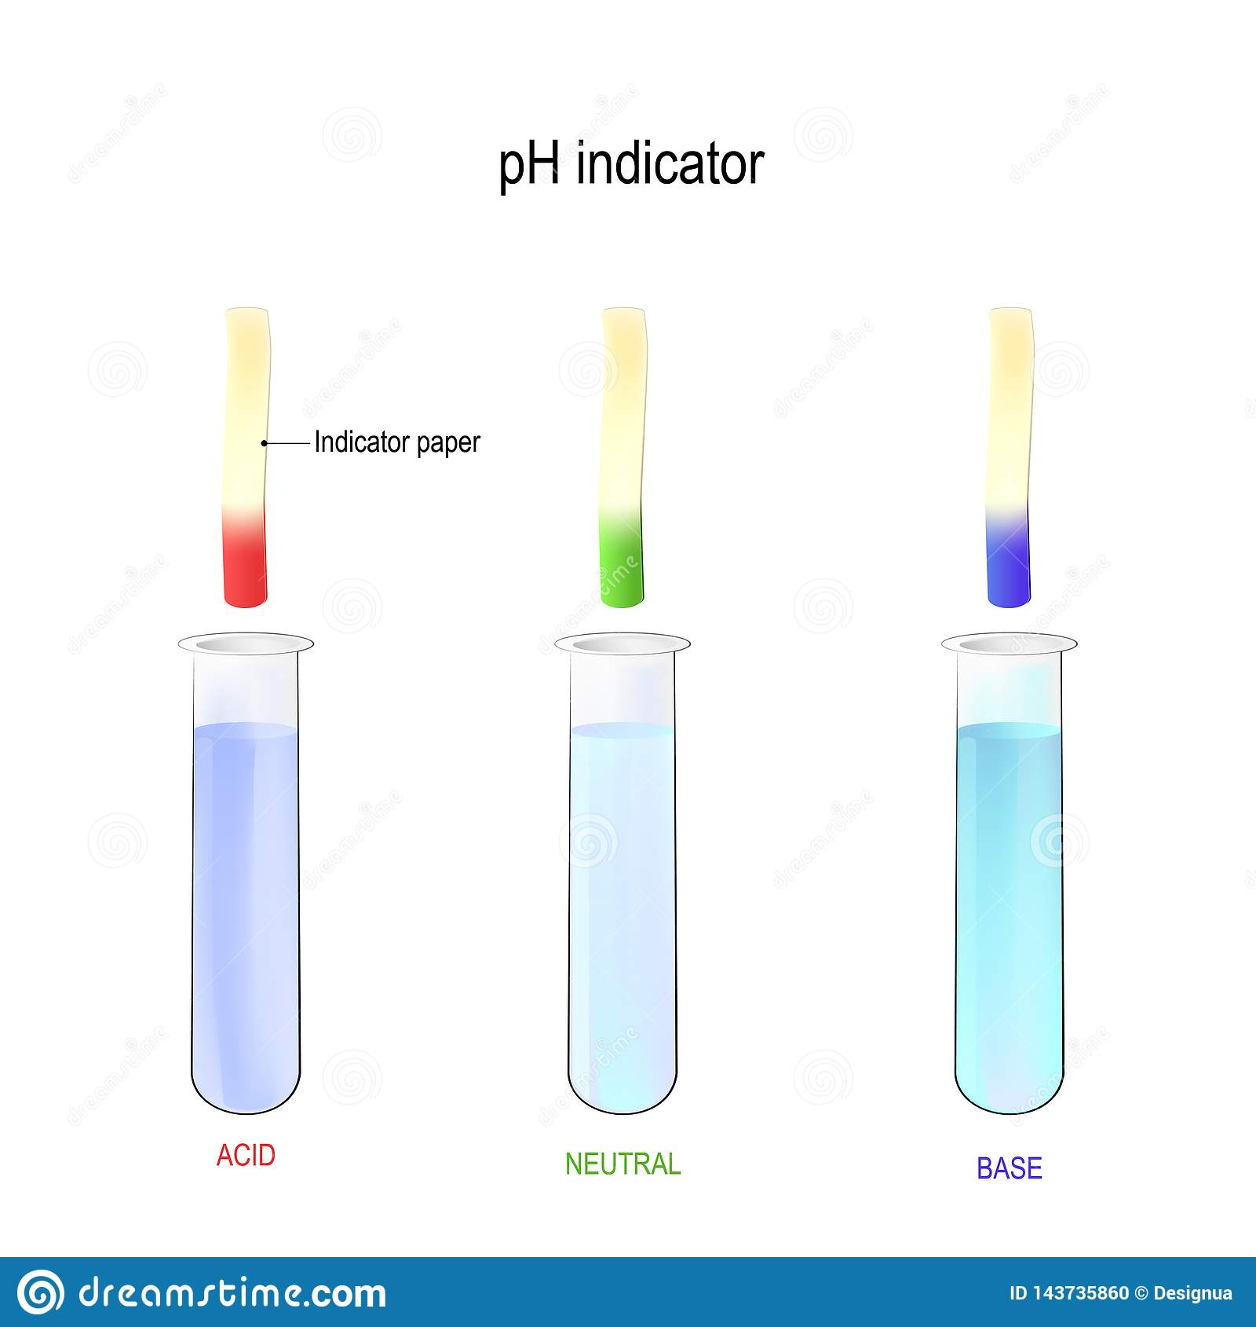
Reproductive Disruption Indicators in Fish
Julia Lingman, Sadie Parkinson, Juliette Bezaire, Linnea Nam, Dee Epshtein, Sarah Epshtein, Owen Shepherd, Wami O Teacher Leader: Mr. Kirkpatrick, Mentor: SitaRam Meena (University Cambridge Boston) )
Oak Park and River Forest HIgh School, Oak Park, IL
Objective: Simple and inexpensive detection test for compounds in aquatic environments indicating at risk teleost population. Endangered regions would be flagged and have limited fishing/harvesting to avoid further harm towards the population.
Challenges: Finding access to some of the compounds and litmus/universal indicator/alternative indicator papers to trial and create the test.
We expect to have a lot of trial and error with existing paper types. We will likely have to switch to experimenting with adding chemicals that are used for similar hormone or compounds in existing tests to our own paper.
We would have liked to start creating test strips to check the levels of various stress proteins, catecholamines (epinephrine) & pathway molecules like CRH and ACTH, certain corticosteroids, and other compounds, and to create a scale based on the color brought on by different amounts / concentrations.
Our test could look something like this, with a gradient scale in terms of compound concentration.

