Slide 1
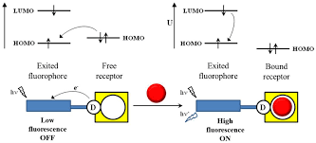
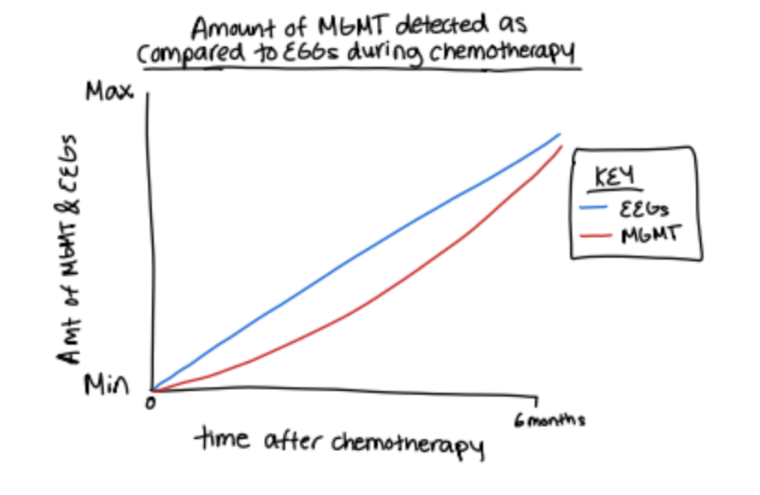
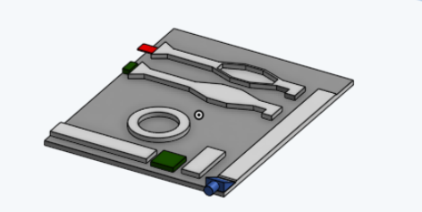
Using Augmented BCI Technology to Detect the Presence and Progression of Glioblastoma Tumors
Members: Naga Sahithi Rajuladevi, Jagruti Lokam, Aarya Trivedi,Chaithra Jogiraju, Vaibhavee Shirkhedkar, Arav Raghunathan, Sujaal Gelle, Nimal Murugan, Abhay Kumar Prashanth, Janahan Mural
Mentor/ Advisors: Mrs. Kate Sharer, Mrs. Pam Seeley, Dr. Kaitlin Dailey (Kansas)
Lambert High School, Suwanee, Georgia, United States
What is the objective of your project?
The focus of our project is to be able to detect and track the progress of chemotherapy of glioblastoma using MGMT. Our solution is to create a cost-effective and efficient biosensor which has two parts, measuring EEGs and MGMT with fluorescence. The purpose of the two parts is to create accurate representation of the data to determine the progress of glioblastoma.
What are the limitations of your tools?
This tool is only accessible for people who are able to use it with a healthcare profession due to the fact that this placement of this detection tool will need to be placed on your scalp. Without the carefulness, it could cause negative impacts in physical and mental aspect.
Model of the Photonic Integrated Circuit:
Notes:
(optional) What techniques did you use or plan to use?
(optional) What technical needs do you have?
(Optional) What results do you have or expect?

