Slide 1
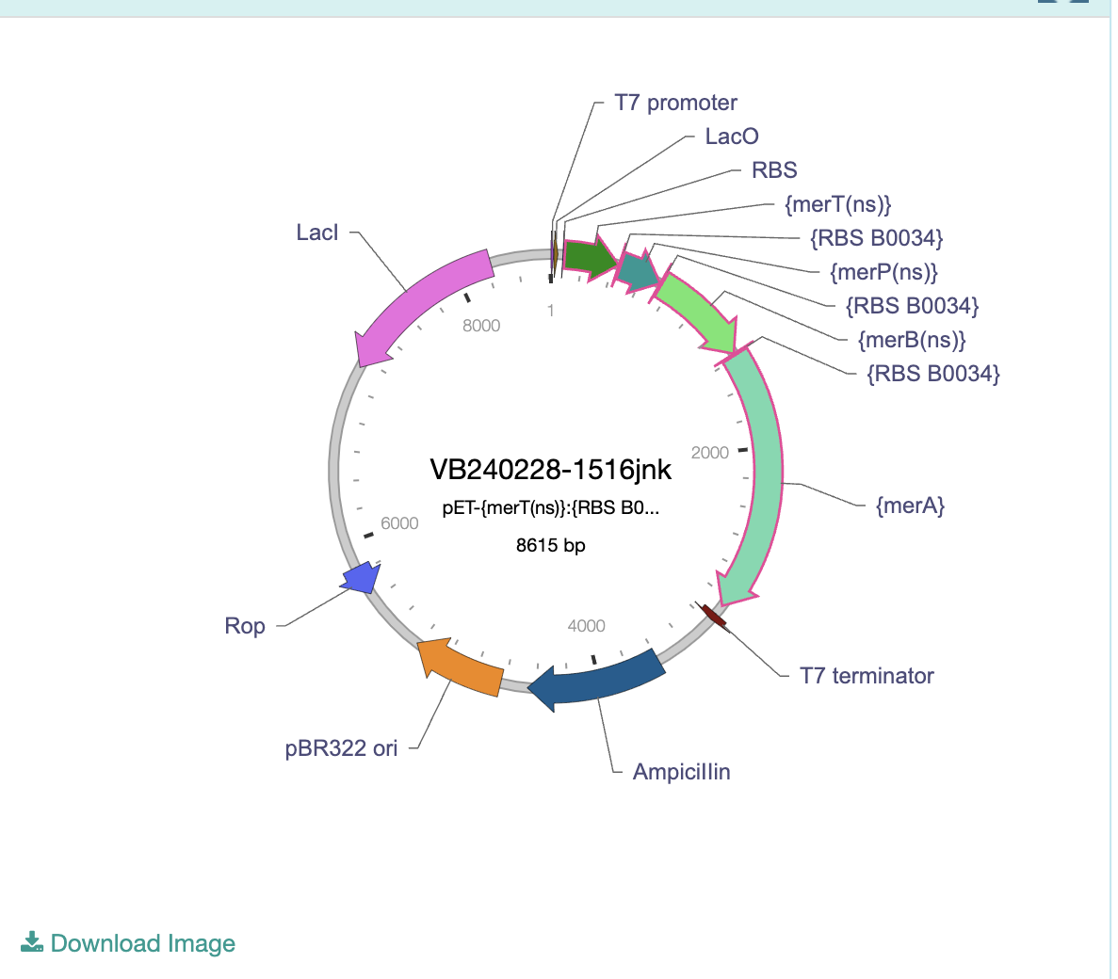
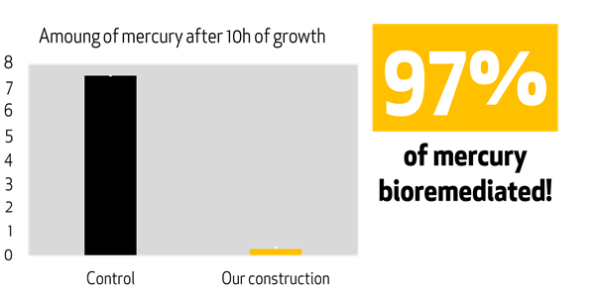
DETOX-I-FISH
Tessica Selvaganesan, Aditya Mukker, Ayan Ragunathan, Aditi Pabidi, Daksh Reddy, David Park, Keerthana Anumukonda, Julia Crossen, Kensley Burke, Catherine Sharer (Teacher), Pamala Seeley (Teacher), Kristin Jenkins (Mentor)
Lambert High School, Suwanee, Georgia, USA
LT audio
Our project aims to detoxify mercury in fish in order to make it safer for human consumption.
We plan to use a transformation in order to insert the plasmid into E. Coli, which will then be grown in a suspension for the Tuna to soak in.
We expect to receive results signaling that the mercury in the tuna has broken down.
This diagram depicts the direction of the main vector and the functions of each part in the sequence.
We would like to test our idea by combining the E. Coli containing mer enzymes with a colored dye to see if they can penetrate the fish meat. We would also test our solution with a substance less toxic than mercury.
Proof that our part chosen works at breaking down mercury

