Slide 1
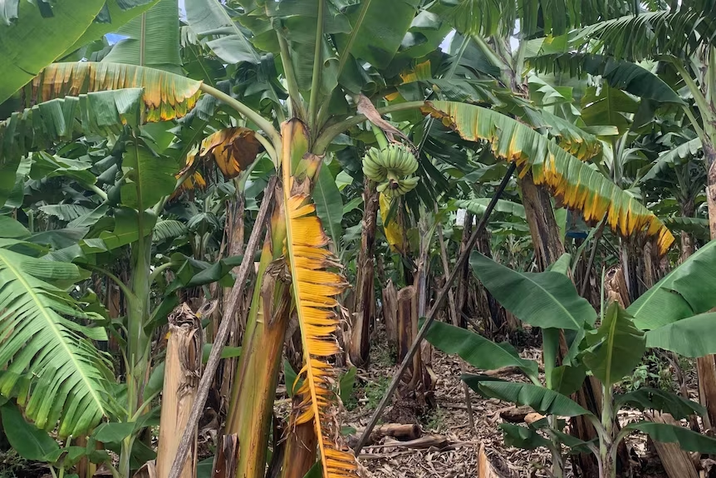
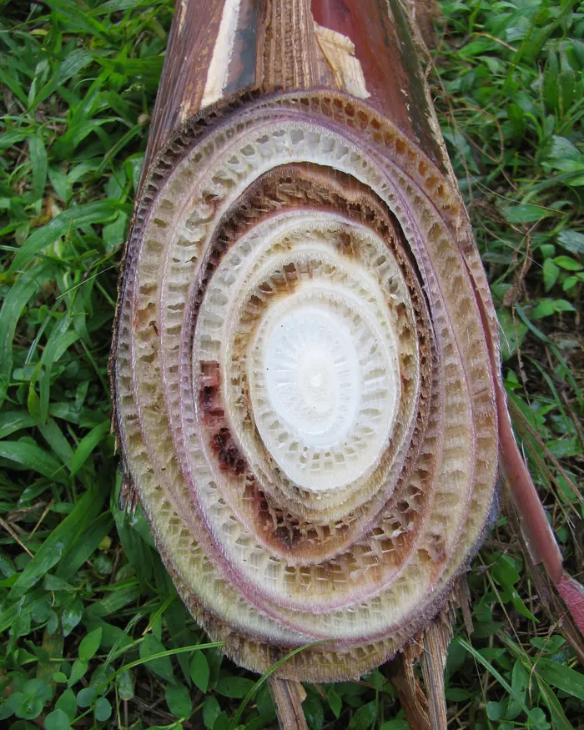
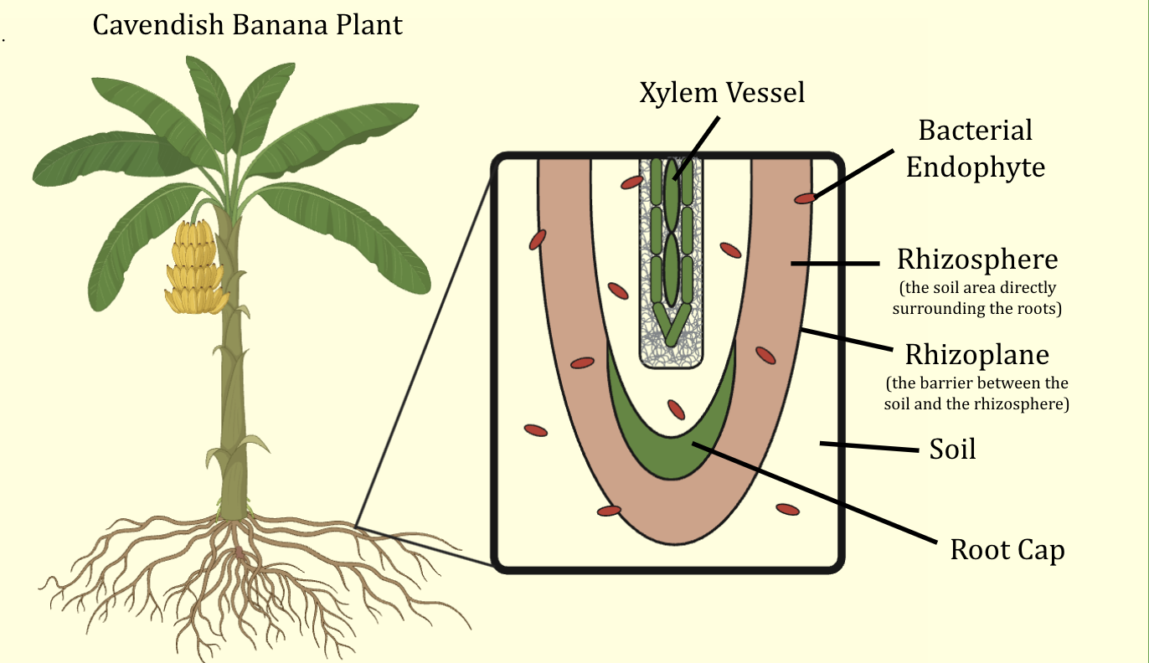
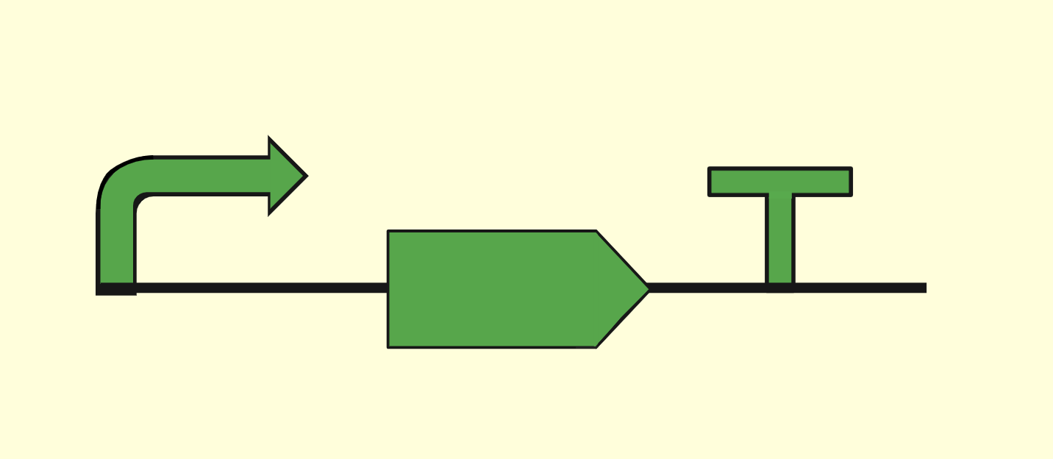
Fusarium Wilt Resistance in Cavendish Bananas
Peter McGinnes, Josh Li, Andrew Parrish, Kate McMullin, Bob Wang ​
Dr. Beth Pethel, Michael Sheets (Boston University)​
Western Reserve Academy, Hudson, Ohio, USA​
Click Here for Audio!
Objective
We aim to combat Fusarium wilt and protect Cavendish banana plants by synthetically engineering bacterial endophytes and introducing them into the soil surrounding the plant’s roots (Figure 1). Ultimately, we hope our solution will be feasible to save Cavendish bananas from extinction, thereby allowing the economies of impacted countries to recover.
Figure 2: An infected banana plant and a cross-section of its pseudostem
Figure 1: A Cavendish banana plant and the soil area surrounding its roots (with bacterial endophytes present)
Our Proposed Solution
We propose using allicin, a compound found in garlic that effectively stops fungal growth. Our design is an allicin expression system for Enterobacter cloacae that works by inserting the gene encoding allicin into the endophyte (E. cloacae) and incorporating that endophyte into the soil.
Figure 3: A simplified visual of our proposed solution
Promoter
Terminator sequence
Plasmid
E. cloacae
Synthesized allicin DNA

