Slide 1
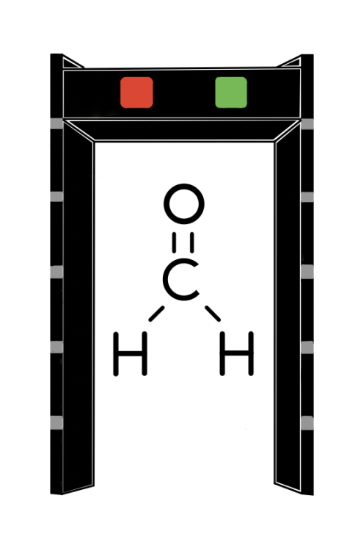
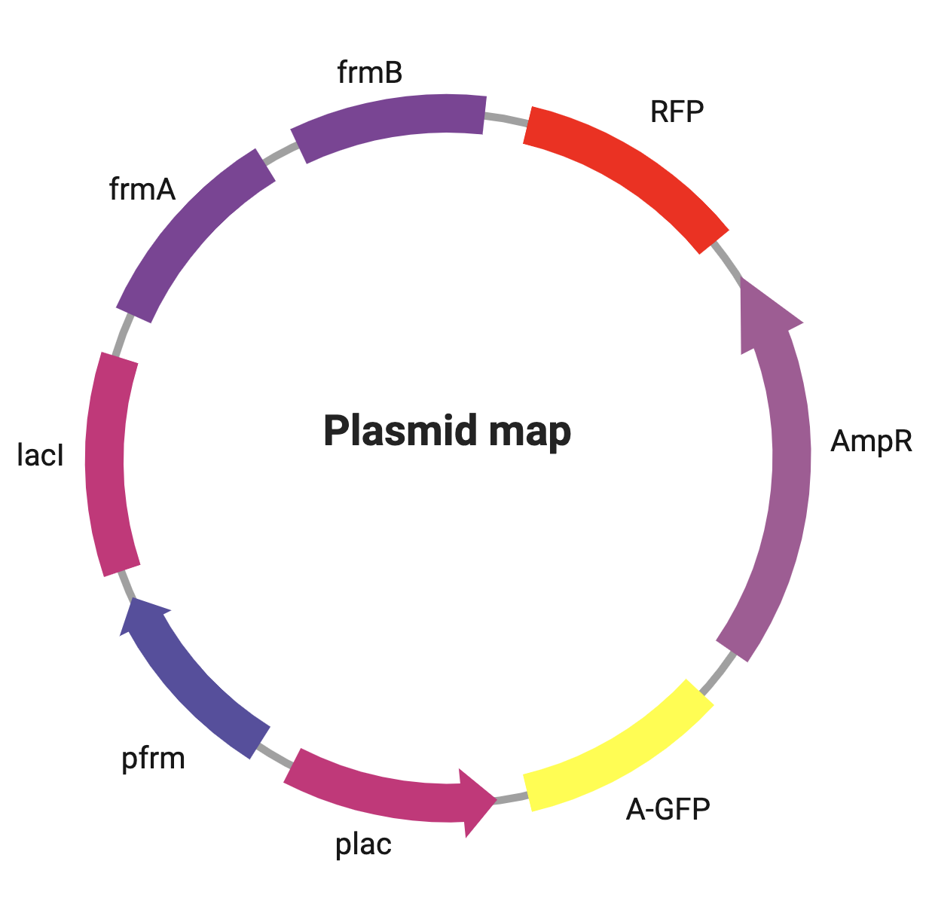
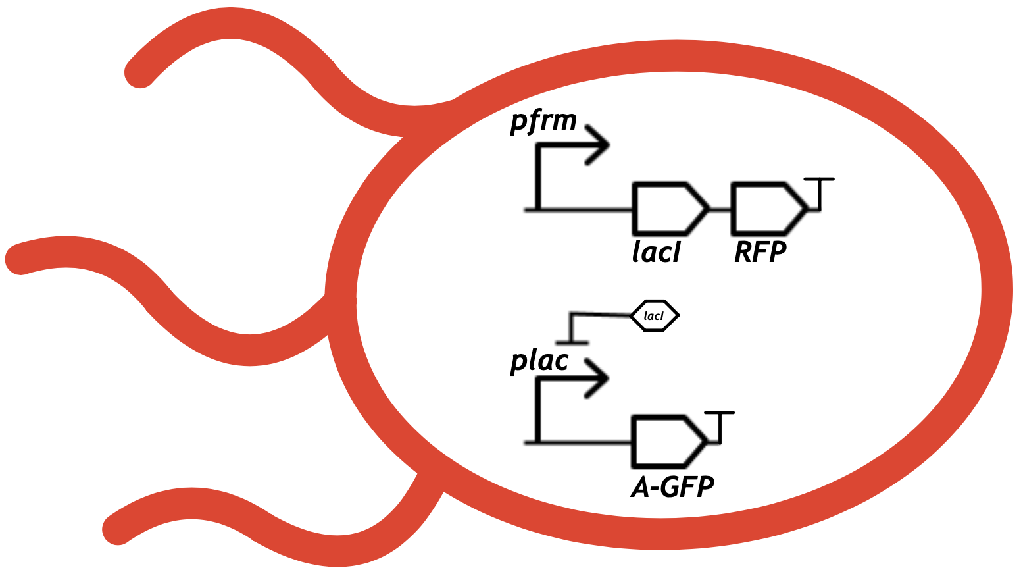
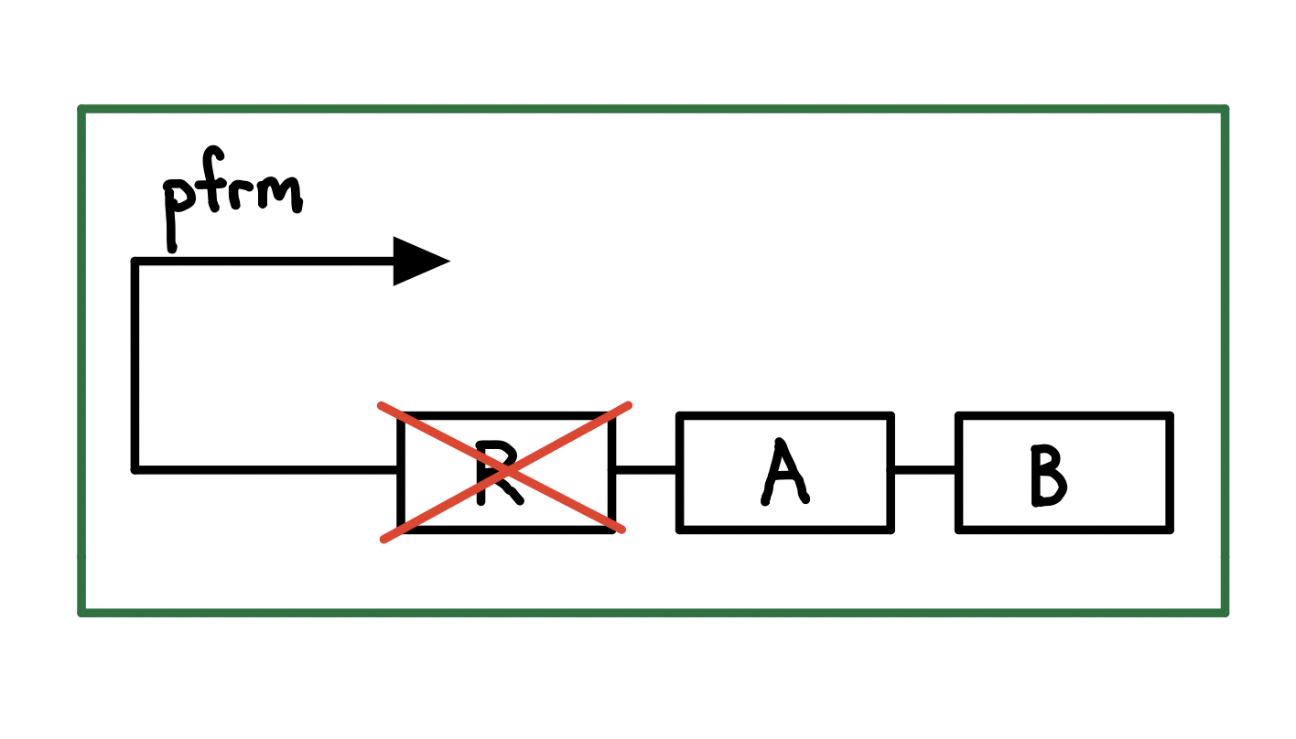
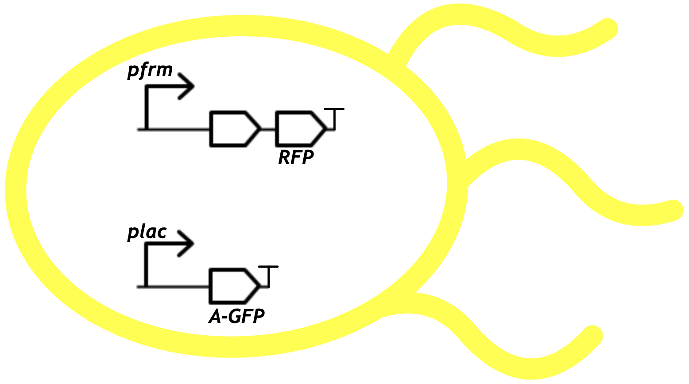
Formaldetector
Tanzin Danzhen, Ethan Tan, Dr. Beth Pethel, Mr. Michael Stark
Western Reserve Academy, Hudson, Ohio, United States
Though common in many places, formaldehyde can be toxic.
Our objective: create a Escherichia coli-based formaldehyde detector and remediator.
Our chassis, ΔfrmR E. coli, has a formaldehyde inducible promoter, pfrm.
We utilize a lacI promoter and repressor system combined with the pfrm promoter, to express yellow or red pigment depending on the presence or absence of formaldehyde.
The deletion of the repressor, frmR, from the chassis ensures continuous remediation of formaldehyde.
Figure 1 (top): The design of our plasmid. The pfrm promoter expresses the lacI repressor, the frmA and frmB genes, and the RFP pigment gene. The plac promoter expresses the amilGFP pigment gene. Our plasmid also has ampicillin resistance as a selectable marker.
Figure 2 (left): When formaldehyde is present, this E. coli will make the red pigment and the lacI repressor. The repressor halts the yellowish-green pigment production.
Figure 3 (right): In the absence of the formaldehyde, no red pigment and lacI are produced, allowing the production of the yellowish-green pigment within the E. coli.
Figure 4 (top): deleting the frmR gene from the Δ frm strain allows the expression of the frmA and the frmB genes, which remediate formaldehyde.

