Slide 1
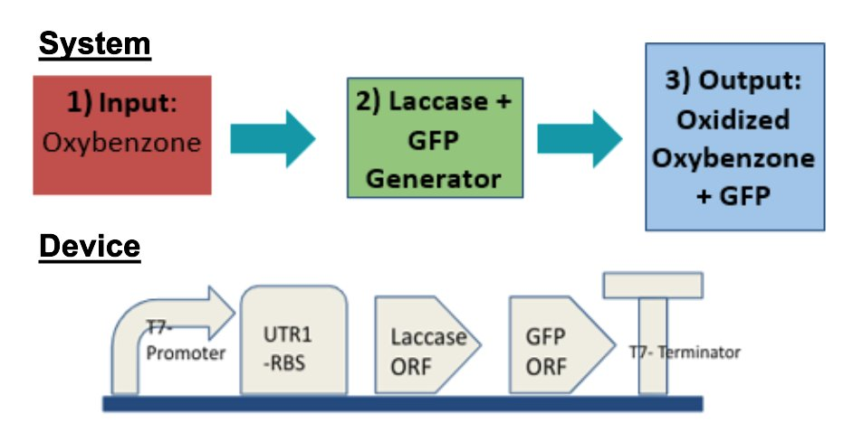
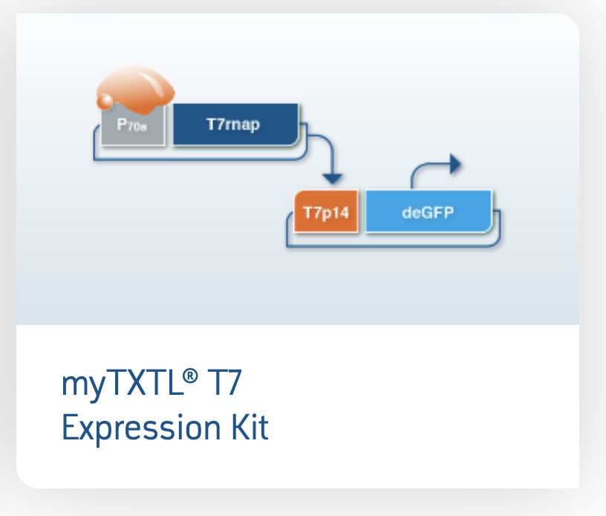
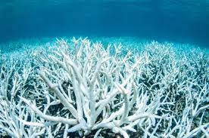
Combating Oxybenzone with Laccase Enzyme
Sadie Parkinson, Ellie Smith, Marin Chalmers, Will Kaegi, Maggie Herman, Cael Walicki, Ally Sugita, Linnea Nam, Sarah Ephstein, Mr. Kirkpatrick, Alberto J. Donayre Torres (UTECH)
Oak Park & River Forest HS, Oak Park, IL, USA
The Problem | The Solution | Next Steps
Photo-toxicity of Oxybenzone from sunscreen leading to Coral Bleaching | Use Synthetic Biology to Manufacture the Laccase Enzyme that will Oxidize Oxybenzone Before It Becomes Photo-Toxic to Coral | Test The Plasmid We Designed In a Cell Free System And Develop A Cu Alginate Matrix To Deliver Laccase Safely to Marine Environments
3) Output: Oxidized Oxybenzone+ GFP
3) Output: Oxidized Oxybenzone+ GFP
3) Output: Oxidized Oxybenzone+ GFP
Input:
Oxybenzone
Input:
Oxybenzone
2) Laccase + GFP Generator
Input:
Oxybenzone
2) Laccase + GFP Generator
2) Laccase + GFP Generator
Notes:
Objective: Use Laccase Enzyme to combat negative effects of Oxybenzone on Coral Reefs
Techniques: Produce Trametes Versicolor strain of Laccase Enzyme in cell free system using SnapGene software to insert enzyme sequence into Arbor Scientific T7 Plasmid Vector
Limitations: Not yet tested cell free system- mechanism of release into marine environments/ethics
Tentative Lightning Talk Script Script:
Person one: Our group sought after a way to combat the negative effects of common sunscreen ingredient Oxybenzone on coral and coral reefs. We propose the use of Trametes Versicolor fungal strain of the enzyme Laccase to oxidize the Oxybenzone substrate before it can experience the metabolic glycosylation reaction which makes it photo toxic and harmful towards coral.
Person Two: We brought the DNA sequence for the Laccase protein into SnapGene where we fused it with a Green Fluorescent Protein, before inserting the super-protein into an Arbor Scientific T-7 Plasmid Vector. Once receiving our [kit] from Twist, which contains our engineered Plasmid DNA, we plan to test for the presence of Laccase [GFP?].
Person Three: A future mechanism for delivery of the Laccase enzyme into marine environments might involve immobilizing it in an Alginate matrix. Alginate being a biocompatible substance, this would allow for the enzyme to do its job without interfering with marine ecosystems.
Person Four: Current limitations to our project include the need for a mediator to the enzyme, and expenses associated with production of Laccase, cell free or through E. Coli.

