Slide 1
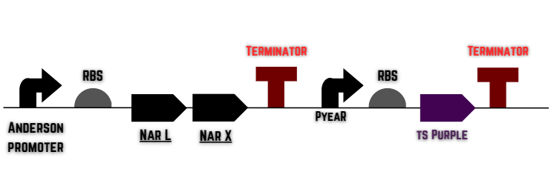
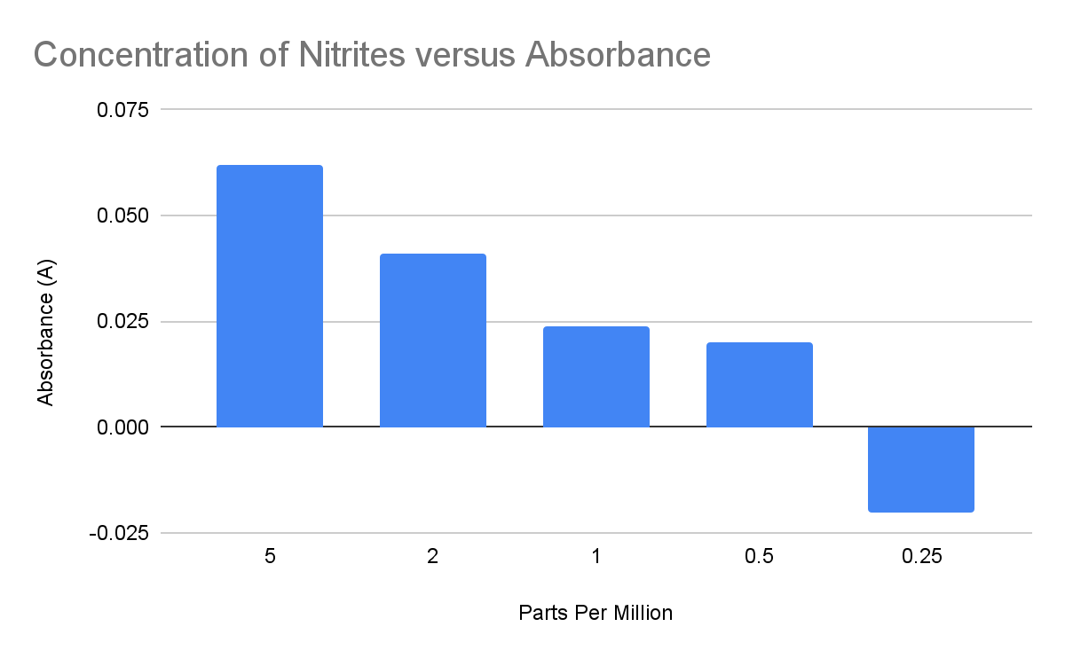
NitriAlert
Chase Howard, Tomidylan Klepper, Eric Thomas, Natalie Baker, Brylee Jones, and Tucker McLain, Amanda Dunham, Hia Ming (Boston University)
DB EXCEL, Kingsport, TN, Sullivan County
Old Sequence
E.Coli nitrate and nitrite detector
Plasmid that utilizes PyeaR and Chromoproteins
Testing and our results
Our new parts and modifications.
Future ideas and plans
New Sequence

