Slide 1
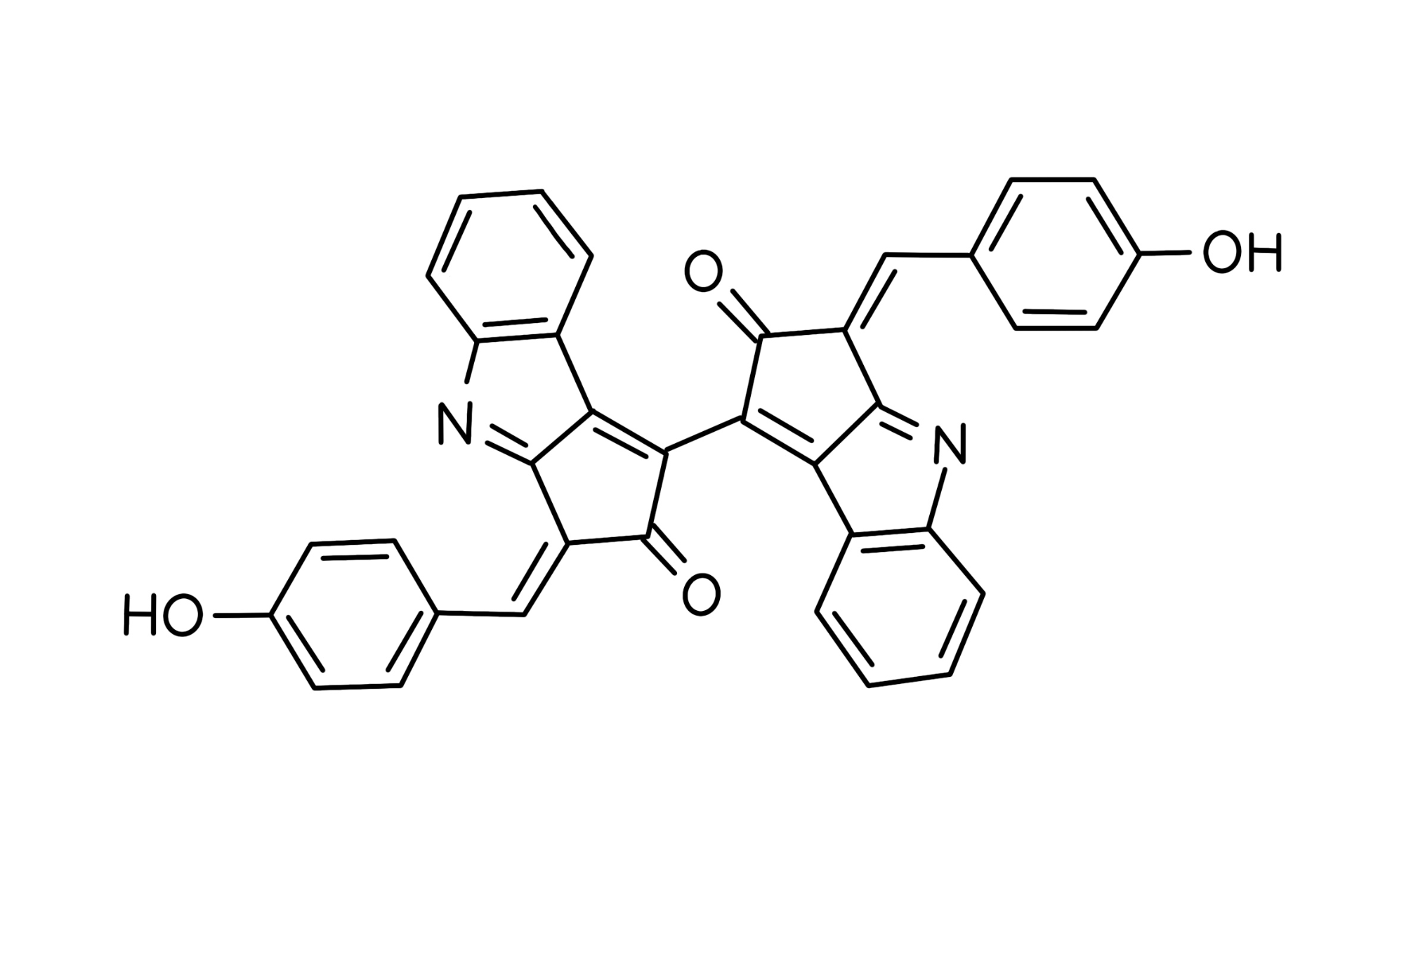
The Application of Cyanobacterial Pigments to Construct Environmentally Friendly Sunscreen
Yihan Ma, Dr. Beth Pethel, Ms. Jackie Thompson (Asimov)
Western Reserve Academy, Hudson, Ohio
Most sunscreen products currently on the market can cause coral bleaching
They disrupt ecological balance
Replace the harmful ingredients with environmentally friendly pigments (MAAs and scytonemin) from Cyanobacteria
Engineer Escherichia coli to overexpress the gene required for biosynthesis of MAAs, mycosporine-glycine (MysC).
Figure 3: Flowchart

