Slide 1
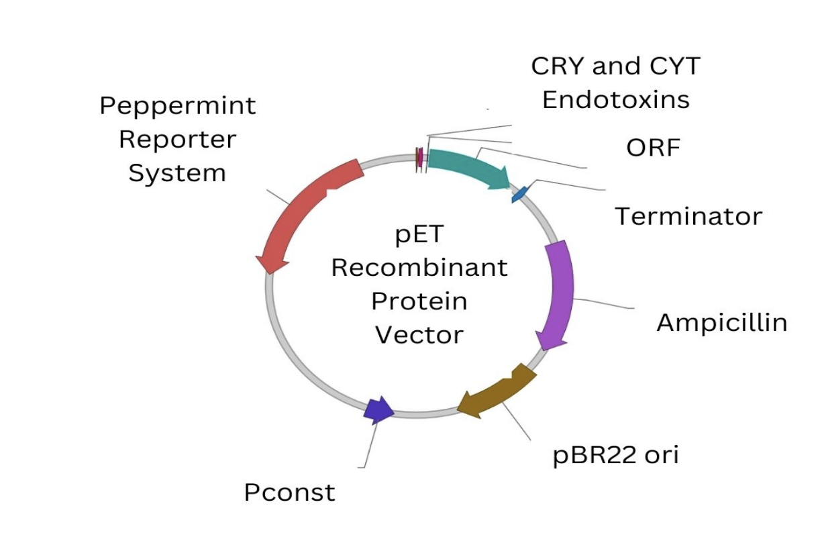
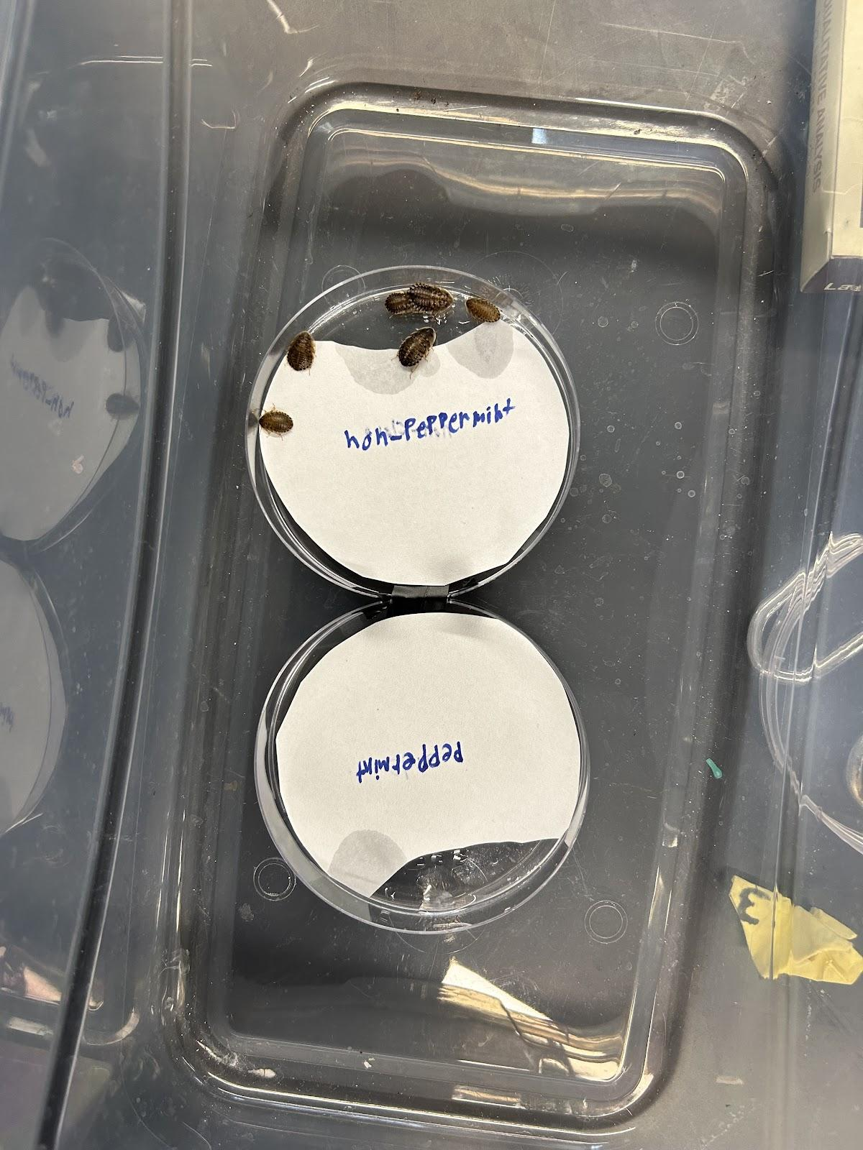
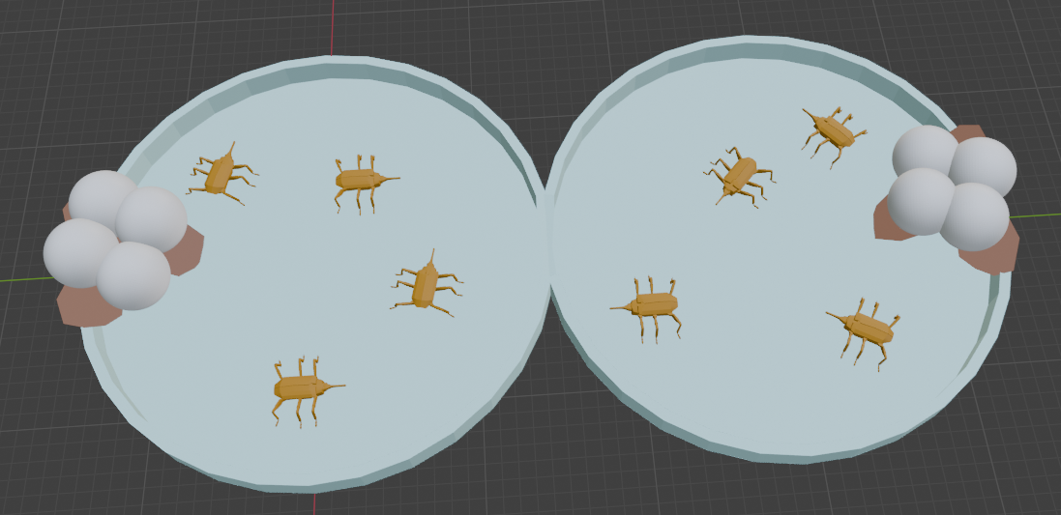
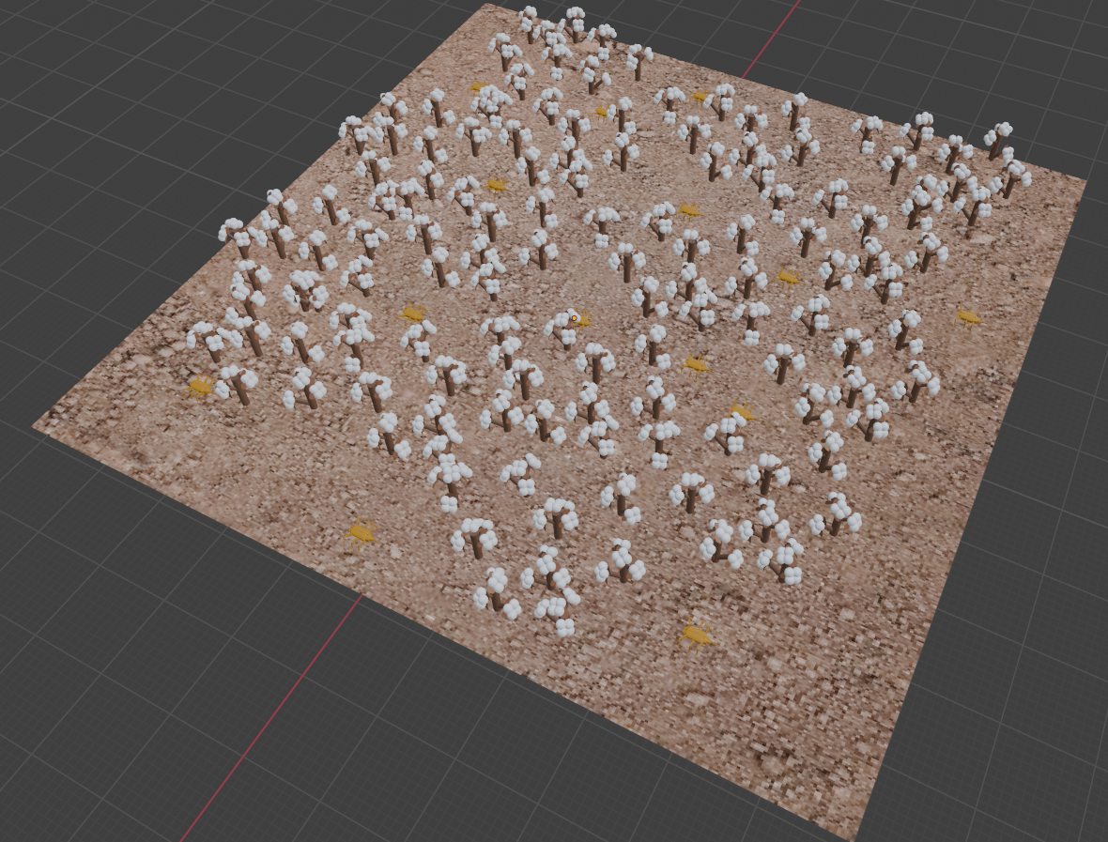
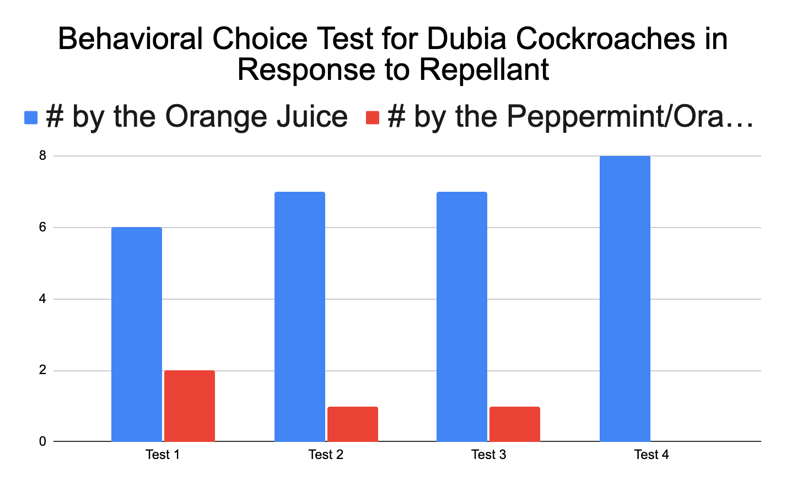
Protecting Protecting a Midsouth Staple: Using Genetically Modified Bacteria as a Pesticide to Protect Cotton
S. Arbelaez, F. Donati, A. Gray, R. Heeter, Z. Ingram, L. Little, M. Owens, M Pfeiffer, S. Sailors, J.Treadwell, T. Vego, Mentors: N. Wallace, J. Weaver
Crosstown High, Memphis, Tennessee, USA
Our project aims to develop a genetically modified bacteria-based pesticide that is safe for cotton crops. By utilizing peppermint, known to deter boll weevils, we plan to engineer E. coli to produce menthyl acetate. This approach hopes to provide an environmentally friendly solution to repel pests.
The molecular science techniques we plan to use are genetic engineering for the manipulation of bacterial DNA, transformation to introduce the modified DNA into E. Coli with a restriction digestion to cut and ligate the new protein that will result in the menthyl acetate.
Images: Plasmid Vector for Pesticide and Behavior Tests to Methyl Acetate

