Slide 1
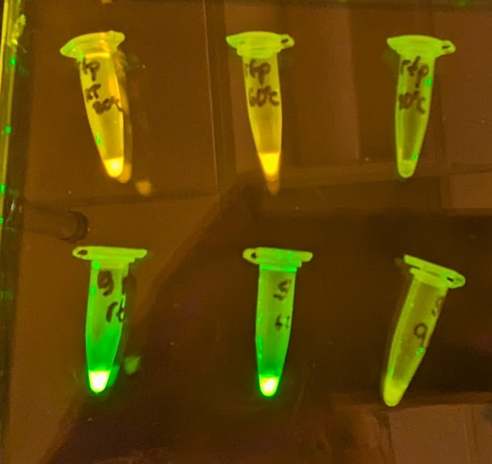
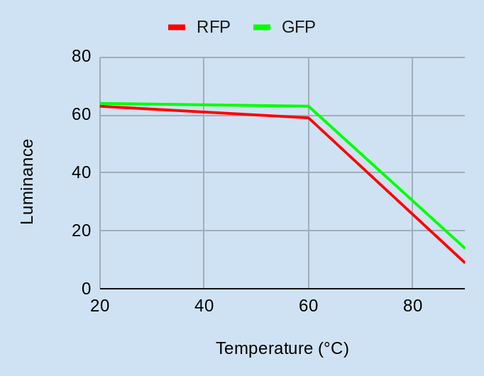
“Let it Glow:” The Heat Never Bothered Me Anyway
Heat-Stable Fluorescent Proteins
Ariadna Estebanez, Samantha O’Brien, Lillian Sequeira, Jishnu Sanyal, Jad Yehia, Tomi Chen, Terry Deng, Luchezar Pirogov, Teacher Leader: Laura O’Brien, Mentor: Mary Lerner (UCB)
Castro Valley High School, Castro Valley, California
Lightning Talk Audio linked here
Background: Fluorescent proteins (FP’s) are widely used in biotechnology, but FP’s denature at higher temperatures
Goal: genetically engineer heat stable FP’s.
Experimental Results: Both RFP and GFP show greatly diminished fluorescence at higher temperatures.
Above: RFP (top row) and GFP (bottom row) after incubation at 20ºC, 60ºC and 90ºC
Design
Heat-stable fluorescent protein!
mRNA
Right: Graphical representation of experimental results using luminance values from color picker website
promoter
ribosome binding site
gene
terminator

