Slide 1
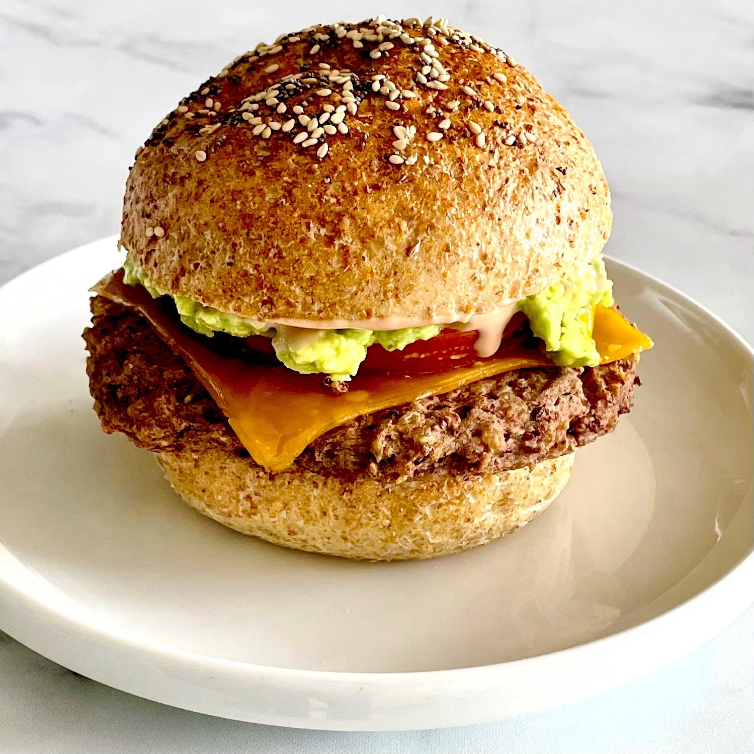
Producing a Meat-like Aroma Protein Using Genetically Engineered Escherichia coli
Team Captain: Katherine Duanmu
Members: Jomana Elghamrawy, Abi Nunes, Ian Walters, Alvin Dzoung
Advisor Dr. Enhua Wang
Academy of Notre Dame, Tyngsboro, MA, USA
The objective of the project is to create a burger that tastes just like meat, but is made out of totally plant based materials.
The technique that was used for the project is genetic engineering, specifically extracting DNA from soybeans to E. Coli.
The bacteria E. Coli will express the gene aminolevulinic acid. This gene expression product-protein heme would be used as a key ingredient to make plant based burger that smells and taste like meat.
Steps for the production of BurgerRoot:
Isolate the aminolevulinic acid DNA from soybean.
Using the specific primer to get the specific aminolevulinic acid gene sequence.
Transform the aminolevulinic acid gene into E. Coli to express the protein
Isolate the heme protein from E.Coli.

