Slide 1
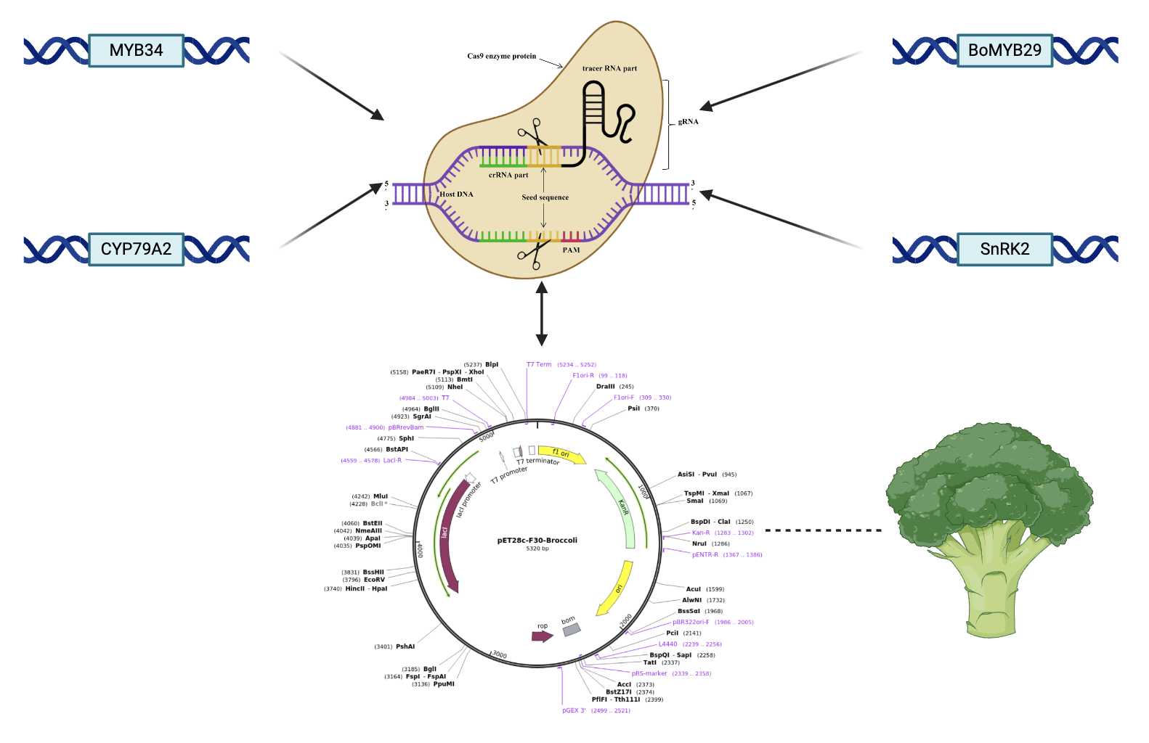
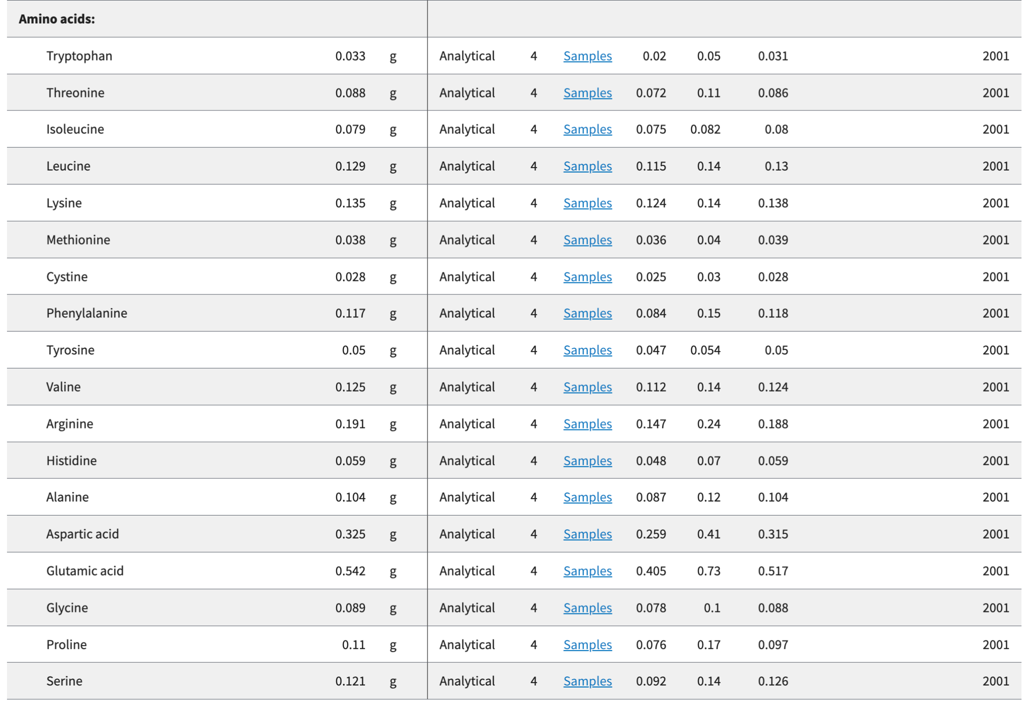
Maximizing protein content in Brassica oleracea: the Ultimate Broccoli
Jaeyi Kim, Chelsea Djajaria, Jing Xiong, Yu Ju Chao, Andrew Tan, Avni Tyagi,
Haoken Huoermaiti, Michelle Cheah, Gitanshu Bhatia(LanzaTech, Senior Research Associate)
Sinarmas World Academy, Tangerang, Banten, Indonesia
Rationale: Broccoli is rich in anti-inflammatory, anti-carcinogenic nutrients. However, despite having relatively significant protein content at 2.6g per 100g, the nutritional effects of protein in broccoli are not as evident. → aim to maximize nutrient output of protein in broccoli
Techniques:
Maximising gene expression:
MYB34(controls the production of aliphatic glucosinolates)
CYP79A2(crucial in the transformation of amino acids into aldoximes, which are nitrogen-rich compounds)
Cross-plant genetic engineering with Chinese kale:
BoMYB29 gene(key regulator of the biosynthesis of methylsulphinyl glucosinolate, rich in amino acids)
Serine/threonine protein kinase SRK2n (SnRK2) genes(necessary enzyme to regulate cholesterol levels in the human body, preventing cardiovascular diseases)
Engineering genes individually into broccoli stem cells: CRISPR-Cas9 technology for precise gene editing.
Improving Protein Storage:
Modifying the genes responsible for protein storage structures, like vacuoles, to increase their capacity for holding proteins.
Checking methods:
Sequencing analysis in DNA: Check whether gene is being expressed or not
Colorimetry: analyse protein content
Gel electrophoresis: determining nutritional content and location
Biomass quantification:
Acid/base pre-treatment, enzyme reaction to break down sugars, centrifugation to separate sugars from rest of the material(filter), protein quantification
Off-target analysis: Evaluating potential unintended edits at sites similar to the target sequence. This is crucial for assessing the specificity of the CRISPR system. If necessary, expand the population of successfully edited cells for further experimentation or downstream applications.
The USDA FoodData Central calculates the nutritional data for broccoli through laboratory analysis of representative samples using standardized reference methods. These results are compiled into a comprehensive database, ensuring accurate and reliable information on the nutritional composition of broccoli.
Audio presentation

