Slide 1


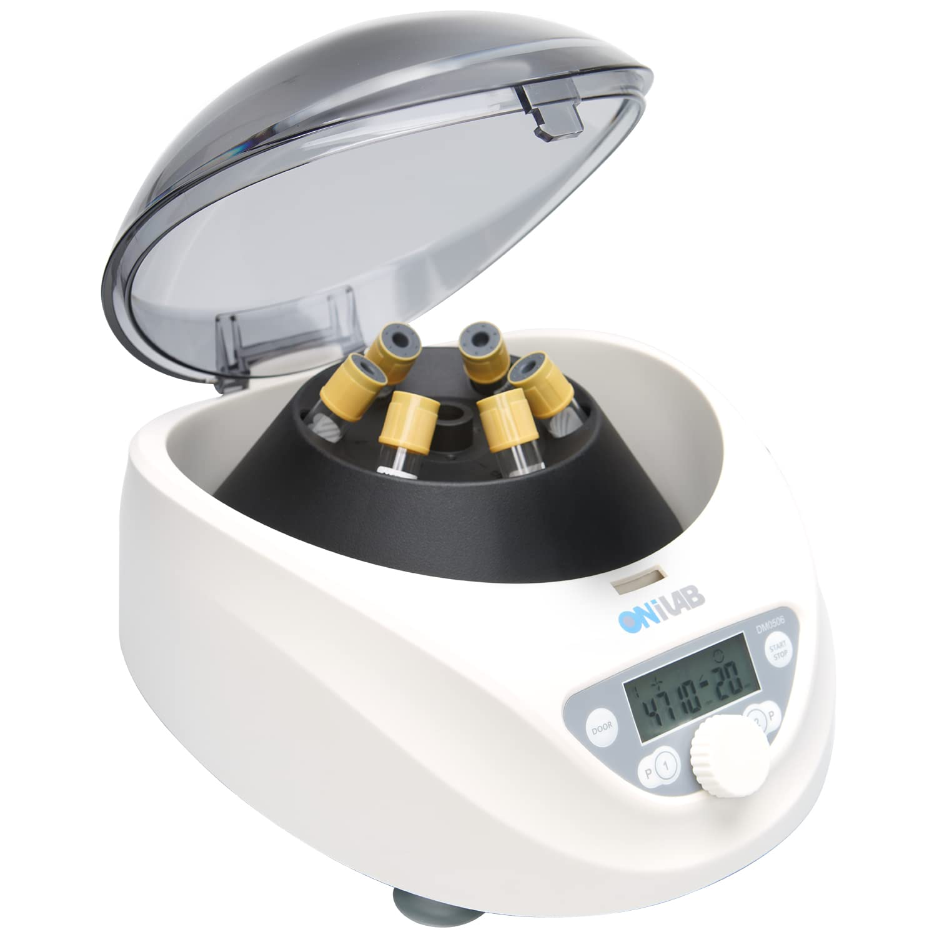
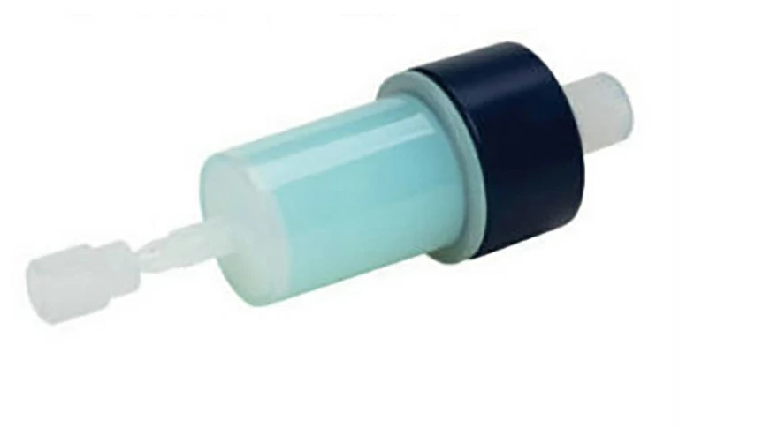
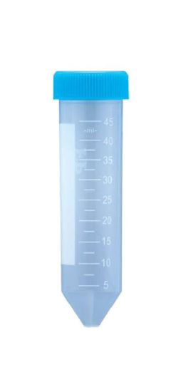
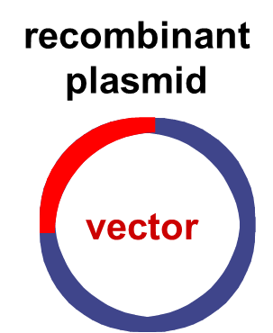
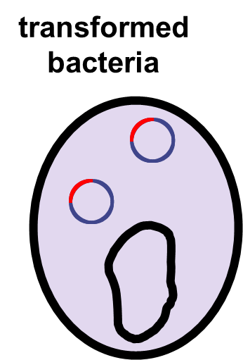
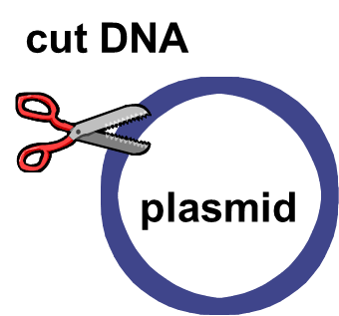




Using Genetic Engineered E. Coli in Small Portable Stations
Katherine Duanmu, Maya Bergeron, Jomana Elghamrawy, Abigail Nunes, Sophia Velez, Dr. Enhua Wang
Academy of Notre Dame, Tyngsboro, Massachusetts, USA
Enzyme Extraction
Our objective is to create a bacteria that can produce an enzyme, FAST-PETase, to biodegrade plastic.
Our team plans to use genetic engineering to create E. Coli containing the FAST-PETase gene.
Specific laboratory techniques include DNA extraction, DNA digestion, DNA ligation, and bacteria transformation.
enzyme purification
Enzyme liquid form storage
Pour liquid on plastics
Transformed E. Coli
FAST-PETase from soil bacteria
Biodegradation

