Slide 1


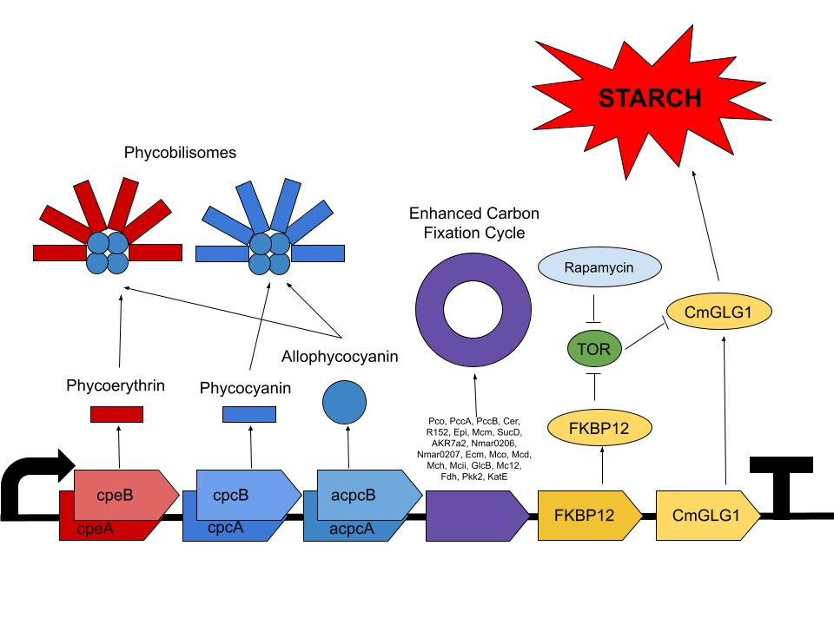

USING ALGAE TO INCREASE FOOD PRODUCTION
Sam Dillon, Adonai Haile, Anya Mittal, Sid Nirgudkar, Sophia Tang, Henry Tshabalala, Aaron Mathieu (Teacher), Chris Kuffner (Boston University)
Acton Boxborough Regional High School, Acton, MA, US
Goal: engineer algae that produce more starch to address lack of access to food
Would use electroporation to transform an algae with our plasmid, but since we don’t have access to that, we will use a DIY technique instead

