Slide 1
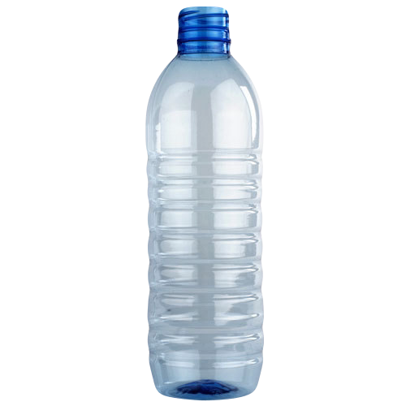
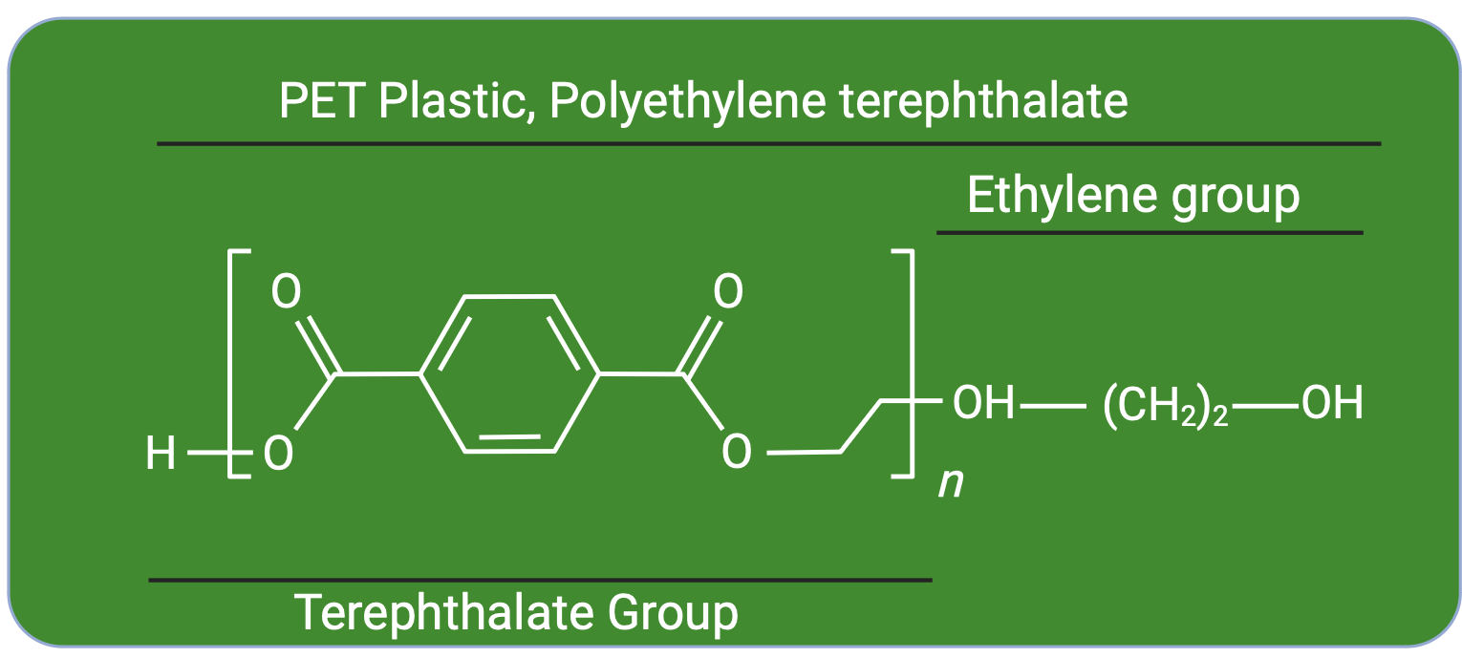
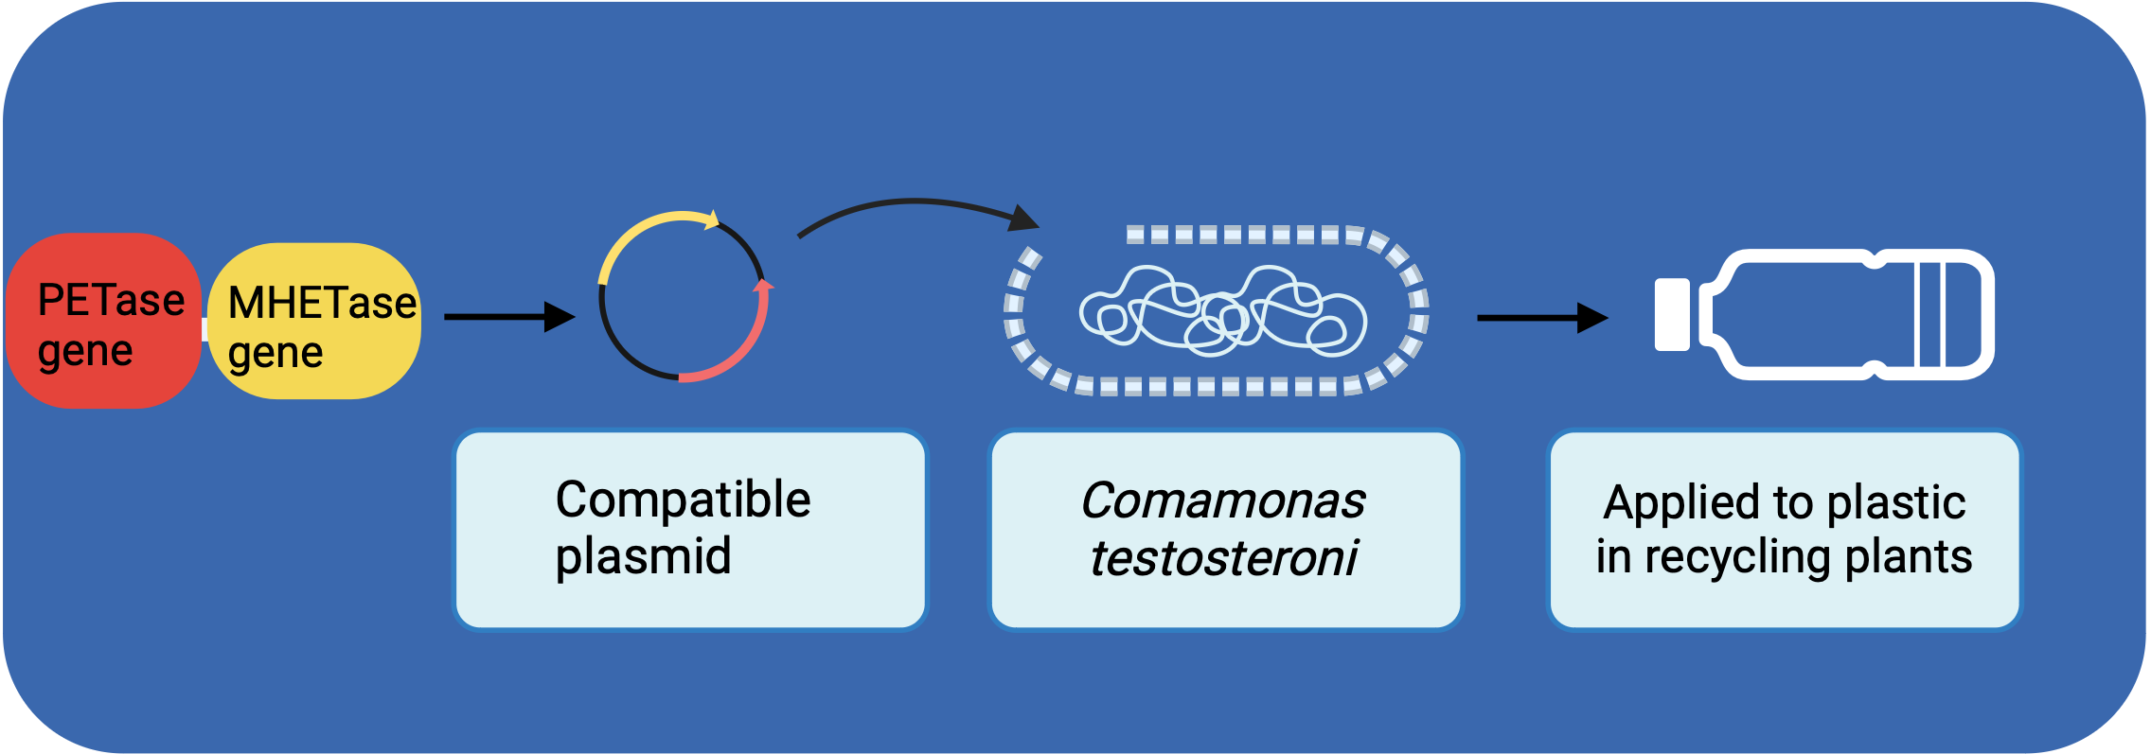
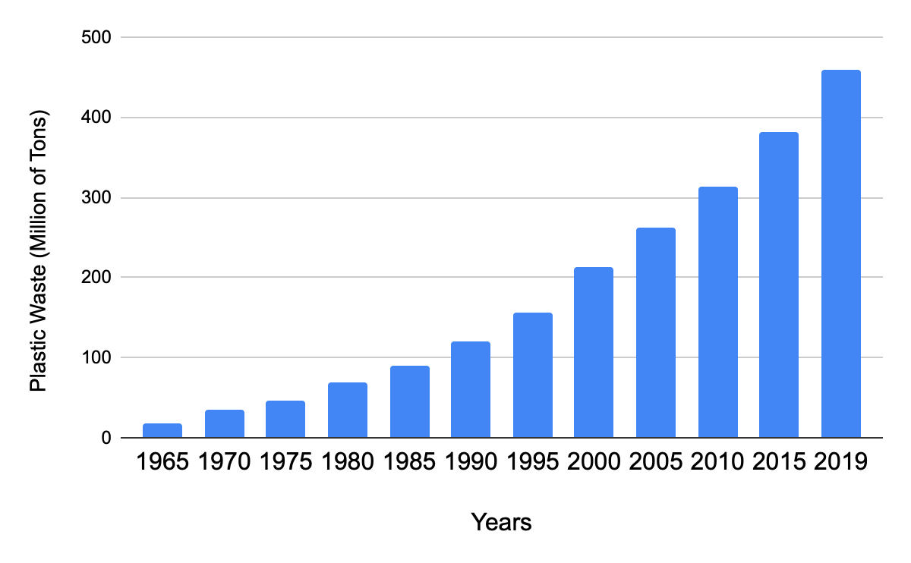
PolyWreck: Degrading Plastic by Inserting Enzymes
Amanda Blasberg, Jacob Wells, James Vacca, Brennan Christian, Arsh Goyal, Dr. Beth Pethel, Maegan Plank (UCB)
Western Reserve Academy, Hudson, OH, USA
Click Image for Audio!
The pervading global threat of plastic pollution is one that still lacks a clear and sustainable remedy. In response, our project aims to address this issue by engineering bacteria endowed with the ability to enzymatically degrade plastics like polyethylene terephthalate (PET) (Figure 1). Our primary objective in doing this is to help minimize the harmful impact that plastic has on the environment that has increased dramatically in recent years (Figure 2). By targeting a common single use plastic like PET, we are confident we can reduce the amount of plastic that plagues the world.
Figure 1: Polyethylene terephthalate, or PET plastic.
Figure 3: The cloning of I. sakaiensis genes into C. testosteroni for degradation of plastic.
The bacteria, Comamonas testosterone, which can break down benzene rings that hold PET together and use it for energy, then enhanced with the genetic material from Ideonella sakaiensis has the possibility of degrading plastics faster. Our project aims to use the two enzymes, PETase and MHETase alongside C. testosteroni with the objective of creating a hyper-efficient degrader.
Figure 2: Drastic increase of the tons of plastic waste in the US throughout recent decades.

