Slide 1
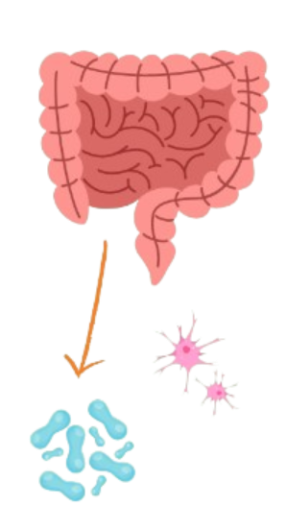
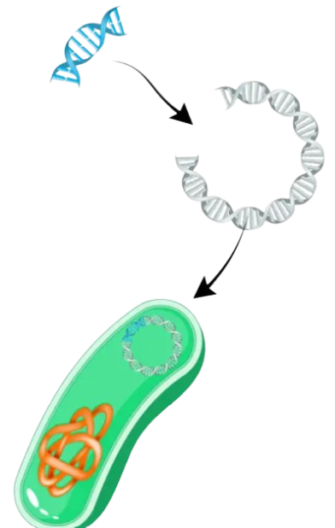
SynthMind Meals
Creating Meals Plans with Engineered Gut Microbes for Neurotransmitter Production to Improve Mental Health
Shashank Ramireddy, Yun Xin Lin, Eshawnive Kallu, Veda Vudithyala, Kanishq Palla, Harrison Turner, Vedant Kalipatnapu, Amey Saokar, Korah Kenyatta-Simmons, Sarah Verma, Mrs. Catherine Sharer, Mrs. Pam Seeley, Mr. Hunter Brown (BioMADE)
Lambert High School, Suwanee, Georgia, US
1. Identify neurotransmitter-producing microbes
2. Extract plasmid DNA of a lactobacillus bacteria and insert neurotransmitter-producing gene.
Our Project
GOAL:
manipulate and regulate the biosynthesis, release, and reuptake of neurotransmitters by using naturally occurring microbes in the gut
implement these microbes into meal plans that consumers can purchase from the grocery store, increasing accessibility of treatment
Neurotransmitter producing bacteria: Streptococcus spp., Lactobacillus plantarum, Enterococcus spp., Escherichia spp., Klebsiella pneumonia, and Morganella morganii
1. Identify neurotransmitter-producing microbes
1. Identify neurotransmitter-producing microbes
Gut microbiota
*Use feedback control mechanisms that enable microbes to sense and respond to neurotransmitter levels
4. Work with nutritionists/dietitians to integrate the engineered microbes into meal plans/food packages in a safe and effective way, introduce to retail stores
TECHNIQUES:
Using PCR and recombination with the modified plasmid and the Lactobacillus cells. Our first step is to learn to extract this bacteria’s genes.
LIMITATIONS:
It’s hard to acquire and sustain gut microbes and simulate how our experiment would work inside of a real human gut.
We also can’t guarantee if the organism will survive when it’s secreting so many compounds (don’t want to cause other GI problems)
3. Introduce the modified plasmid back into Lactobacillus cells through transformation. Then use an e. Coli culture to replicate probiotics

