Slide 1


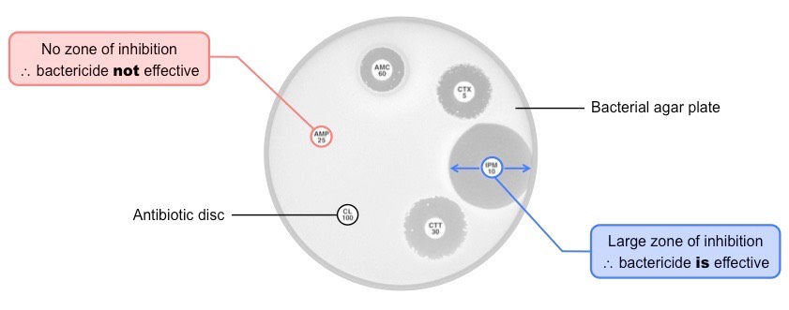
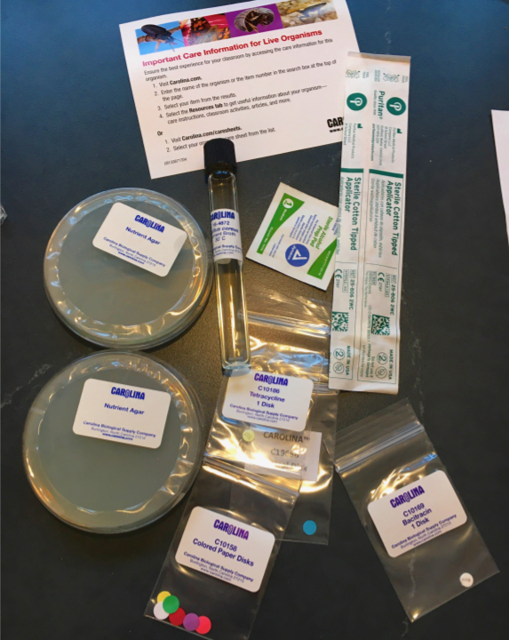
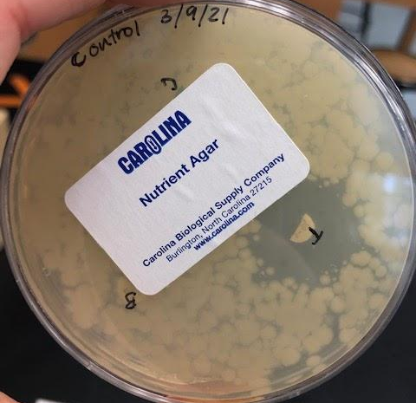
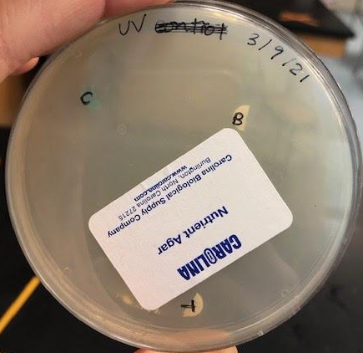
Effect of UV Light on Antibiotic Sensitivity
Baishali Chaudhuri and Eunchai Kang
Mentors: Alberto Donayre & Lindsey L’Ecuyer
Andover High School, Andover, MA
Experiment
Label control and petri dish with plate type and date
Wipe tube opening
Use the cotton swap to dip in the tube and swab both petri dishes back and forth in two perpendicular directions (clamshell method). Use a different swab for each plate.
Place the test plate on top of the UV light upside down with the lid off and the light wrapped in tin foil for 15 minutes
Using 91% isopropyl alcohol to sterilize a scalpel, pliers, and a cutting surface, cut the white bacitracin disk in half
Using the sterile pliers, place one half of the white bacitracin disk into the control plate and the other half into the test disk
Repeat steps 5 and 6 with the yellow tetracycline and colored paper disks
Incubate the plates at body temperature for over 24 hours but no more than 48 hours
Results: We ended up irradiating the cells with UV light for too long, which ended up killing the bacteria and therefore, we couldn’t move forward with the experiment.
Introduction
Antibiotic Sensitivity: Antibiotics kill bacteria. However, different kinds of bacteria are killed by different kinds of antibiotics. If someone has an infection, a doctor could choose to grow the bacteria in the presence of different antibiotics, and they would see that the bacteria are more sensitive to some antibiotics, and less sensitive to others.
Objective: How does UV light affect the antibiotic sensitivity of Bacillus cereus?
Materials:
Not pictured: UV light, incubator, scalpel, pliers, 91% isopropyl alcohol
alcohol wipes
cotton swabs
control
UV
2 petri dishes (nutrient agar)
bacteria tube
(bacillus cereus)
tetracycline
No zone of inhibition = no bacterial growth; UV radiation killed all bacteria
bacitracin
tetracycline was much more effective than bacitracin
colored paper (control)
bacitracin was not as effective

Slide 2
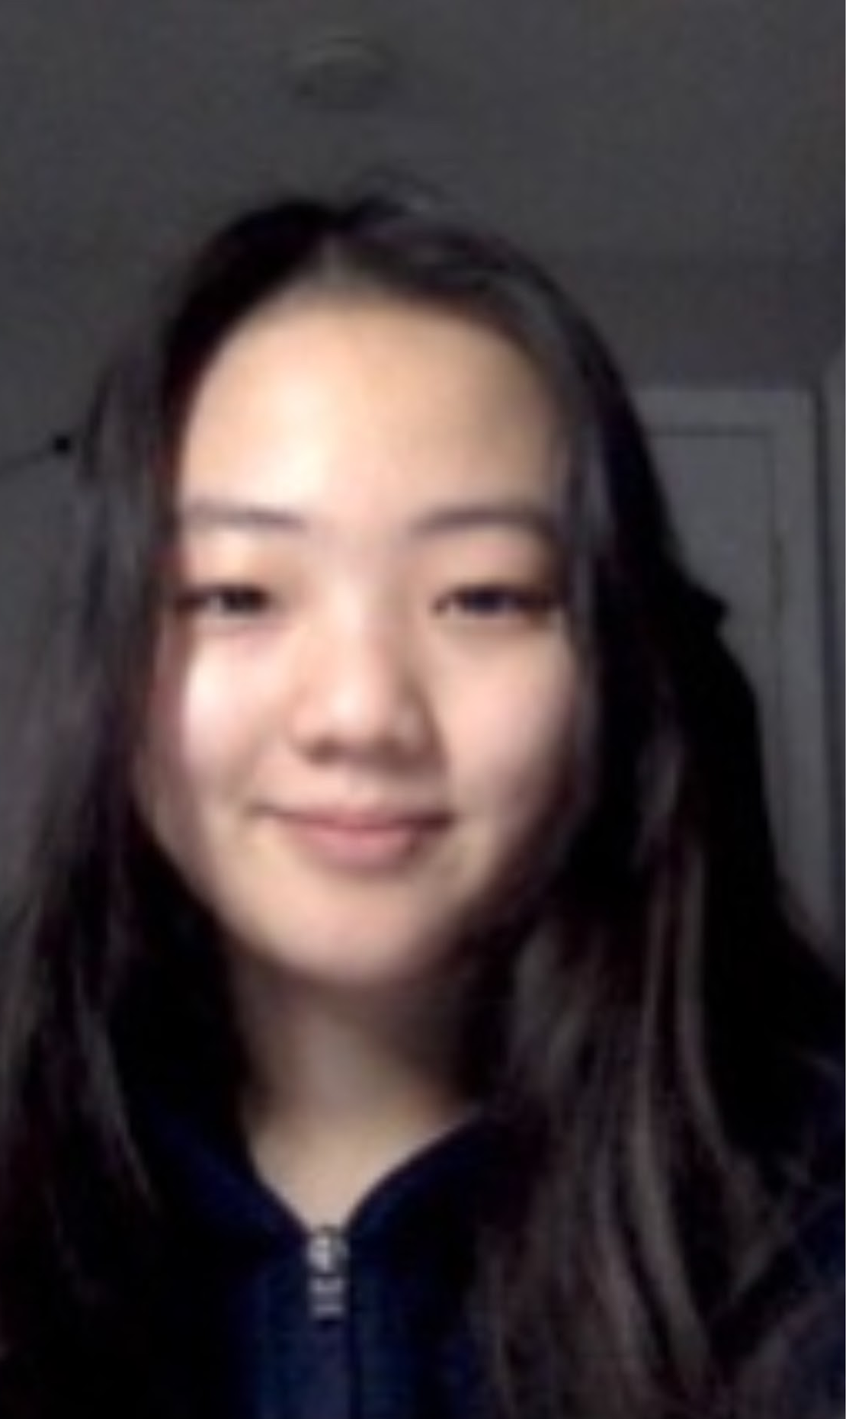
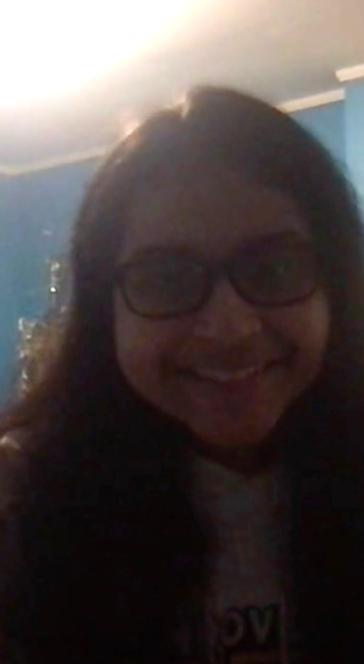
Effect of UV Light on Antibiotic Sensitivity
Baishali Chaudhuri and Eunchai Kang
Mentors: Alberto Donayre & Lindsey L’Ecuyer
Andover High School, Andover, MA
About Us:
Team of 2
  About 3 years of experience with BioBuilders
Published in Biotreks 2020
Challenge for Next Time
Redo the experiment, but irradiate the sample for less than 15 minutes so bacteria has the chance to grow (try 5 minutes and 10 minutes)
Future Tests
  Explore the effect of sunscreen on the bacteria and compare/contrast with the effects of UV light
  Explore UV effects on Gram-negative bacteria vs. Gram-positive bacteria
Thank you to our mentors!
Alberto Donayre
Lindsey L’Ecuyer

